Slide 1
Protecting the Unbound Mind
IRB Oversite of Research on Consciousness Altering Interventions
Lou Lukas, MD

Slide 2
I work for VA, I do NOT speak for VA
Disclaimer 1:
All opinions and information are mine and are not endorsed or supported by VA
No COI

Slide 3
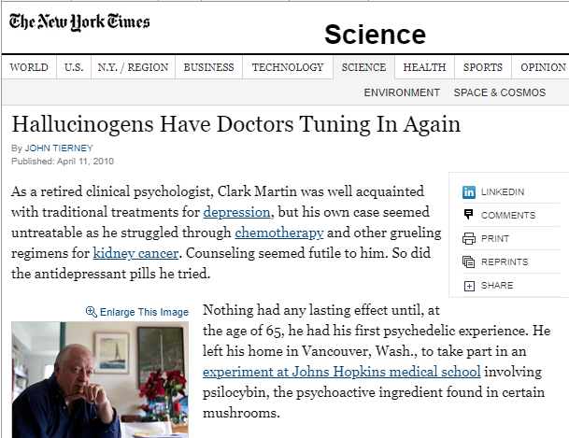
I’m here because of my study on Psilocybin For Cancer Distress
https://archive.nytimes.com/www.nytimes.com/2010/04/12/science/12psychedelics.html

Slide 4
How the Mind Binds Us to Reality

Slide 5
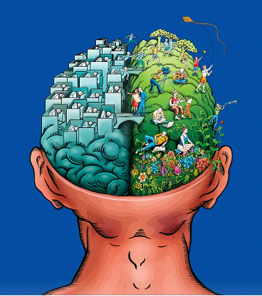
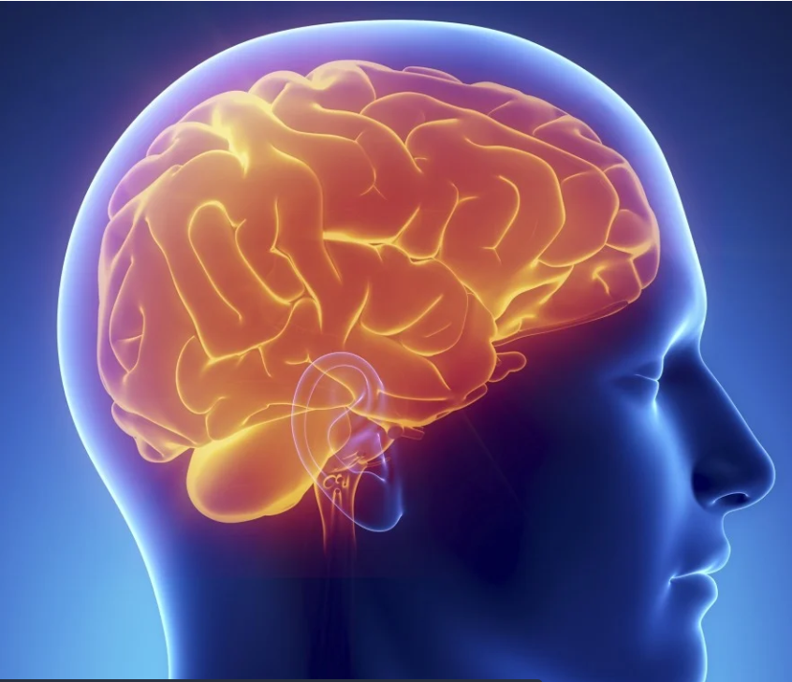
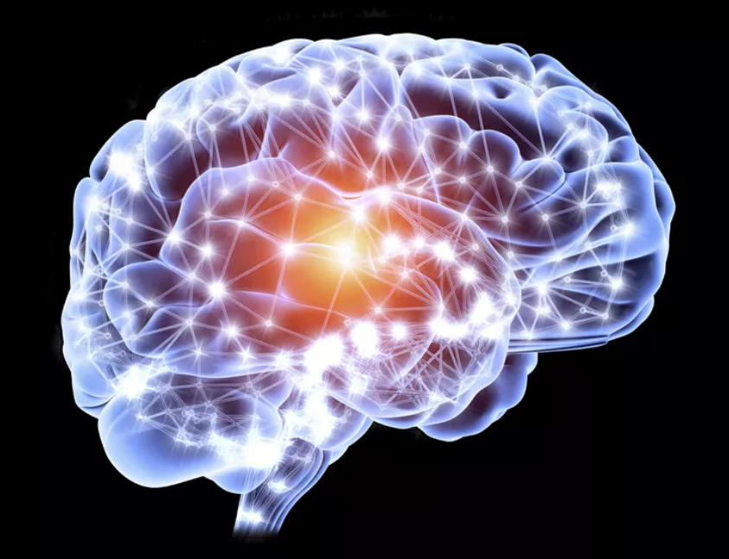
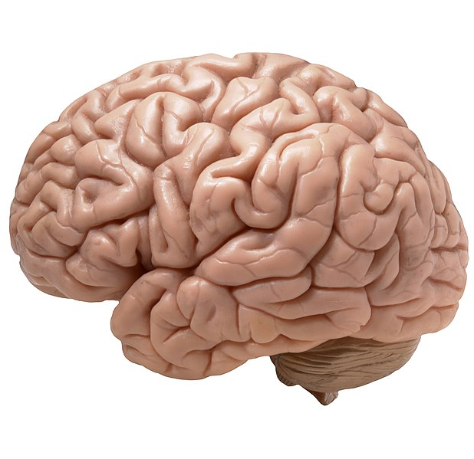
What’s the Mind Doing?
Our knowledge of reality is comprised of perceptions produced by the brain’s cortex.
The brain is the most complex network in the universe, but it is locked inside the vault of your skull.
All it has are millions of electro-chemical impulses carried through nerves to let it know what is going on inside your body and in the world at large.
All of reality is too much information to process, so most of our brain’s function is filtering out excess stimulus.
It builds a simplified, good-enough version of reality- all maintained by a delicate web of nerves- that you can use to navigate through the crazy world around you.
It’s almost like your brain is staging the Lego-movie version of a real-life event, and you’re the star of the movie!

Slide 6
How Psychedelics Unbind the Mind

Slide 7
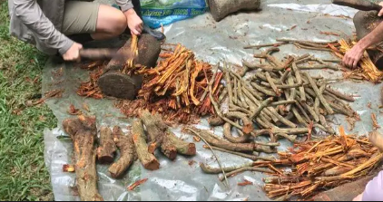
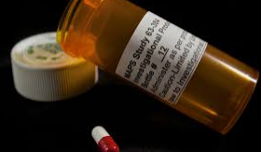
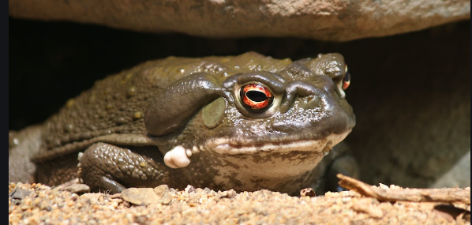
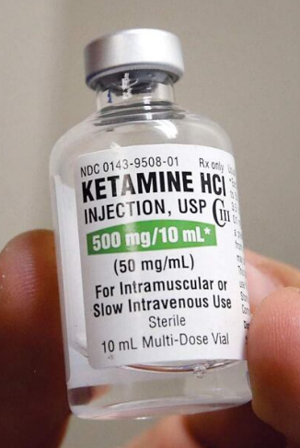
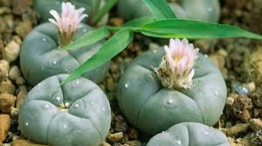
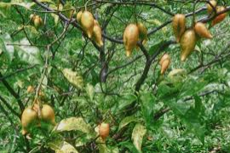
Psychedelic agents are ubiquitous in nature and synthesized in labs

Slide 8
“Psychedelic Trip”
Perceived Phenomena
(new stories, meaning making)
Psilocyn
Serotonin 2A receptor
Neural network activation -->
Neuroplasticity
& Long-term changes)

Slide 9
Common Psychedelic Experiences and Outcomes
Mystical Experiences (experiential spirituality)
Sacred, positive mood, outside time and space, noetic
Awe
Grandness of the world
Promotion of the “the small self”
Emotional Breakthroughs
Cathartic resolution of internal conflict
Connectedness
Self, others, nature
Cognitive Flexibility
Perspective taking
“Among the most personally meaningful or spiritually powerful experiences of my life”

Slide 10
Preparation
Screening
Assuring fit between person and protocol
Several hours of counseling about experience
Skills to navigate non-ordinary consciousness
Dosing
Comfortable living room like space
1-2 guides/facilitators
Single moderately-high dose (25mg oral capsule)
~6-hour session
Internally focused- head phones, eye shades
Integration
A few hours of debriefing, sensemaking, weaving the extraordinary into the ordinary

Slide 11
There are many ways to alter consciousness

Slide 12
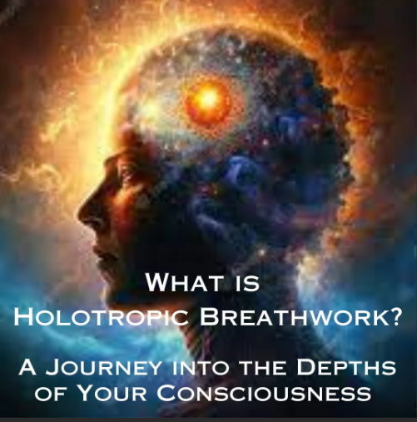

Slide 13
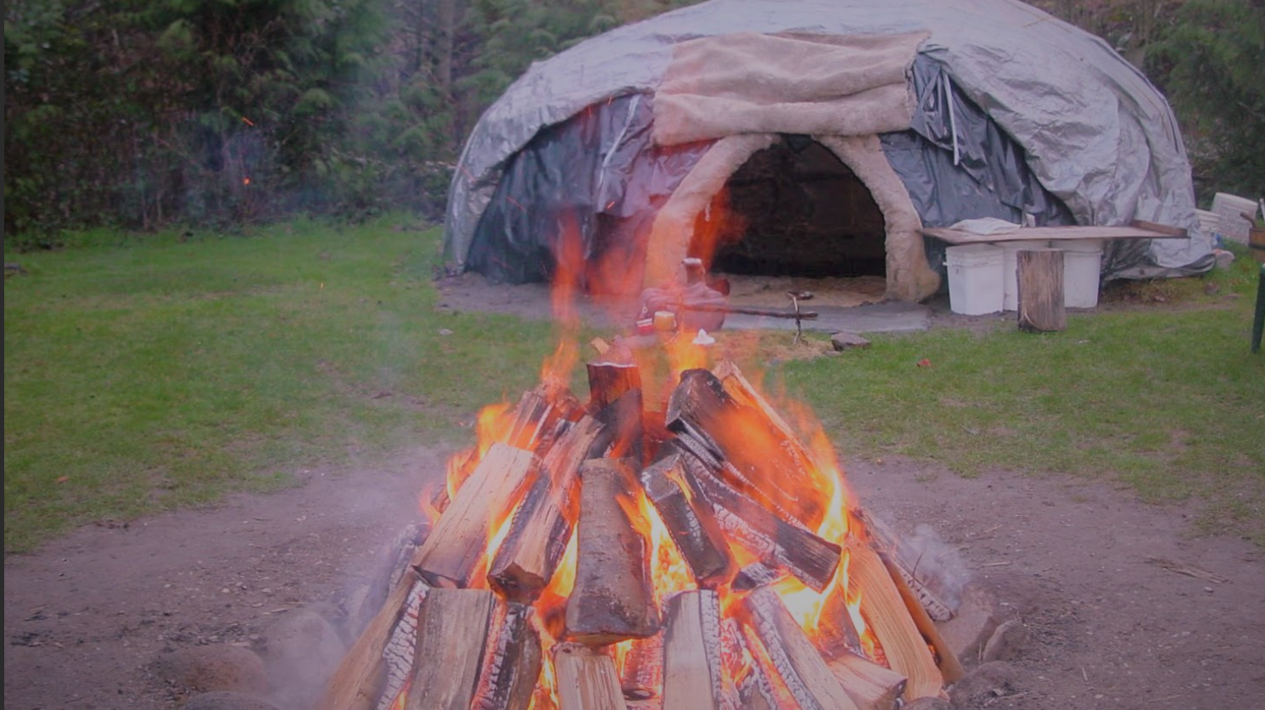

Slide 15
There are many ways to alter consciousness They all work to “unbind the mind”

Slide 16
What’s so bad about an unbound mind?
Vulnerability!

Slide 17
Vulnerability From Yourself “Be careful spending too much time in your head, it’s a bad neighborhood.”

Slide 18
Vulnerability to Others
Suggestibility
Coercion
Unwanted sexual romantic attention

Slide 19
Issues for Human Protection

Slide 20
Who is the PI?
Background and Training
Experiences with substance or method
Motivation
Mentors
Collaborators
Beware of Gurus and Messiahs

Slide 21
Consent
How can you provide consent for an experience you can’t imagine?
Layered/ Repeated Consent
Consent from different parts of the subject
What is the escape hatch?
How is Hype dealt with?
In-session Behavior

Slide 22
Screening
Is this subject right for this study?
Mental health history
Psychosis
Trauma (often unrecognized)
Substance Abuse
Previous introspection/therapy
Safety
Support
Is the Study right for the Population?
How long is preparation?
How long is integration?

Slide 23
Preparation
How will subject be prepared for the experience?
Proportional to experience?
Who is doing it?
How are they supervised?

Slide 24
Setting for “dosing”
Place?
Group or individual?
Appropriate for intervention?
Privacy
Bathrooms
Surveillance

Slide 25
Long Term Follow Up
How are you monitoring AE’s, the golden oldies aren’t enough.
Acute AEs
What is the emergency plan (rarely needed)?
Longer Term AE’s
Anxiety, Derealization
Existential or ontological shock
6-months minimum

Slide 26
Protecting the Unbound Mind
Questions?

