Slide 1
Research (or not research?) at the Edge: What is (or isn't) Human Subject Research
Bruce Gordon, MD, FAAP
Assistant Vice Chancellor for Regulatory Affairs
Professor, Pediatrics
University of Nebraska Medical Center
Children's Nebraska

Slide 2
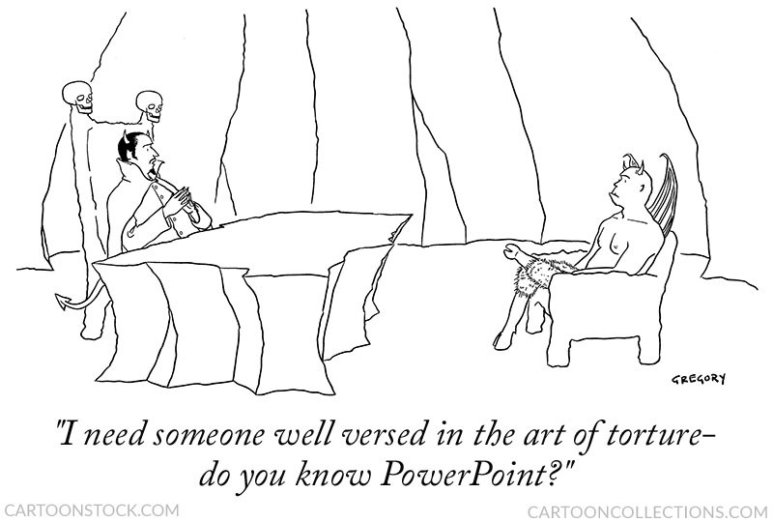

Slide 3
What is human subject research?
A human subject is a living individual about whom an investigator conducting research obtains (1) information or biospecimens through intervention or interaction with the individual, or (2) identifiable private information or identifiable biospecimens
Notes:
private information …
Information about that occurs in a context where individual can reasonably expect no observation or recording, or information provided for purposes that individual can reasonably expect will not be made public (eg, medical records)
identifiable …
the identity of the subject is or may readily be ascertained by the investigator or is associated with the information or biospecimen

Slide 4
What is human subject research?
A human subject is a living individual about whom an investigator conducting research obtains (1) information or biospecimens through intervention or interaction with the individual, or (2) identifiable private information or identifiable biospecimens
intervention includes both physical procedures by which information or samples are gathered, and manipulations of the subject or the subject’s environment
interaction includes communication or interpersonal contact between investigator and subject
Notes:
interaction – if I get information from you by talking or thru a survey … you are a human subject

Slide 5
What is human subject research?
A human subject is a living individual about whom an investigator conducting research obtains (1) information or biospecimens through intervention or interaction with the individual, or (2) identifiable private information or identifiable biospecimens
private refers to "information … that the individual can reasonably expect will not be made public"
identifiable refers to information "for which the identity of the subject is or may readily be ascertained by the investigator"
Notes:
we'll get back to the meaning and significance of "identifiability" later …

Slide 6
What is human subject research?
Research means a systematic investigation … designed to develop or contribute to generalizable knowledge

Slide 7
What is human subject research?
Research means a systematic investigation … designed to develop or contribute to generalizable knowledge
systematic investigation is a detailed, methodical activity, planned in advance, that involves data collection and analysis, in order to answer a scientific or scholarly question

Slide 8
What is human subject research?
Research means a systematic investigation … designed to develop or contribute to generalizable knowledge
systematic investigation is a detailed, methodical activity, planned in advance, that involves data collection and analysis, in order to answer a scientific or scholarly question
generalizable knowledge is information that is expected to expand the knowledge base of a scientific discipline or other scholarly field of study

Slide 9
What is human subject research?
Research means a systematic investigation … designed to develop or contribute to generalizable knowledge
systematic investigation is a detailed, methodical activity, planned in advance, that involves data collection and analysis, in order to answer a scientific or scholarly question
generalizable knowledge is information that is expected to expand the knowledge base of a scientific discipline or other scholarly field of study

Slide 10
What is human subject research?
Phase I PK/dose finding study of new drug ABC123
Phase III randomized trial comparing two standard surgical procedures
Testing of modified approved orthopedic device
Measurement of a gait parameters in stroke patients
Retrospective review of EHR to determine risk factors for T2DM
Prospective cohort study of heart disease among adult women
Focus group discussion about usability of educational website
Survey of immigrants re attitudes towards COVID vaccines
Analysis of identifiable pathology specimens for activity of specific biochemical pathway
…

Slide 11
What is NOT human subject research? 45 CFR 46.102(l)
Scholarly and journalistic activities
for example, oral history, journalism, biography, literary criticism, legal research, and historical scholarship
Public health surveillance
the difference between PH surveillance and research is that the purpose of the former is to inform the decisions or actions that must be made by a public health authority
Criminal justice or criminal investigation activities
Intelligence, homeland security, defense, or other national security missions
Notes:
2018 revision to the Common Rule (HHS regulations) presented 4 types of activities which were specifically designated as "not human subject research"
Public health surveillance - "… necessary to allow a public health authority to identify, monitor, assess, or investigate potential public health signals, onsets of disease outbreaks, or conditions of public health importance …"
In general, public health surveillance involves collecting, testing, analyzing, and using information or biospecimens to improve public health and prevent disease. It provides timely and useful evidence, and it enables public health authorities to be more effective in their efforts to protect and promote public health
Public health surveillance uses information and biospecimens from a variety of sources, and often uses the same analytical and laboratory techniques as epidemiological research. However, the difference between public health surveillance and research in this context is that the purpose of the surveillance is to inform the decisions or actions that must be made by a public health authority.
The direct link to decision making and action by a public health authority is a hallmark of public health surveillance.
https://www.hhs.gov/ohrp/regulations-and-policy/requests-for-comments/draft-guidance-activities-deemed-not-be-research-public-health-surveillance/index.html#_ftn2
Thacker SB, Qualters JR, Lee LM. Public Health Surveillance in the United States: Evolution and Challenges. MMWR Supp. 2012 Jul 27; 61(3):3-9.

Slide 12
What else is (or isn't) human subject research …?

Slide 13
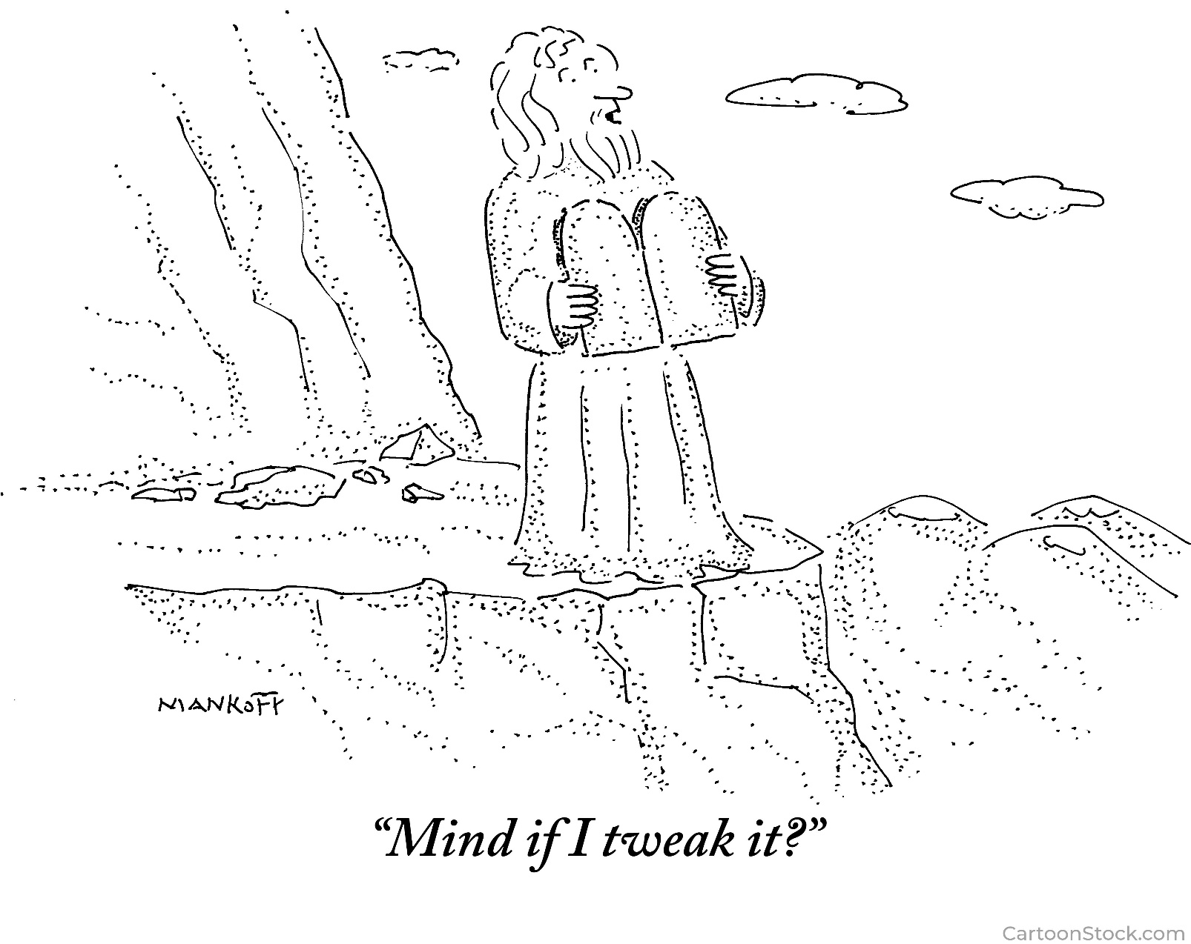

Slide 14
Quality Improvement
Quality Improvement activities are "systematic, data-guided activities designed to bring about immediate improvements in health care delivery in particular settings"
The Hastings Center (2007). Health Care Quality Improvement: Ethical and Regulatory Issues
Quality improvement (QI) in health care focuses on translating existing knowledge from research into clinical practice to improve the quality of health care for individuals and populations
Duke University Health System HRPP 2016

Slide 15
Quality Improvement
The key difference between research and QI is that research studies are intended to create new knowledge that can be generalized to other populations and settings, while QI in health care uses existing knowledge to improve outcomes within a local institution or setting
Duke University Health System HRPP 2016

Slide 16
Quality Improvement
Research means a "systematic investigation … designed to develop or contribute to generalizable knowledge."
QI does not (in general) create generalizable knowledge …
"activities conducted … whose purposes are limited to implementing a practice to improve quality of patient care, and collecting patient or provider data for clinical, practical or administrative purposes … do not satisfy the definition of 'research' under 45 CFR 46 …" (OHRP Guidance: Quality Improvement Activities FAQs)

Slide 17
Is it HSR or QI?

Slide 18
Characteristics of QI activities
 | Human Subjects Research | Quality Improvement
Purpose | Discover new knowledge; prove it | Bring (new) knowledge in daily practice, operationalize it
Starting point | Question or hypothesis | Existing knowledge
Design | Rigid protocol that remains unchanged throughout research | Adaptive, iterative design
Tests | One large "blind" test; minimize data peeking; control the environment and variables | Many sequential observable tests; continuous data stream; monitor how the system responds to interventions in realtime
Based on Hastings Center Report (2007)
Notes:
Based on the Hastings Center Report

Slide 19
Characteristics of QI activities
 | Human Subjects Research | Quality Improvement
Benefits | May or may not benefit subjects; intended to benefit future patients | Directly benefits process, system or program; may or may not benefit current patients
Risks | May put subjects at risk | No additional risk to patients OR risks are those ordinarily expected when practice changes are implemented within a health care environment
Participant obligation | No obligation | Responsibility to participate as component of care
Based on Hastings Center Report (2007)

Slide 20
Characteristics of QI activities
 | Human Subjects Research | Quality Improvement
Endpoint | Answer a research question | Improve a program, process or system
Analysis | Statistically prove or disprove a hypothesis | Compare program, process or system to established standards
Adoption of findings | Usually little urgency to disseminate results quickly | Results rapidly adopted into local care delivery
Publication | Investigator obligated to share results | QI practitioners encouraged to share systematic reporting of insights
Based on Hastings Center Report (2007)
Notes:
based on Hastings Center report 2006, modified by …

Slide 21
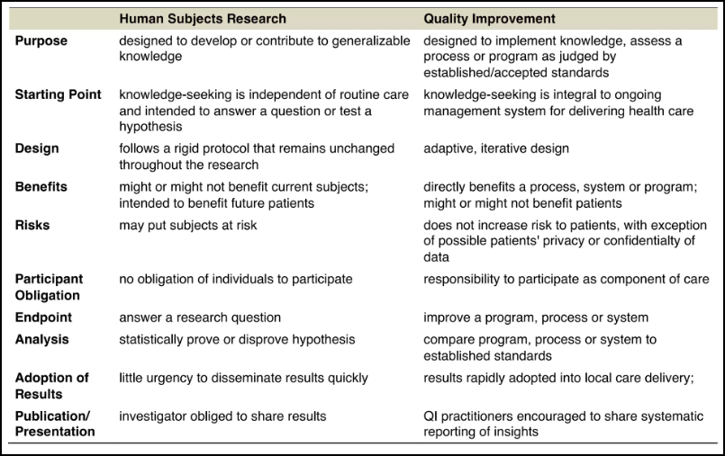

Slide 23
Characteristics of QI activities UNMC HRPP Policy 1.7
The activity is intended to improve the process/delivery of care within a specific health care setting
The activity is intended to evaluate current practice and/or attempt to improve it based upon existing knowledge
There is sufficient existing evidence to support implementing this activity to create practice change
The activity is conducted by clinicians and staff* who provide care or are responsible for the practice change in the institutions where the activity will take place
* including students
Notes:
isn't about "does this [intervention] work"; it is about "can we do it here …"

Slide 24
Characteristics of QI activities UNMC HRPP Policy 1.7
The methods for the activity are flexible and include approaches to evaluate rapid and incremental changes
The activity will involve a sample of the population (patients/participants) ordinarily seen in the institution where the activity will take place
The planned activity will only require consent that is already obtained in clinical practice, and could be considered part of the usual care

Slide 25
Characteristics of QI activities UNMC HRPP Policy 1.7
Future patients/participants at the institution where the planned activity will be implemented will potentially benefit from the project
The risk to patients/participants is no greater than what is involved in the care they are already receiving OR risks of participating in the activity can be considered acceptable or ordinarily expected when practice changes are implemented within a health care environment
UNMC HRPP Policy 1.7: Investigational Activities
(modeled after Oregon State University policy)

Slide 26
HSR vs QI
What about publication? Does that make the activity "generalizable"?
it depends …
publication of specific results of the QI project (how well it worked) probably does not constitute research
publication of methods utilized to achieve improvement in a process or program perhaps does …

Slide 27
HSR vs QI
What about publication? Does publication make the activity "research"?
"Even when a procedure applied in practice may benefit some other person, it remains an intervention designed to enhance the well-being of a particular individual or groups of individuals; thus, it is practice [and not] research …" (Belmont Report, 1979)
Since QI is fundamentally "a procedure applied in practice" to "enhance the well being of particular group of individuals", publication need not make it "research" unless it includes other elements of research
Notes:
F Davidoff, P Batalden: "Toward stronger evidence on quality improvement. Draft publication guidelines: the beginning of a consensus project"
Qual Saf Health Care 2005;14:319–325. doi: 10.1136/qshc.2005.014787

Slide 28
Quality improvement
Are there QI activities that are also research?
"if a project involves introducing an untested clinical intervention for purposes which include not only improving the quality of care but also collecting information about patient outcomes for the purpose of establishing scientific evidence to determine how well the intervention achieves its intended results, that quality improvement project may also constitute nonexempt human subjects research"
OHRP Guidance: Quality Improvement Activities FAQs

Slide 29
Characteristics of activities which are both QI and research
Testing of issues that go beyond current knowledge based on science and experience, such as new treatments
Random allocation into different intervention groups
Deliberately delayed feedback of data from monitoring the implementation of changes, especially if this is done to avoid biasing the interpretation of data
Involvement in key project roles of researchers who have no ongoing commitment to improvement in local care
Funding, sponsorship, or substantial participation by parties outside the clinical setting or organization
The Hastings Center (2007). Health Care Quality Improvement: Ethical and Regulatory Issues

Slide 30
Quality improvement
Characteristics of activities which are both QI and research
Testing of issues that go beyond current knowledge based on science and experience, such as new treatments
Random allocation into different intervention groups
Deliberately delayed feedback of data from monitoring the implementation of changes, especially if this is done to avoid biasing the interpretation of data
Involvement in key project roles of researchers who have no ongoing commitment to improvement in local care
Funding, sponsorship, or substantial participation by parties outside the clinical setting or organization
The Hastings Center (2007). Health Care Quality Improvement: Ethical and Regulatory Issues

Slide 31
QI or research?
A group of affiliated hospitals implements a procedure known to reduce pharmacy prescription error rates and collects prescription information from medical charts to assess adherence to the procedure and determine whether medication error rates have decreased as expected
QI (per OHRP)
https://www.hhs.gov/ohrp/regulations-and-policy/guidance/faq/quality-improvement-activities/index.html

Slide 32
QI or research?
Hospital is considering purchasing and using a gel pad (FDA approved for a different purpose) to reduce the occurrence of pressure sores in ICU patients. Project will assess both the acceptability (among nurses and patients) and the effectiveness of the device.
both QI and research
"if a project involves introducing an untested clinical intervention … for the purpose of … [determining] how well the intervention achieves its intended results, that quality improvement project may also constitute nonexempt human subjects research"
Notes:
https://www.hhs.gov/ohrp/regulations-and-policy/guidance/faq/quality-improvement-activities/index.html

Slide 33
QI or research?
A GI fellow wants to compare two types of bowel prep for colonoscopy (both used clinically) with a third (hybrid) prep. Prep A (equal divided doses) has been shown (in a randomized study) to be more effective than B (single dose), but less well tolerated. The hybrid is unequal divided doses. Patients will be randomized (A vs B vs hybrid), and efficacy and patient satisfaction will be assessed
Research
not existing knowledge (efficacy of hybrid not known)
testing hypothesis ("hybrid is better than A or B")
rigid protocol

Slide 34
QI or research?
Based on the prior research study, the GI service at the hospital implements the hybrid prep as its standard procedure for all patients
A GI fellow is assigned to collect data from patient and physician surveys; based on these surveys, the GI service modifies the prep to make it easier to administer
QI
activity is intended to improve the process/delivery of care within a specific health care setting

Slide 35
QI or research?
Project designed to reduce incidence of CLABSI
Intervention targets clinicians' use of five evidence-based procedures recommended by the CDC (hand washing, full-barrier precautions during the insertion of CVCs, skin prep with chlorhexidine, avoiding the femoral site, and removing unnecessary catheters)
Strategies include education, checklists, supply carts, intervention for non-compliance, feedback on CLABSI rates
CLABSI rates compared baseline and after 3 months
Notes:
CLABSI = central line associated blood stream infection

Slide 37
QI or research?
"OHRP found that the implementation of the Comprehensive Unit-based Safety Program …, the subsequent collection and analysis of data from ICU patients exposed to those interventions, and the surveys of hospital personnel, represented non-exempt human subjects research that was conducted without appropriate IRB review and approval …"
Letter from OHRP to JHU School of Medicine, November 6, 2007

Slide 39
What else is (or isn't) human subject research?
Research means a "systematic investigation … designed to develop or contribute to generalizable knowledge."
Notes:
systematic investigation is a detailed, methodical activity, planned in advance, that involves data collection and analysis, in order to answer a scientific or scholarly question

Slide 40
Case reports
A Case Report is a report of a single case of a disease, usually with an unusual or novel occurrence, which typically describes the findings, clinical course, and prognosis of the case, often accompanied by a review of other cases previously reported in the biomedical literature to put the reported case in context
a case report is a "story" …
not systematic  therefore not HSR
Notes:
Systematic Investigation is a detailed, methodical activity, planned in advance, that involves data collection and analysis, in order to answer a scientific or scholarly question
See combination of definitions from Journal of Medical Case Reports 2013, 7:239 and Singapore Med J 2010;51(1): 10-14

Slide 41
Case reports
A Case Series consists of multiple cases (by our definition, >3 cases) and usually involves some systematic analysis (similarities, dissimilarities)
systematic  therefore HSR
Notes:
See combination of definitions from Journal of Medical Case Reports 2013, 7:239 and Singapore Med J 2010;51(1): 10-14

Slide 42
Case reports
If a Case Report includes any additional "interventions or interactions" (blood tests, radiographs, evaluations, procedures, etc) performed solely for research purposes then the Case Report is research and requires IRB review and approval and informed consent
Notes:
See combination of definitions from Journal of Medical Case Reports 2013, 7:239 and Singapore Med J 2010;51(1): 10-14

Slide 43
Case reports
Even though a single case report is not HSR, informed consent from the patient or LAR is ethically appropriate and required by most journals
If the case report includes patient identifiers, then it is subject to HIPAA and authorization is required
Identifiers include "Any other unique identifying … characteristic …"
HIPAA applies to PHI from deceased persons
Notes:
Get consent (ethical obligation)
respect for autonomy (privacy)
Get HIPAA authorization if identifiers
usually no names or MRNs but may include dates, or "Any ... unique identifying number, characteristic, or code….” )
Remember HIPAA Privacy rule includes deceased individuals

Slide 44
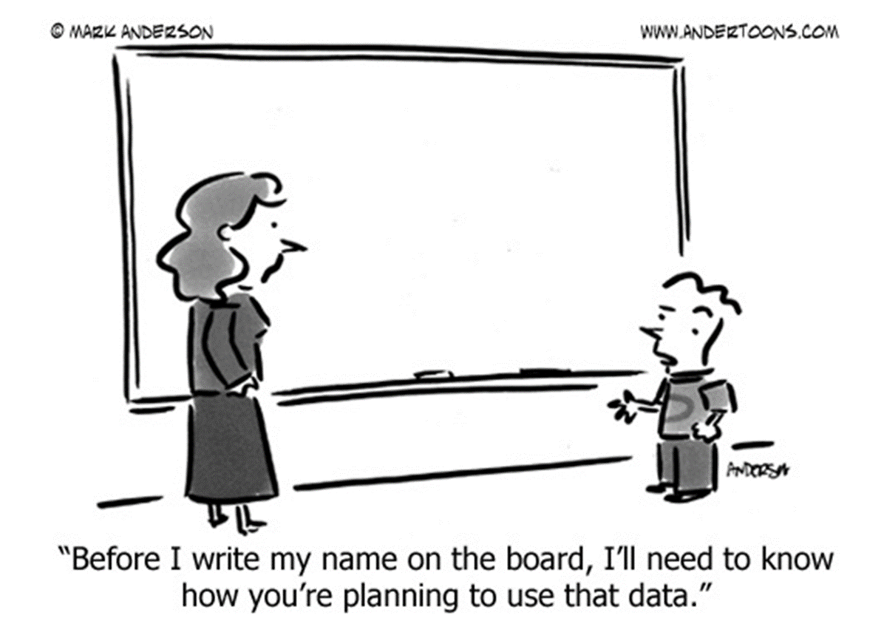

Slide 45
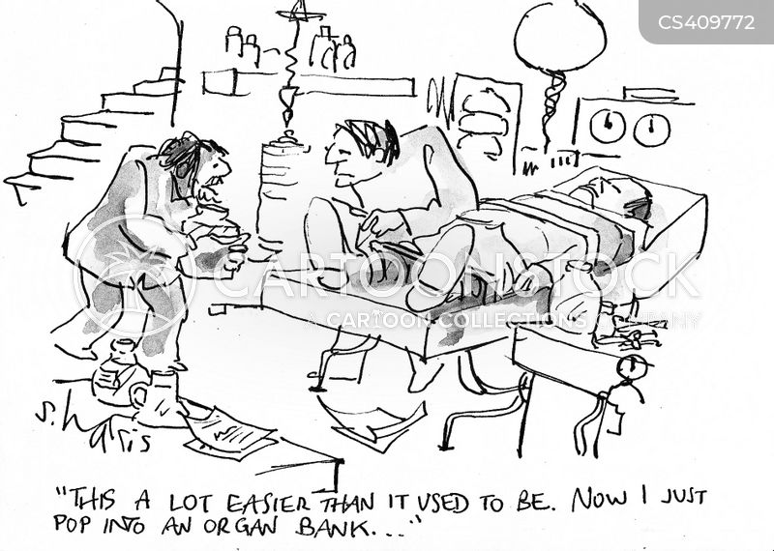

Slide 46
What else is (or isn't) human subject research?
Research means a "systematic investigation … designed to develop or contribute to generalizable knowledge."

Slide 47
Investigator proposes to retain excess (left-over) tumor tissue from patients undergoing clinically indicated biopsy for future research. Tissue will be coded, linked to PHI from the EHR; the key will be maintained by the PI.
Investigator proposes to create and maintain a data registry, drawing from EHR, several publicly available state and NIH funded databases, and several private registries. Data will be mined for future undefined research.
Notes:
applies to both tissue and data banking …

Slide 48
Biobanks and Data Registries
A Biobank is a collection of biologic specimens (pathology specimens, biologic fluids, DNA/RNA, cell lines, organoids …) with or without associated health information
A Data Registry is an organized collection of information, usually from patients with a specific disease or condition, and related to diagnosis, treatment, outcome and other aspects of the disease or condition

Slide 49
HBM banking components and transactions
Specimen Source
Bank
Users

Slide 50
Creation of a Biobank
Creation of a biobank (or of a data registry) constitutes research subject to IRB review even though no "research" is being done …
"Operation of the Repository and its data management center should be subject to oversight by an Institutional Review Board" (OPRR November 1997)
Specimen Source
Bank
Users
"HSR" requiring IRB review

Slide 51
Saving HBM to a Biobank
Transfer of identifiable HBM to an existing bank constitutes research subject to IRB review even though no "research" is being done …
Transfer of de-identified HBM to an existing bank may or may not require IRB review …
Specimen Source
Bank
Users
"HSR" perhaps requiring IRB

Slide 52
Use of HBM from a Biobank
Use of HBM from a tissue bank may or may not require IRB review, depending on
whether HBM is identifiable
whether the HBM was obtained for research purposes
what was described in the initial CF
Specimen Source
Bank
Users
HSR perhaps requiring IRB review

Slide 53
Use of HBM from Biobank
Human subject research
IRB (or ORA) approval required; informed consent may be needed
(unless banking consent specific)
Is HBM linked directly to an individual?
YES
NO
YES
Can investigators readily ascertain the identity of the individuals OR is the key available to the investigator?
Is HBM coded?
YES
NO
NO
Not human subject research
IRB approval not required*; informed consent is not needed
(*unless FDA regulated)

Slide 54
HBM banking components and transactions
"HSR" perhaps requiring IRB review
HSR perhaps requiring IRB review
Specimen Source
Bank
Users
"HSR" requiring IRB review

Slide 55
HBM banking components and transactions
"HSR" perhaps requiring IRB review
HSR perhaps requiring IRB review
Specimen Source
Bank
Users
"HSR" requiring IRB review

Slide 56
Creation of a biobank or of a data registry constitutes research subject to IRB review even though no "research" is being done …
Deposition of identifiable HBM or IPI (including PHI) into a biobank or data registry constitutes research subject to IRB review
depends on whether identifiers are provided to the end used, and the conditions of the initial consent to bank the samples or data
Notes:
OPRR 1997
https://www.hhs.gov/ohrp/regulations-and-policy/guidance/issues-to-consider-in-use-of-stored-data-or-tissues/index.html

Slide 58
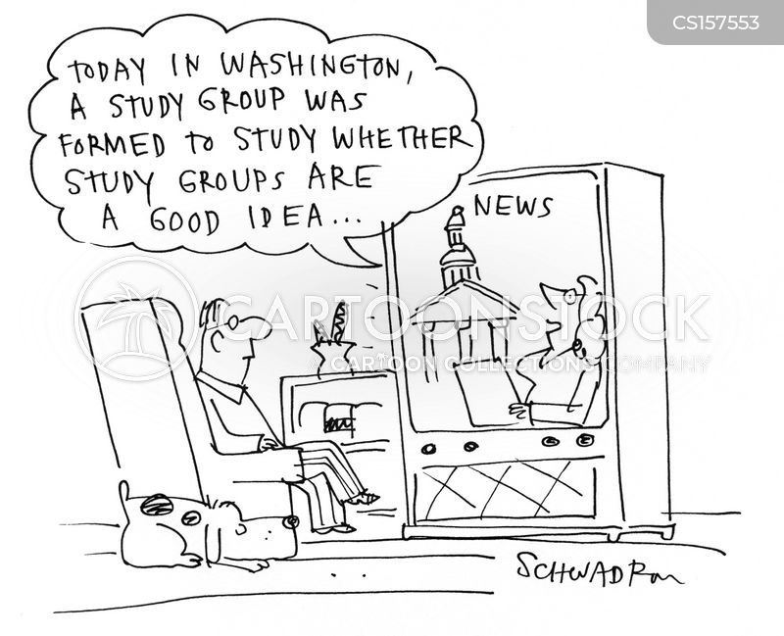

Slide 59
What else is (or isn't) human subject research?
Research means a "systematic investigation … designed to develop or contribute to generalizable knowledge."
Notes:
systematic investigation is a detailed, methodical activity, planned in advance, that involves data collection and analysis, in order to answer a scientific or scholarly question

Slide 60
A private foundation funds a program to provide access to laptop computers to children in a series of elementary schools in an underserved urban area. Funding includes requirement to assess whether the program is working by reviewing standardized test scores and drop-out rates among users of the program. Based on results of the assessment, foundation will decide whether to expand the program, or revise criteria for choosing eligible schools

Slide 61
Program Evaluation
"Program assessment (or program evaluation) is a systematic collection of information about the activities, characteristics and outcomes of a specific program or model, to contribute to continuous program improvement, and/or to inform decisions about future program development."
Centers for Disease Control and Prevention. Framework for program evaluation in public health. MMWR 48(R11):1-40, 1999

Slide 62
Program Evaluation
In general, Program Evaluation has the following characteristics:
Intent of project is to evaluate a specific program …
Activities are not designed to develop or contribute to generalizable knowledge
Activities are mandated by the program, usually its funder, as part of its operations
Findings are expected to directly affect the conduct of the program and identify improvements
No benefit to participants expected; evaluation concentrates on program improvements or whether the program should continue
Oregon State University

Slide 63
Program Evaluation?
A private foundation funds a program to provide access to laptop computers to children in a series of elementary schools in an underserved urban area
Administrators at one of the eligible schools propose to administer a survey of children and parents to address the hypothesis that access to nutrition information from websites lead to better eating habits
likely HSR
intent of the project is to develop or contribute to generalizable knowledge

Slide 64
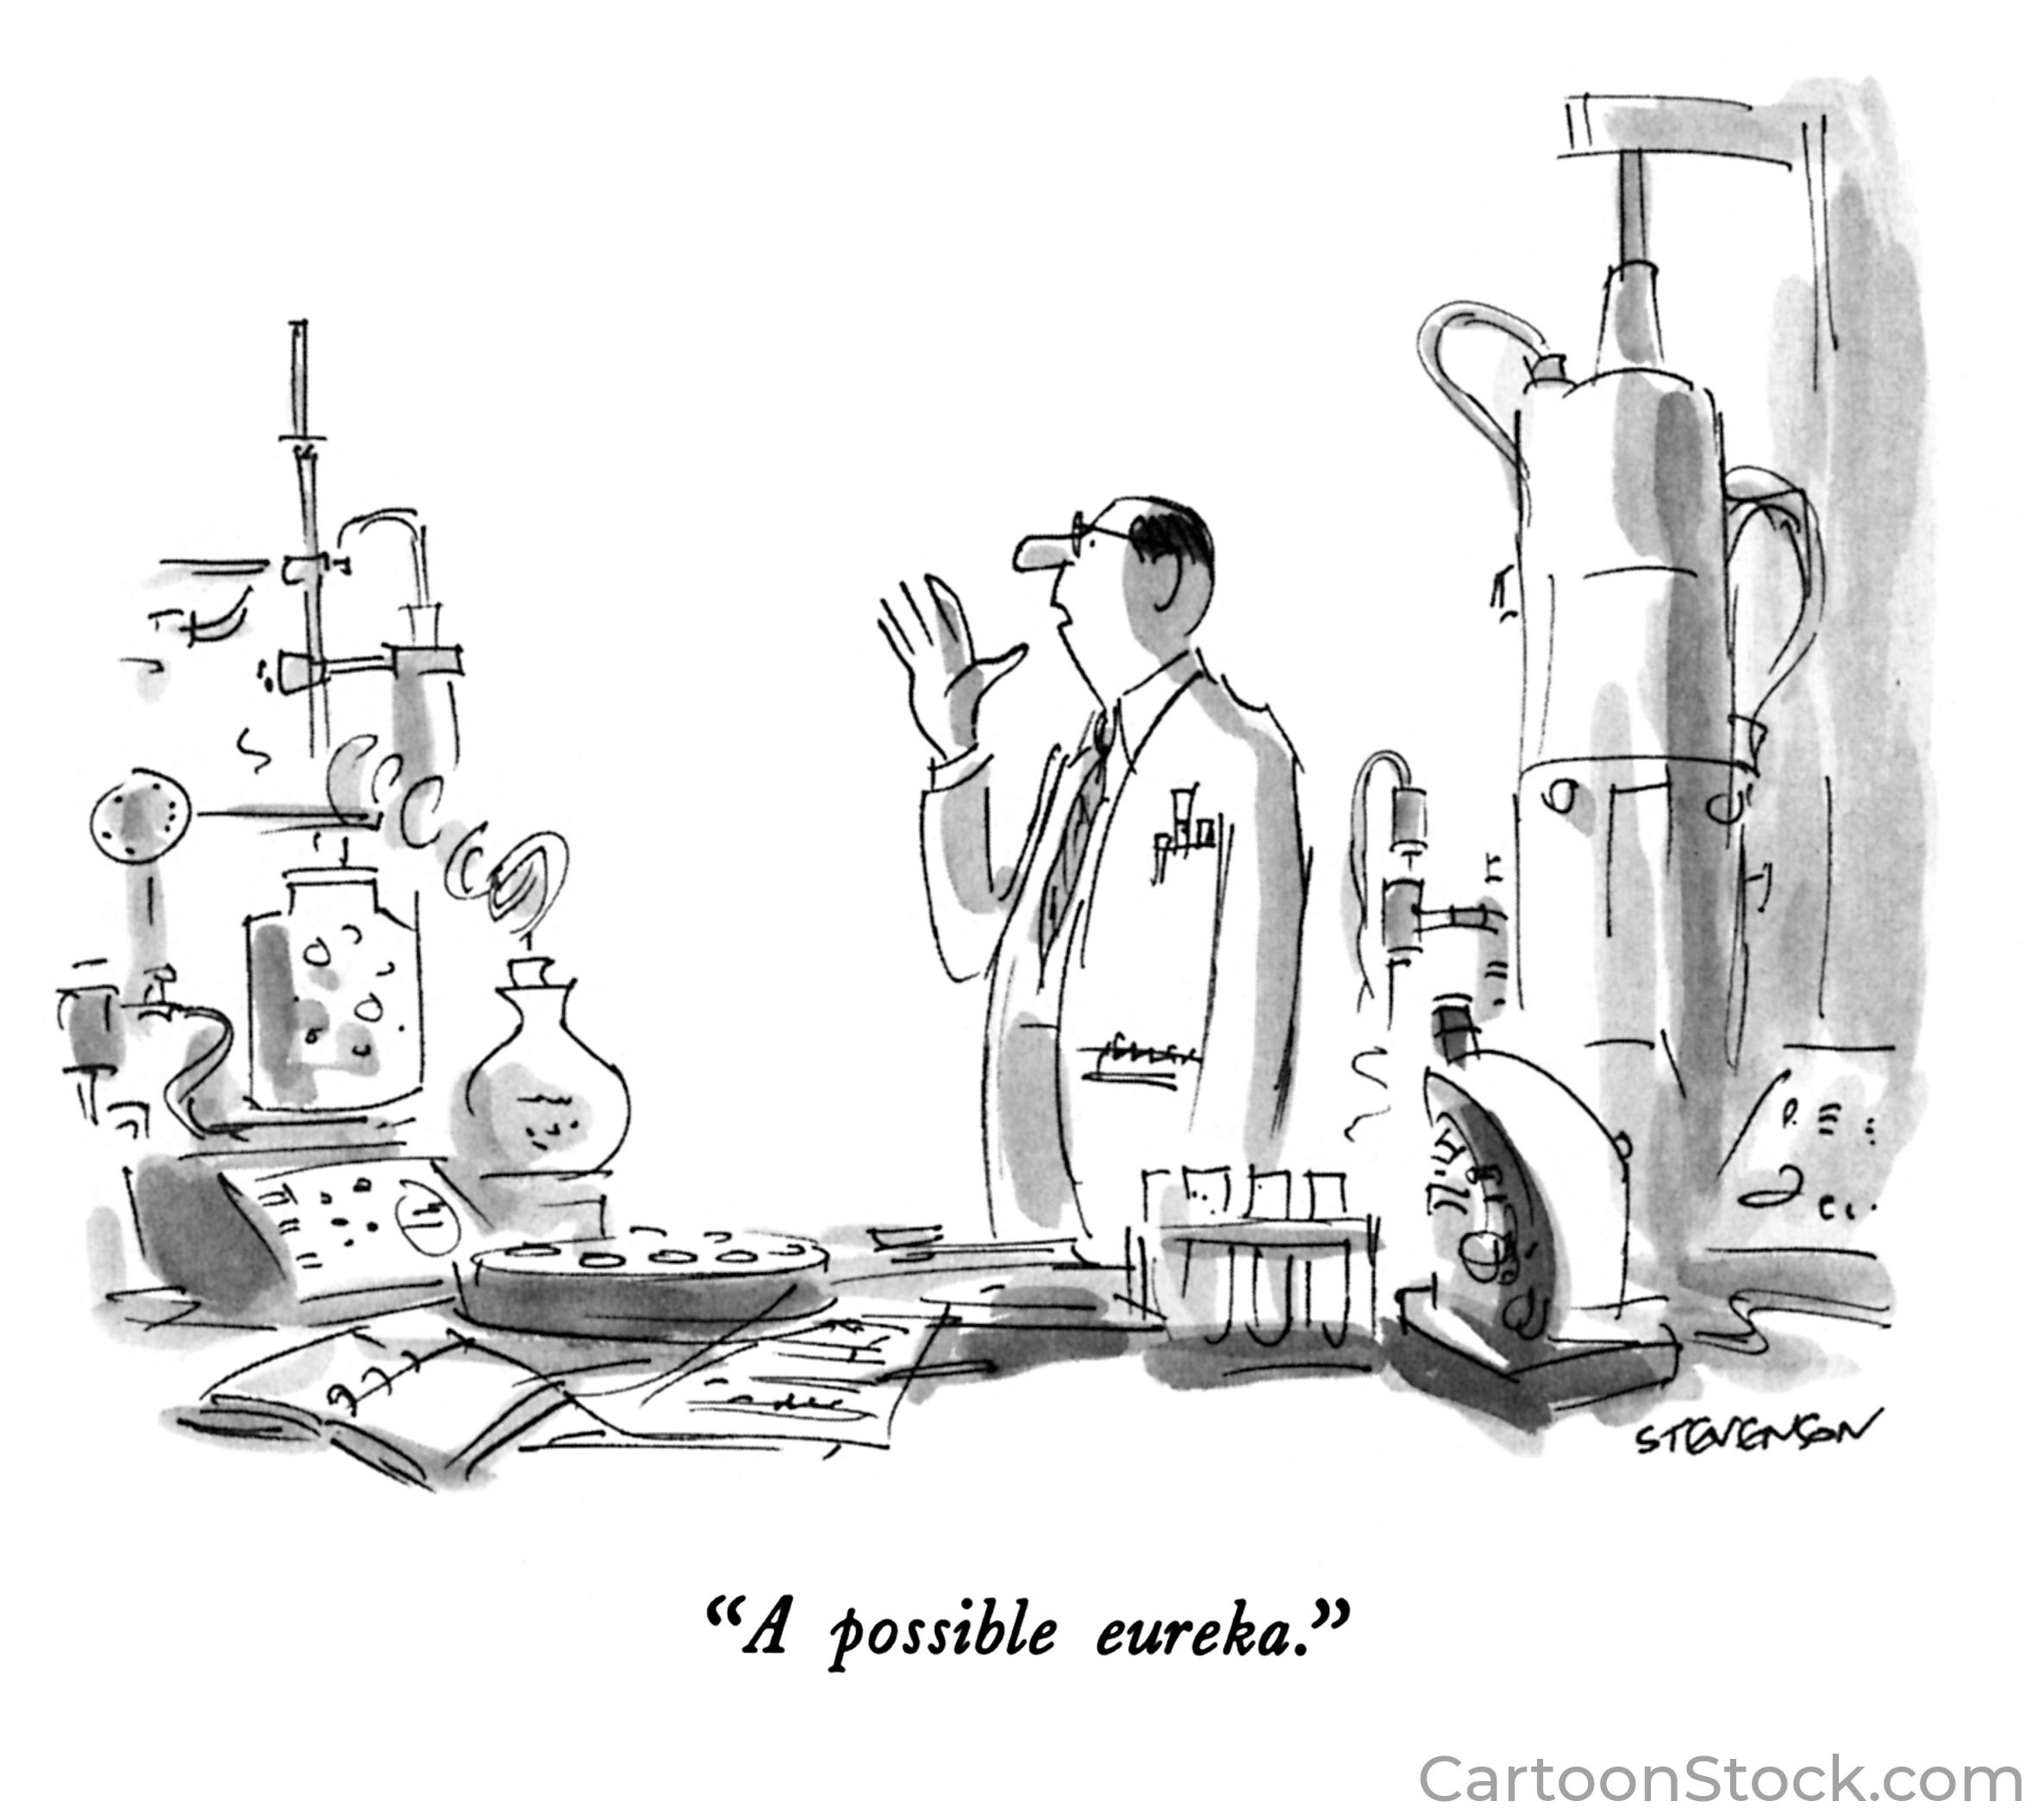

Slide 65
What else is (or isn't) human subject research?
Research means a systematic investigation … designed to develop or contribute to generalizable knowledge

Slide 66
An oncologist prescribes a combination of drugs not previously reported with the sole intent of treating a patient with an advanced malignancy
Based on the favorable results of prior innovation, a group of oncologists revises their standard of care to include the novel therapeutic approach
A surgeon, responding to the specific anatomy of a patient undergoing a procedure, proposes to make modifications to an accepted surgical procedure
Based on experience with animal models, a cardiologist offers a novel therapy to treat infants with congenital heart disease in utero
Notes:
Baby Fae?

Slide 67
Innovative practice
"'Practice' refers to interventions that are designed solely to enhance the well-being of an individual patient or client and that have a reasonable expectation of success …"
"By contrast, the term 'research' designates an activity designed to test a hypothesis, permit conclusions to be drawn, and thereby to develop or contribute to generalizable knowledge …"
Belmont Report, 1979
Notes:
Belmont

Slide 68
Innovative practice
"When a clinician departs in a significant way from standard or accepted practice, the innovation does not, in and of itself, constitute research. The fact that a procedure is 'experimental,' in the sense of new, untested or different, does not automatically place it in the category of research."
Belmont Report, 1979
Notes:
Later reiterated by NBAC in report "Ethical and Policy Issues in Research Involving Human Particpants"

Slide 69
Society of University Surgeons position paper: "Responsible Development and Application of Surgical Innovations" (2008)
Innovation is not research → not subject IRB review
Recommended creation of Surgical Innovation Committees (SIC)
"The SIC is charged with ensuring appropriate oversight and disclosure of innovations. Like an IRB, the SIC will assess the relative merits and potential adverse consequences of the innovation, and uphold ethical and patient safety standards."
J Am Coll Surg 206(6):1204, 2008

Slide 70
Innovative practice
"When a clinician departs in a significant way from standard or accepted practice, the innovation does not, in and of itself, constitute research. The fact that a procedure is 'experimental,' in the sense of new, untested or different, does not automatically place it in the category of research."
"Radically new procedures of this description should, however, be made the object of formal research at an early stage in order to determine whether they are safe and effective."
Belmont Report, 1979
Notes:
Later reiterated by NBAC in report "Ethical and Policy Issues in Research Involving Human Particpants" 2001

Slide 71
Innovative practice
Innovative practice should be formally tested sooner rather than later ...
premature adoption of innovative practices without adequate supportive evidence may promote wide acceptance of therapies that are ineffective
premature adoption of innovative practices without formal scientific testing may compromise the ability to determine effectiveness, weigh risk against benefit, compare the practice with other procedures, or develop alternative approaches
ACOG Committee Opinion: Innovative Practice: Ethical Guidelines, December 2006 (reaffirmed 2015)
Notes:
why should we move do research sooner rather than later on innovative practices?
National Commission and NBAC agree

Slide 72
Innovative practice vs research
If the innovation is planned, AND:
surgeon seeks to confirm a theory about the innovation; OR:
innovation differs significantly from currently accepted local practice; OR:
outcomes of the innovation have not been previously described; OR:
innovation entails risks for complications; OR:
specific or additional patient consent appears appropriate
… then the "innovation" should be [treated as] research
Position Statement, Society of University Surgeons (J Am Coll Surg 206(6):1204, 2008)
Notes:
Biffl et al : Responsible Development and Application of Surgical Innovations: A Position Statement of the Society of University Surgeons
J Am Coll Surg 2008
doi:10.1016/j.jamcollsurg.2008.02.011

Slide 73
Innovative practice vs research
Considerations which offer criteria to clinician for a decision to move from innovation to formal research
the innovation represents a significant departure from standard practice
the innovation carries risks that are unknown or that may be significant in proportion to expected benefit
the introduction of the innovation is expected to result in generalizable knowledge
ACOG Committee Opinion: Innovative Practice: Ethical Guidelines, December 2006 (reaffirmed 2015)

Slide 74
Innovative practice vs research
IRB does not regulate the practice of medicine
Innovative therapeutic practices (even if unproven) which are performed in the course of rendering treatment are not research
However, if there is an intent to develop or contribute to generalizable knowledge then that activity should be classified as research

Slide 75
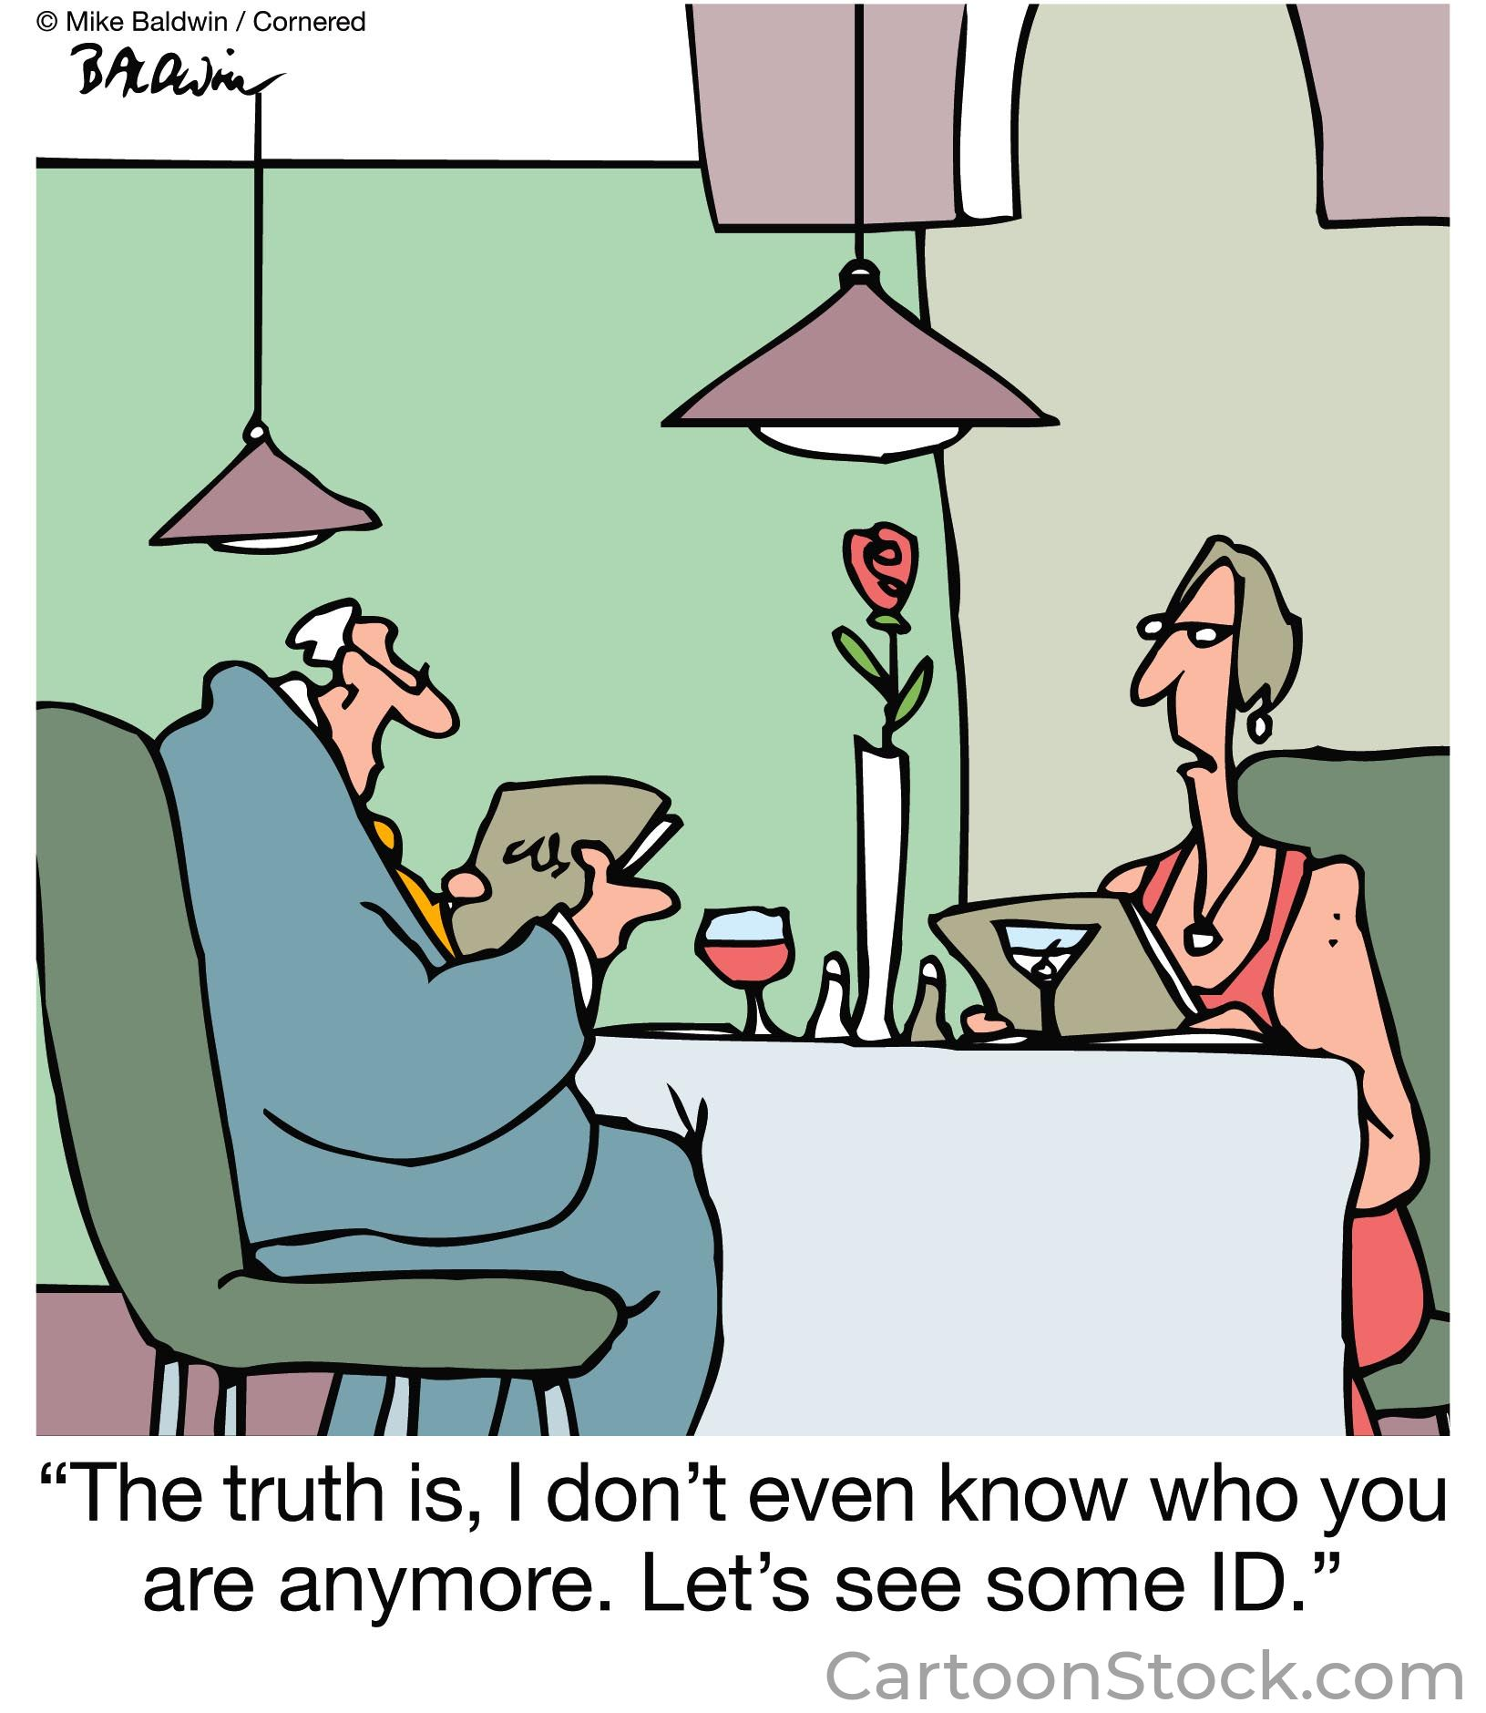

Slide 76
Investigator proposes to use discarded placentas, provided to her without identifiers, to study the interactions of cytokines involved in angiogenesis
Investigator receives blood and limited medical history from patients with post-COVID-19 syndrome to study roles of immune effector cells; identifiers (including dates) are not recorded by the investigator
Investigator proposes to excess kidney tissue from clinically indicated biopsy to study role of specific biomarker in progression of diabetic kidney disease; identifiers retained to monitor clinical course

Slide 77
What else is (or isn't) human subject research?
A human subject is a living individual about whom an investigator conducting research obtains ... (2) identifiable private information or identifiable biospecimens
Notes:
identifiable …
the identity of the subject is or may readily be ascertained by the investigator or is associated with the information or biospecimen

Slide 78
Research with deidentified data and materials
Obtaining or using identifiable private information or biospecimens for research purposes = human subject research
information or specimens are identifiable when they can be linked to specific individuals directly or indirectly through coding systems, OR
the identity of the donor can readily be associated by the investigator through some other means
OHRP Guidance: Coded Private Information or Biospecimens Used in Research (2018)
Notes:
Examples:
1. key to decipher the code is destroyed
2. agreement with the investigator or repository policies prohibit the release of the key
3. release of key is prohibited by law

Slide 79
Identifiers (from HIPAA Privacy Rule) 45 CFR 164.514 (b)(2)(i)
"Identifiable" means including any of the 18 identifiers named in the Privacy Rule
Name, address, phone number, email address
All dates (except year)
SSN, MRN, insurance number, account number
License or certificate number, VIN or license plate number, Serial number
URL, IP address
Biometric identifiers, Full face photographic images
Any other unique identifying number or code

Slide 80
Identifiability
Identifiability is critical in determining the level of IRB review needed
no identifiers provided to researcher → NOT human subject research (NHSR)

Slide 81
Identifiability
Identifiability is critical in determining the level of IRB review needed
no identifiers provided to researcher → NOT human subject research (NHSR)
identifiers provided to researcher but not recorded by researcher → HSR but exempt from 45 CFR 46
no IRB review needed, but determination of "exempt" status should be made by someone other than the investigator
Notes:
Exemption from 45 CFR 46 does not mean exempt from ethics review
investigators performing exempt studies may need to make provisions to obtain informed consent, protect confidentiality, minimize risks

Slide 82
Identifiability
Identifiability is critical in determining the level of IRB review needed
no identifiers provided to researcher → NOT human subject research (NHSR)
identifiers provided to researcher but not recorded by researcher → HSR but exempt from 45 CFR 46
no IRB review needed, but determination of "exempt" status should be made by someone other than the investigator
Notes:
Exemption from 45 CFR 46 does not mean exempt from ethics review
investigators performing exempt studies may need to make provisions to obtain informed consent, protect confidentiality, minimize risks

Slide 83
Identifiability
Identifiability is critical in determining the level of IRB review needed
no identifiers provided to researcher → NOT human subject research (NHSR)
identifiers provided to researcher but not recorded by researcher → HSR but exempt from 45 CFR 46
identifiers recorded by the researcher → HSR and requires IRB review

Slide 84
Identifiability
Is genetic information an identifier?
Not currently per regulation; however …
"Federal departments or agencies implementing this policy shall (i) upon consultation with appropriate experts (including experts in data matching and re-identification), reexamine the meaning of … 'identifiable private information' and 'identifiable biospecimen' ... This reexamination shall take place within 1 year and regularly thereafter (at least every 4 years) …" (45 CFR 46.102(e)(7))

Slide 85
Is it Human Subjects Research?
information or specimens are identifiable when they can be linked to specific individuals directly or indirectly through coding systems
coded information is not considered identifiable if
the key has been destroyed, OR
or if investigator cannot access the key:
an agreement between the investigator and the holder of the key prohibits the release of the key
repository written policies and procedures prohibit the release of the key to the investigators
release of the key is prohibited by law
Notes:
OHRP Guidance: Coded Private Information or Biospecimens Used in Research (2018)

Slide 86
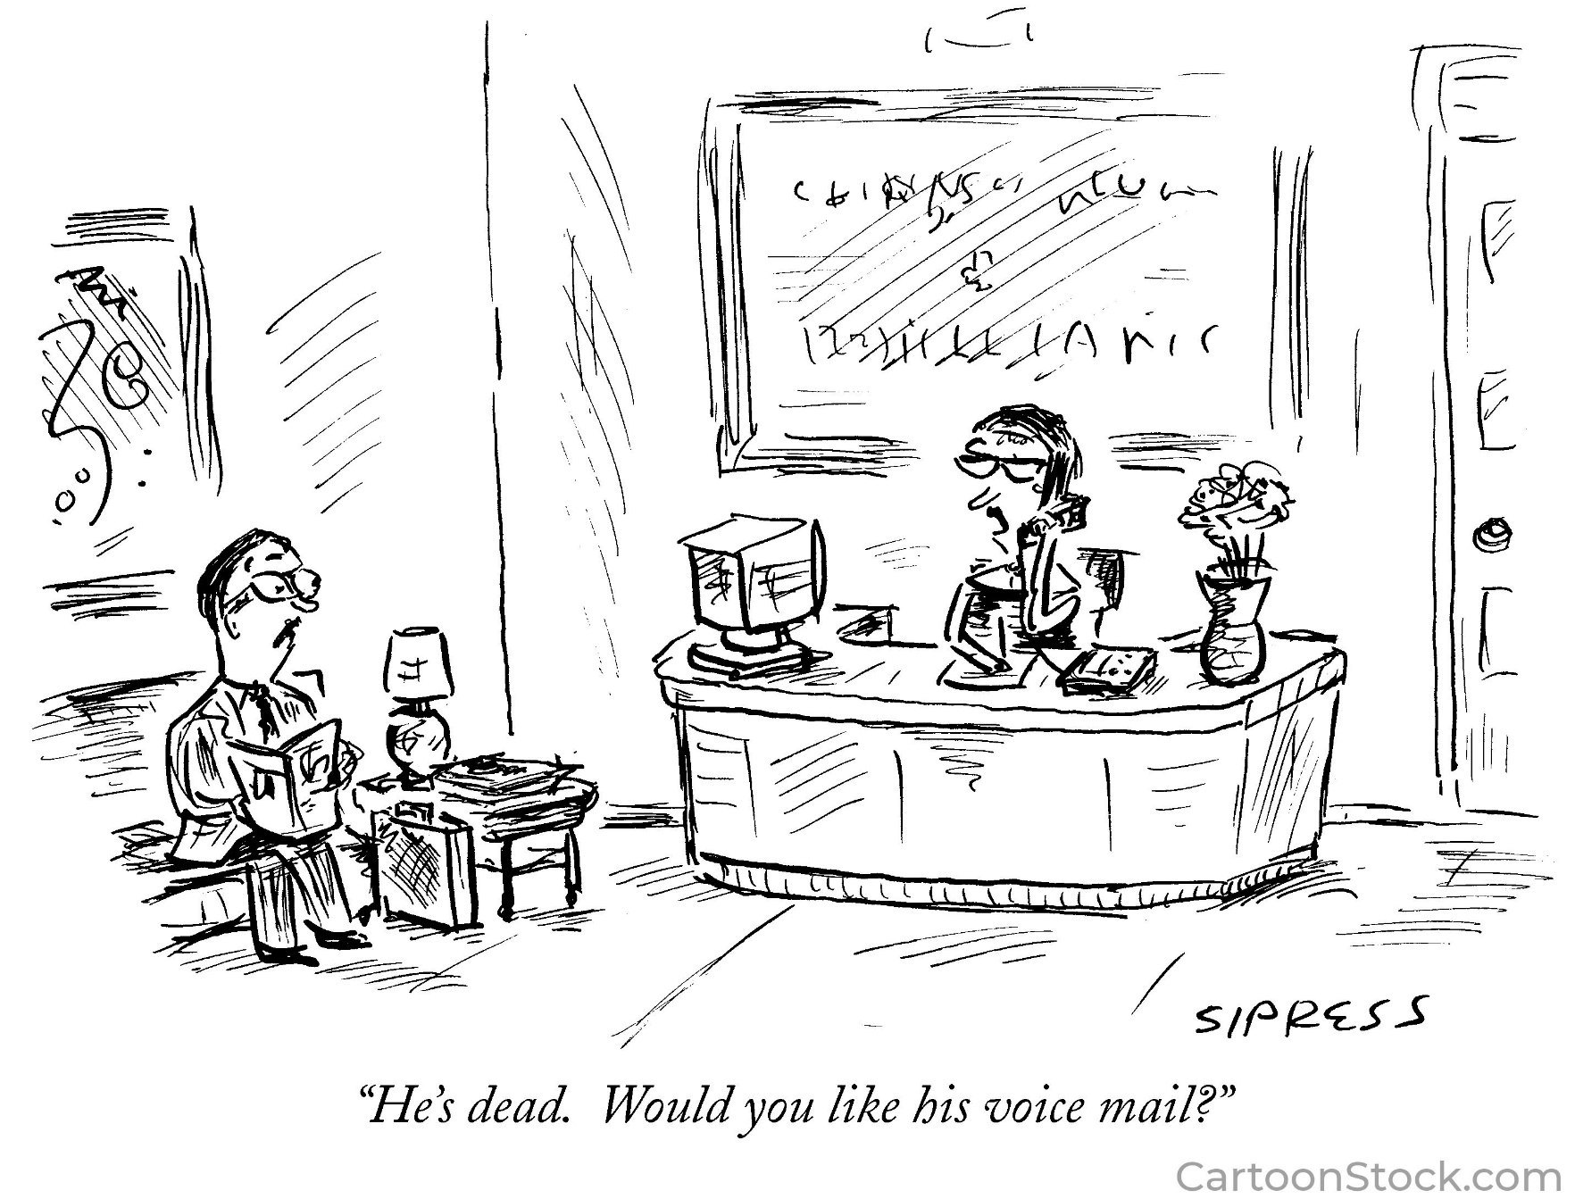

Slide 87
What else is (or isn't) human subject research?
A human subject is a living individual about whom an investigator conducting research obtains (1) information or biospecimens through intervention or interaction with the individual, or (2) identifiable private information or identifiable biospecimens
Research involving deceased persons does NOT require IRB review
however, prior authorization by patient or authorization by LAR is required under the UAGA
Notes:
private information …
Information about that occurs in a context where individual can reasonably expect no observation or recording, or information provided for purposes that individual can reasonably expect will not be made public (eg, medical records)
identifiable …
the identity of the subject is or may readily be ascertained by the investigator or is associated with the information or biospecimen

Slide 88
What else is (or isn't) human subject research?
A human subject is a living individual about whom an investigator conducting research obtains (1) information or biospecimens through intervention or interaction with the individual, or (2) identifiable private information or identifiable biospecimens

Slide 89
Decedent research
Research involving deceased persons is NOT human subject research
not a "living individual"
Does not require IRB review
however, prior authorization by patient or authorization by LAR is required under the UAGA

Slide 90
HIPAA Privacy Rule and decedent research
HIPAA Privacy Rule still applies individually identifiable health information of a decedent for 50 years following the date of death of the individual
the Privacy Rule generally protects a decedent’s health information to the same extent the Rule protects the health information of living individuals
Research involving PHI from a decedent requires authorization of LAR, or waiver of authorization by a Privacy Board
at UNMC Privacy Board is the IRB

Slide 91
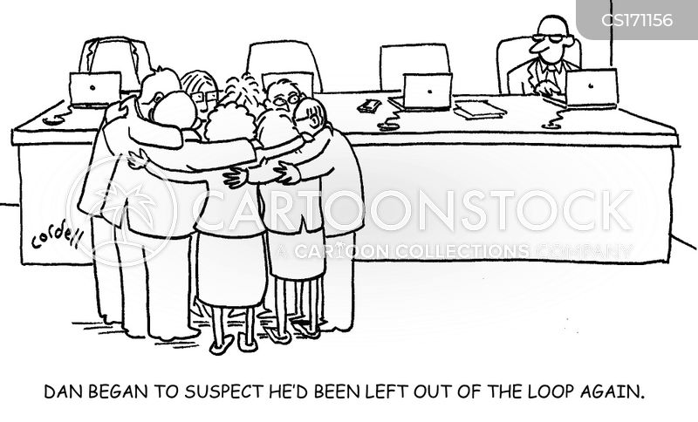

Slide 92
A study of the comparative efficacy of didactic vs interactive lecture styles in inner city middle school students
A survey of preferred hair color in potential mates; identifiers retained to monitor for changes over time
A study to correlate address, DOB and smoking history with Emergency Department use; EHR reviewed, identifiers recorded
A study of variations in gene sequence and frequency among Japanese males enrolled in the 1000 Genome Project
A study assessing ability of older adults to solve word puzzles under various noise conditions

Slide 93
What else is (or isn't) human subject research?
"Unless otherwise required by law or by department or agency heads, research activities in which the only involvement of human subjects will be in one or more of the categories … of this section are exempt from the requirements of this policy …" (45 CFR 46.104(a))

Slide 94
Exempt research
"Exempt research" is "human subject research" but it is exempt from the specific regulations at 45 CFR 46 and/or 21 CFR 50, 56
"exempt research" is NOT exempt from ethics review
investigators performing exempt studies will need to make provisions to protect confidentiality and minimize risks, and may need to obtain informed consent
Notes:
previously mentioned in context of identifiability of data

Slide 95
Exempt categories 45 CFR 46.104(d)
Research conducted in established or commonly accepted educational settings, involving normal educational practices that are not likely to adversely impact students’ opportunity to learn…
Research involving the use of educational tests, survey procedures, interview procedures or observation of public behavior if
information is recorded so that subjects cannot be identified (directly or indirectly); OR
no risk to subjects if identity disclosed

Slide 96
Exempt categories 45 CFR 46.104(d)
Research with consenting adults involving benign behavioral interventions
Research with identifiable information or biospecimens that are collected for some other reason, if:
information or biospecimens are publicly available; OR
information is recorded so that subjects cannot be identified (directly or indirectly); OR
information is protected by HIPAA

Slide 97
Exempt categories 21 CFR 56.104
Emergency use of a test article
Taste and food quality evaluations and consumer acceptance studies …

Slide 98
Exempt research
Exempt research is human subject research
Exempt research is exempt from the specific regulations at 45 CFR 46 and/or 21 CFR 50, 56
does not require IRB review
but determination of exemption must be made by someone other than the investigator, usually the "IRB"
Exempt research is NOT exempt from ethics review
investigators performing exempt studies will need to make provisions to protect confidentiality and minimize risks, and may need to obtain informed consent
Notes:
previously mentioned in context of identifiability of data

Slide 99
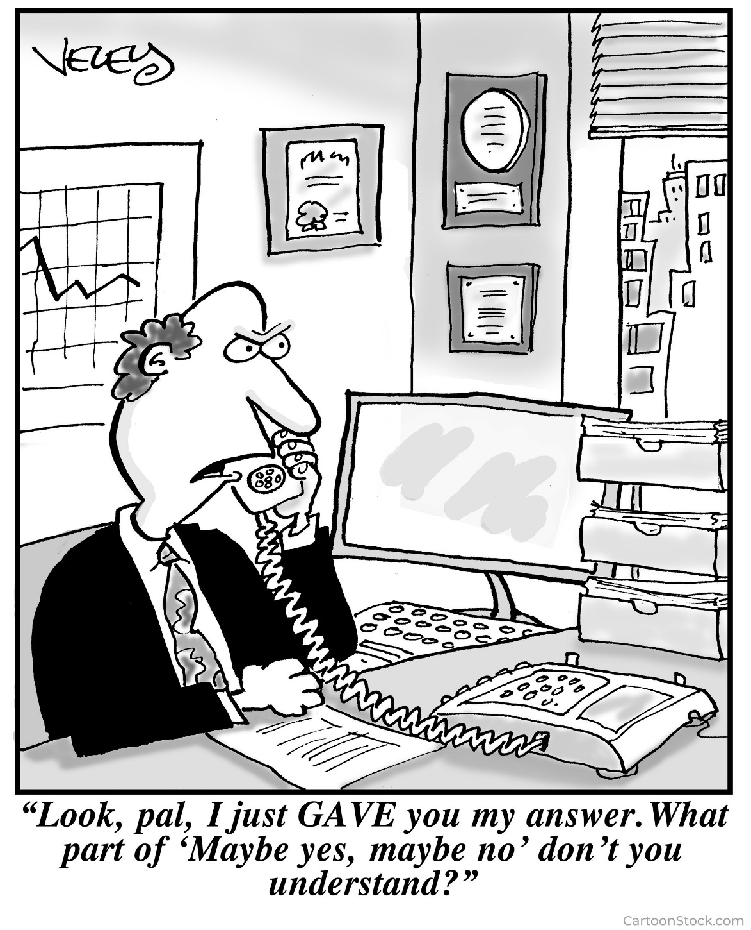

Slide 100
What is (or isn't) human subject research?
Quality Improvement isn't …
unless the project involves introducing an untested clinical intervention in order to assess how well the intervention works
A Case Report isn't …
but a Case Series is
Creating a Biobank is …
but putting HBM in or taking HBM out might not be
Program Evaluation isn't …
unless the intent is also to create generalizable knowledge

Slide 101
What is (or isn't) human subject research?
Innovative Practice isn't …
unless the intent is also to create generalizable knowledge
Research with de‐identified HBM or data isn't …
but they must actually be de‐identified
Research with deceased persons isn't …
but HIPAA might still apply
Exempt research is …
but it doesn't require IRB review (and it's not exempt from ethics review)

Slide 102
Criteria for IRB approval 45 CFR 46.111; 21 CFR 56.111
Risks to subjects are minimized
Risks to subjects are reasonable in relation to anticipated benefits
Selection of subjects is equitable
Informed consent is sought
Informed consent is documented
Adequate provisions for monitoring data
Adequate provisions to protect privacy of subjects and confidentiality of data
Additional safeguards for vulnerable populations

Slide 103
Criteria for IRB approval 45 CFR 46.111; 21 CFR 56.111
IRB must be satisfied that all the review criteria have been met in order to approve a protocol
IRB must have sufficient information upon which to base its decision
If information related to criteria for approval is not available, or if the PI cannot be directed to make specific changes, then the protocol must be tabled

Slide 105
