Slide 1
Uncovering Bias in Artificial Intelligence
John Windle MD
Professor of Cardiovascular Medicine
Richard and Mary Holland Distinguished Chair of Cardiovascular Science
Founding Director of the Center for Intelligent Health Care

Slide 2
About this talk
I have no relevant disclosures
Much of this talk is based on NIST Special Publication 1270 (https://doi.org/10.6028/NIST.SP.1270
Learning Objectives:
That the learner will come away with a deeper understanding of the foundations for concern about bias within artificial intelligence
To identify strategies to mitigate the potential for bias within artificial intelligence especially as it relates to the IRB.

Slide 3
About this talk
A Couple of Definitions
Artificial Intelligence: A class of software-based systems that generate predictions, recommendations, classifications, or decisions.
Bias: The intentional or unintentional intrusion of opinion as fact, or the selection of information presented in a manner that serves to promote only one view of a fact.
ISO definition of Bias: “The degree to which a reference value deviates from the truth.”

Slide 4
Bias
Three Classes of Bias
Human-Cognitive and perceptual bias
Statistical-Errors induced by datasets or algorithms that induce untoward effects.
Systemic-Institutional procedures and practices that operate to induce favoritism or disadvantage to individuals or groups.

Slide 5
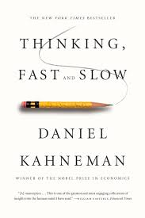
Human Bias
Two thought modes: Fast and Slow.
  Fast is instinctive and emotional
  Slow is more deliberative and logical
Humans are susceptible to bias.
  Loss Aversion
  Anchoring
  Framing Choices
Humans have too much confidence in expert’s judgement.
Humans have to much confidence in artificial intelligence’s judgement.

Slide 6

Human and Statistical Bias
Dunning-Kruger Effect
People overestimate their ability (subjective ability versus objective ability

Slide 7
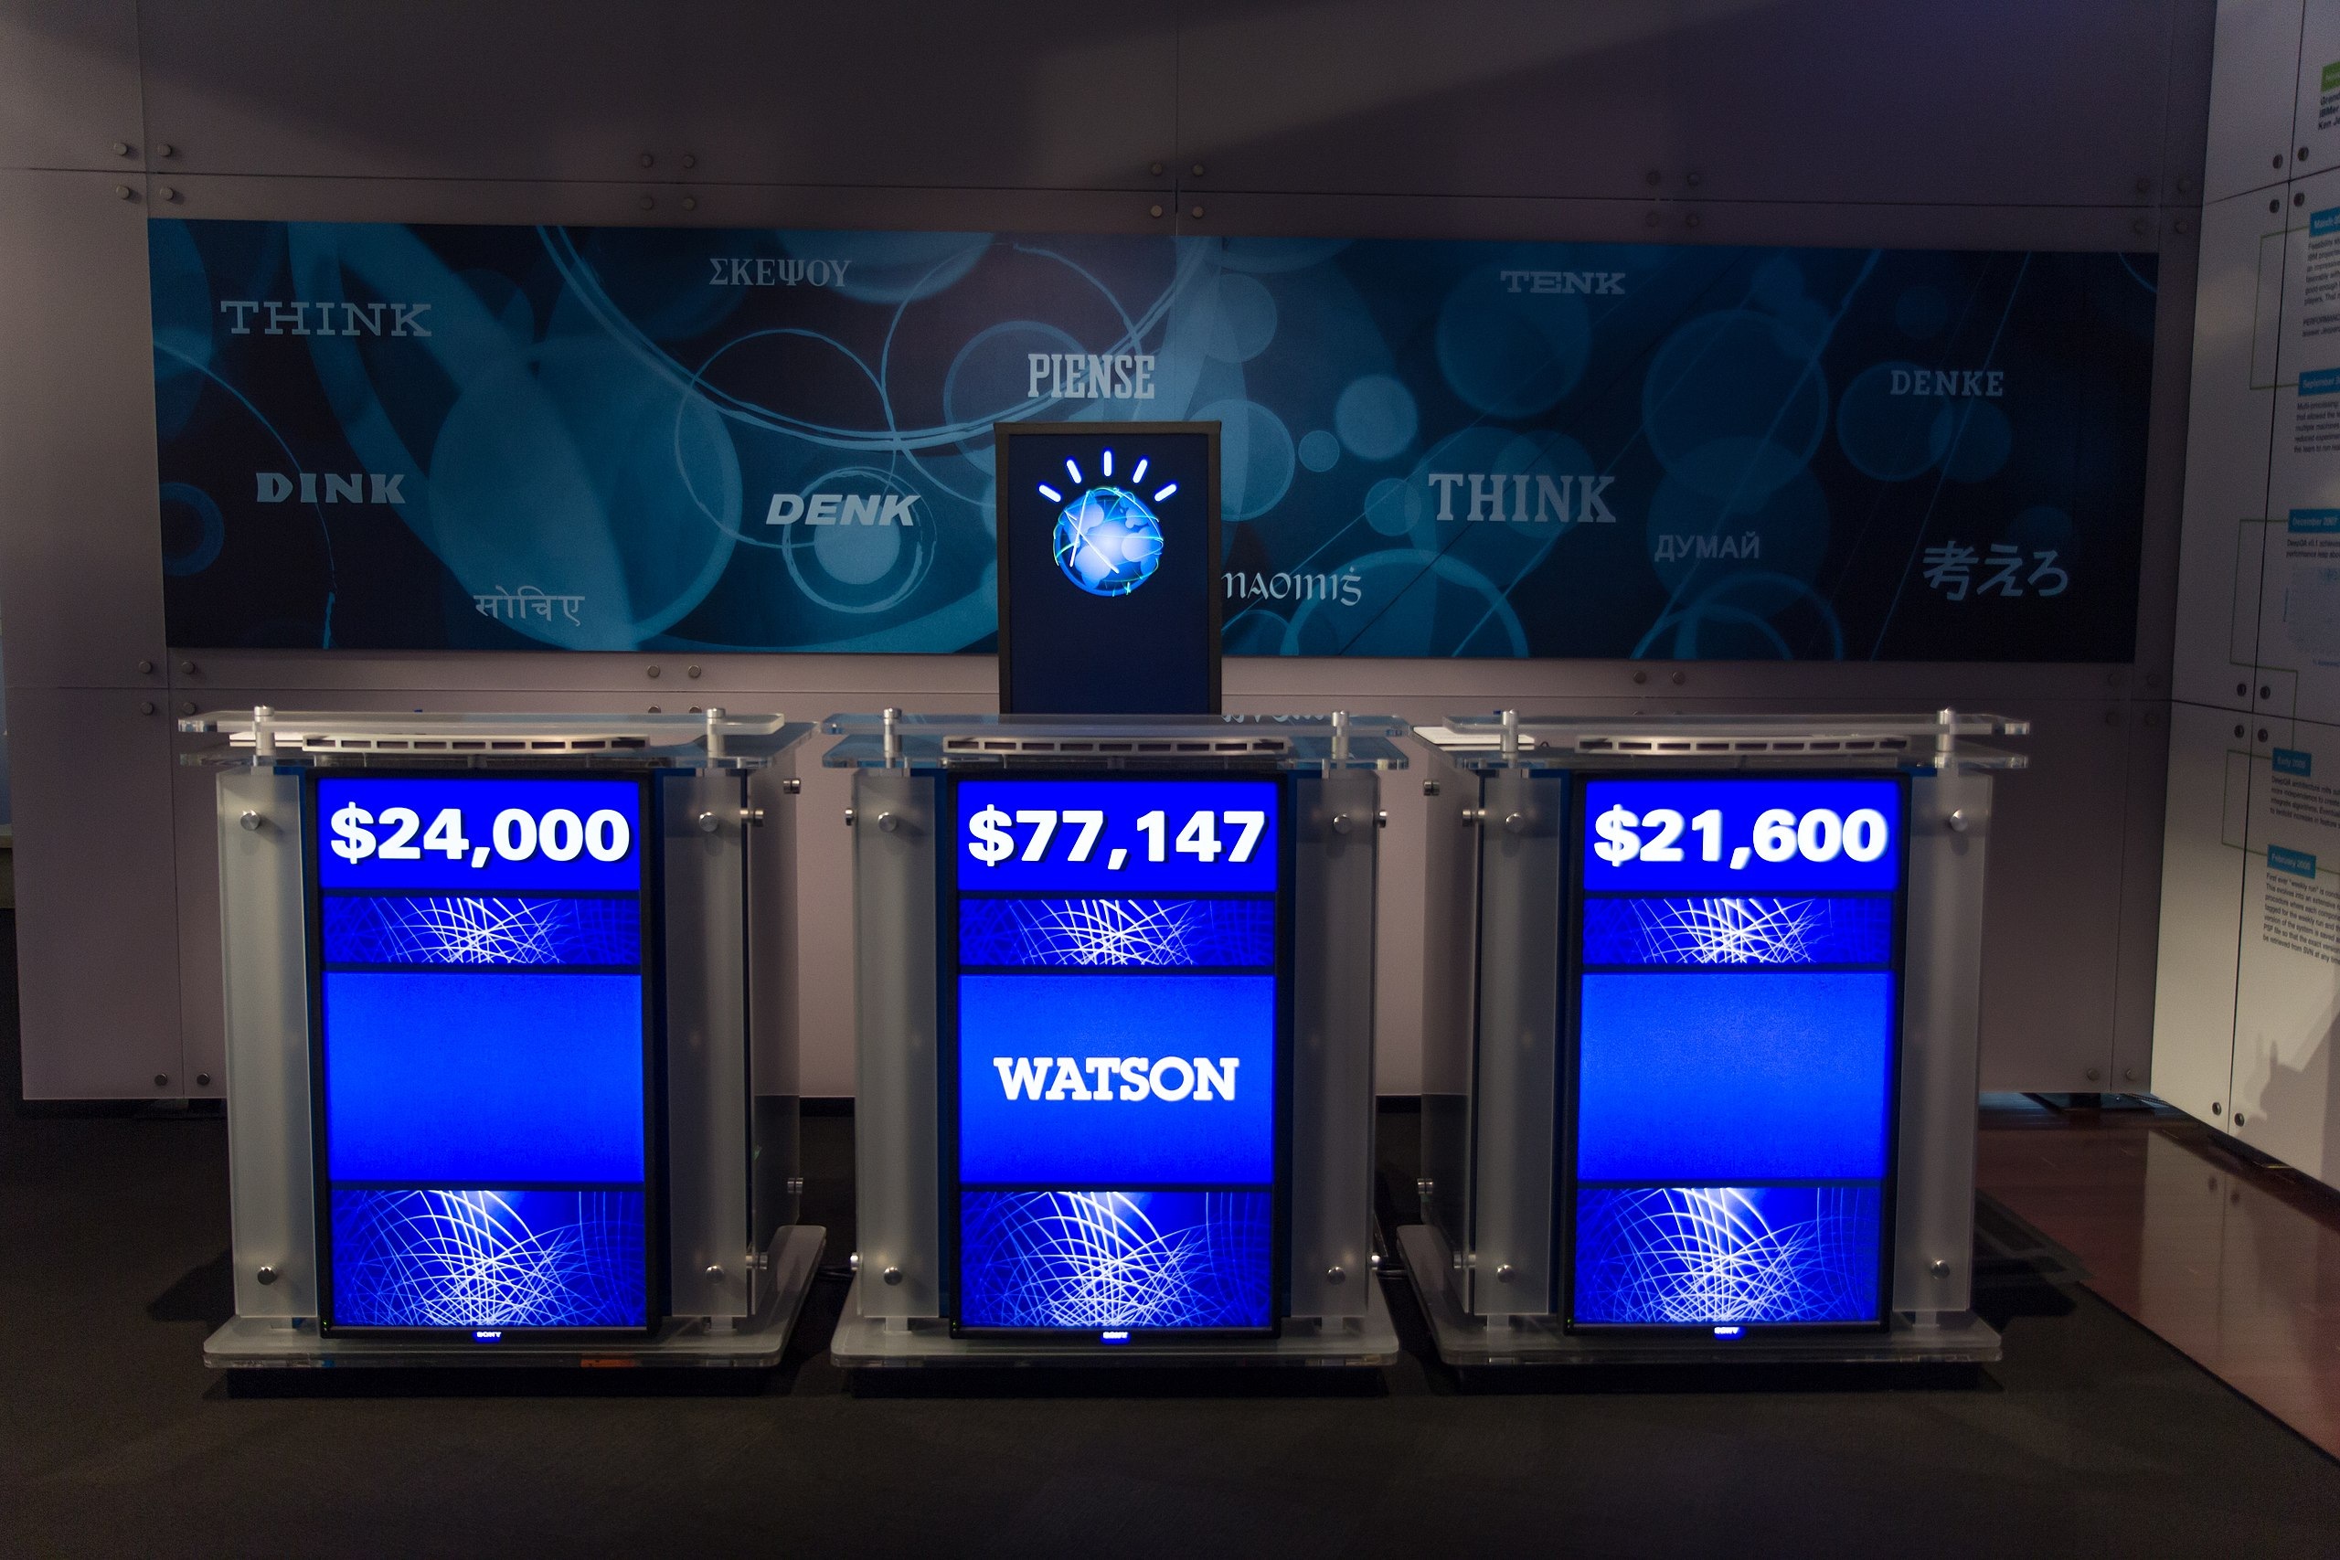
Human and Statistical Bias
McNamara Fallacy
The tendency to focus on the numbers, metrics, and quantifiable data while disregarding the meaningful qualitative aspects
AI algorithms are driven by mathematical formulas and based often based on quantitative data sets

Slide 8
Human and Statistical Bias
Merton’s Law of Unintended Consequences
Intervention in a complex system tends to create unanticipated and often undesirable outcomes
Ignorance
Errors in Analysis
Group Think
Almost all actions have intended and unintended consequences, however, in action can also have unintended consequences.
Notes:
Actions of intended and unintended consequences,

Slide 9
Statistical Bias
Simpson’s Paradox
The Statistical Phenomena where an association between two variables in a population emerges, disappears or reverses when the population is divided
Most often occurs when there is an incomplete understanding of the causal impact of data.
Notes:
Men are more likely to have heart attacks than women, however, if you bring in the variable of age, let’s say 80 years of age and up, woman have more heart attacks than men (because if many men have died prior to age 80.

Slide 10

Bias-streetlight effect
Humans-We look for things where there is light, seeing what we have learned to see.
Statistical-We use the datasets that we have access to
Statistical-We ask questions to fit the data we are provided.

Slide 11
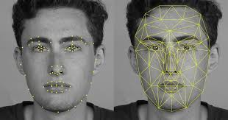
Deployment Bias
Facial Recognition software is a great security and convenience feature
However, it can be misused to create profiles that have unintended consequences (racial, ethnic, and gender bias)

Slide 12
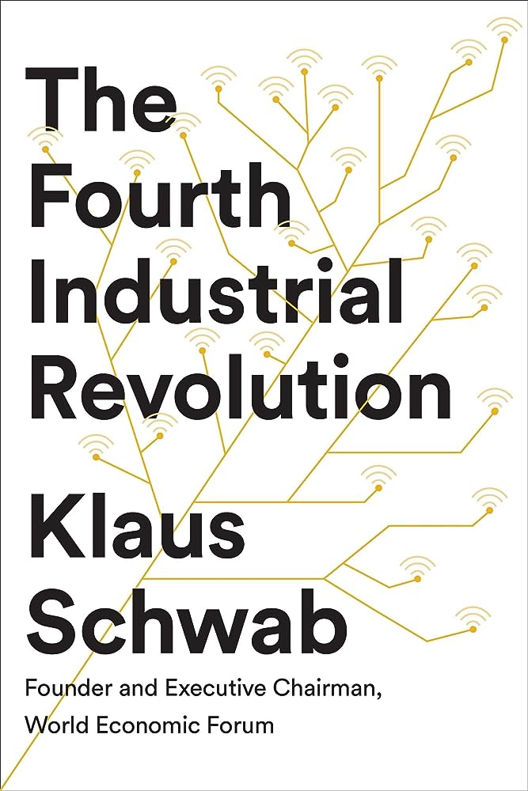
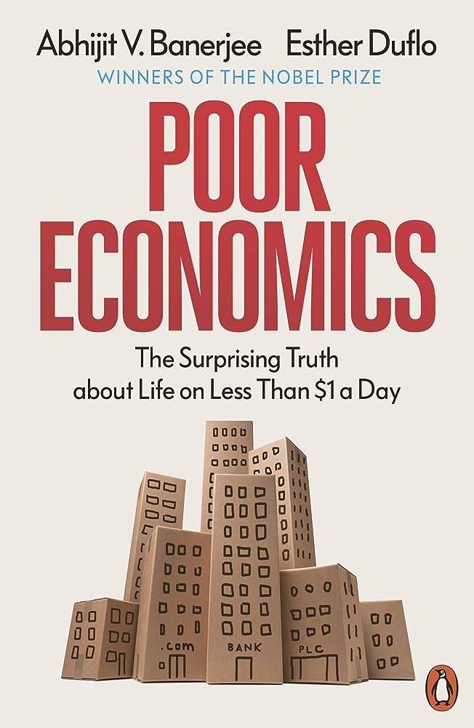
Bias-Selection Bias
Notes:
Klaus Schwab describes the upcoming 4th revolution because of digital technology, however notes that much of the world is still living in the second revolution. This leads to the “Ecologic Fallacy”, under-representation and valuation of individuals not participating in the 4th Industrial revolution. This can show up when AI scrapes text messages and social media sites.

Slide 13
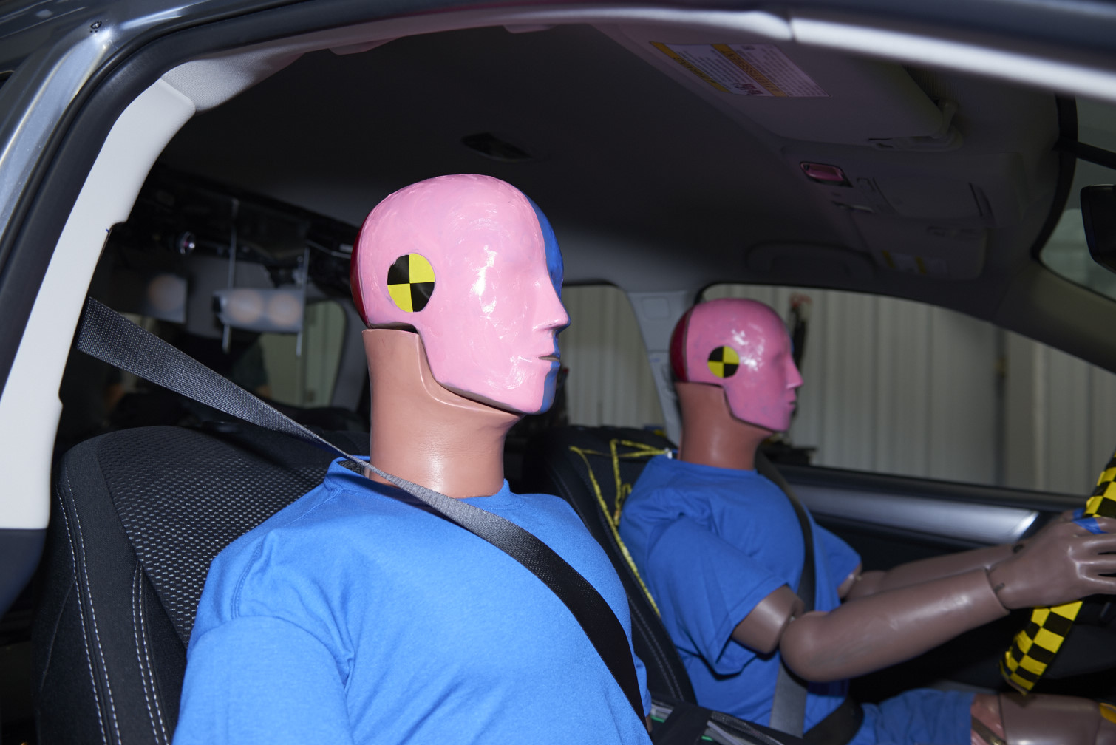
Algorithm Bias

Slide 14

Algorithm Bias

Slide 15
Bias-Algorithm
Generative AI-Large Language Models
Until recently many AI algorithms relied on human corrections and training. Large language models are unsupervised.
LLM are susceptible to epistemic and aleatoric uncertainty
  Epistemic-Knowable
  Aleatoric-Randomness the can’t be explained-noise in the system

Slide 16
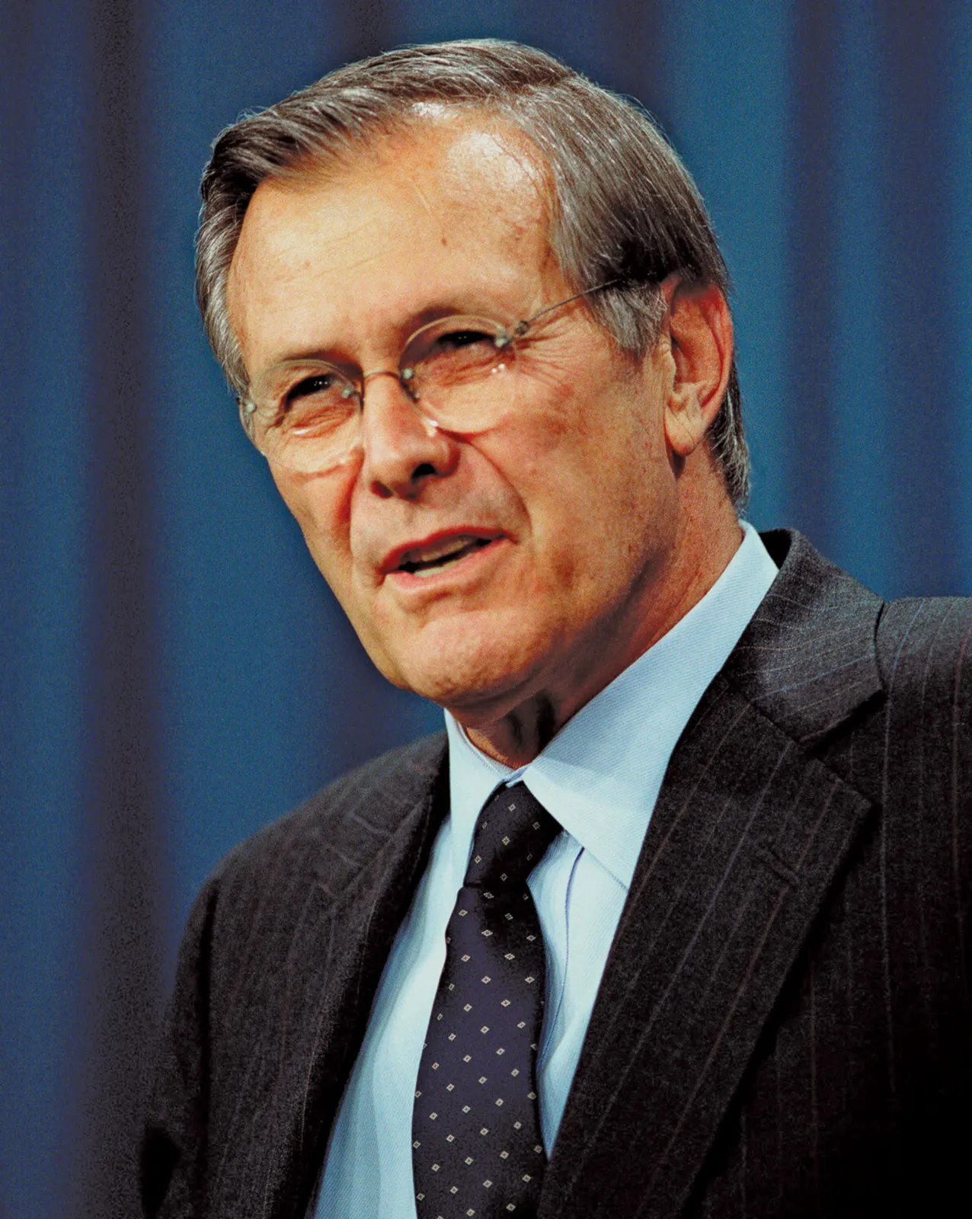
Epistemic and Aleatoric Unknowns?
Donald Rumsfeld
“Reports that say that something hasn't happened are always interesting to me, because as we know, there are known knowns; there are things we know we know. We also know there are known unknowns; that is to say we know there are some things we do not know. But there are also unknown unknowns-the ones we don't know we don't know. And if one looks throughout the history of our country . . . it is the latter category that tends to be the difficult ones”

Slide 17
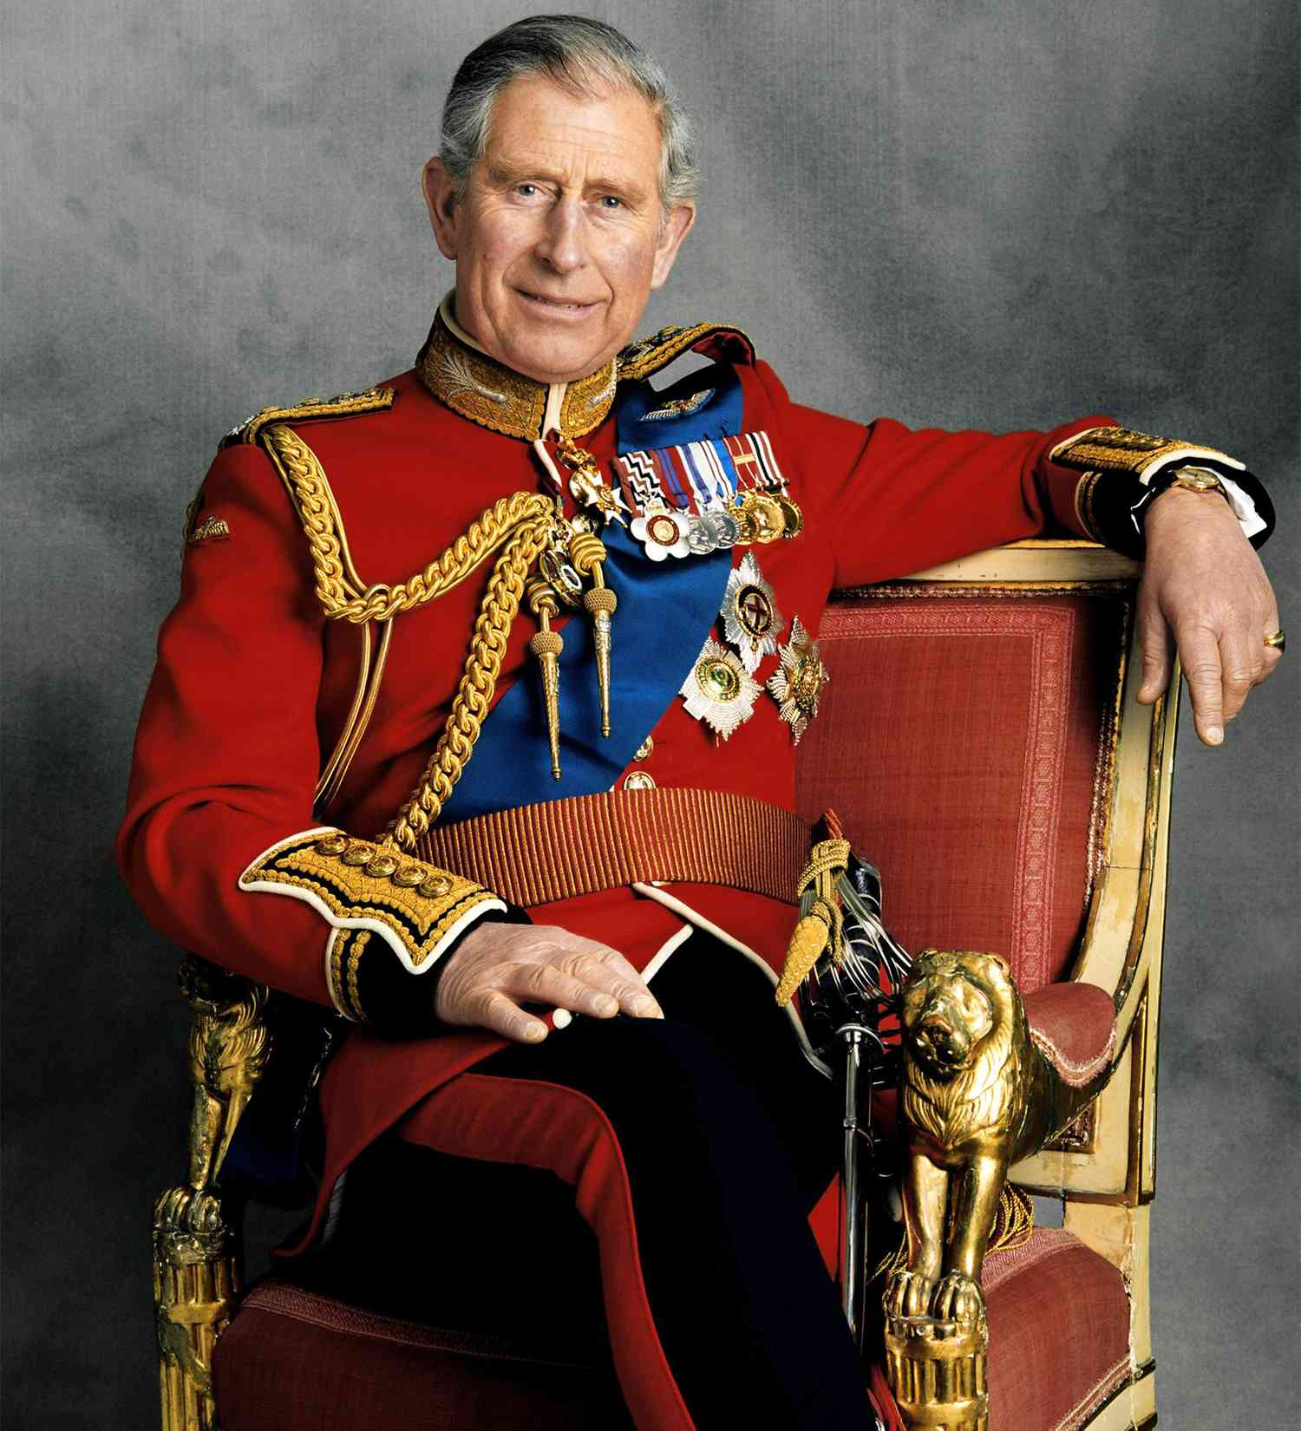

And One Last Example of Bias
Who is this?
Male
Born in 1948
Raised in the UK
Married Twice
Is Wealthy and Famous
Lives in a Castle

Slide 18
And One Last Example of Bias
Who is this?
Male
Born in 1948
Raised in the UK
Married Twice
Is Wealthy and Famous
Lives in a Castle
Anchoring, Framing, Availability and Conformational bias

Slide 19
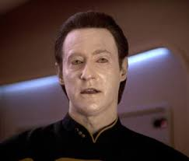
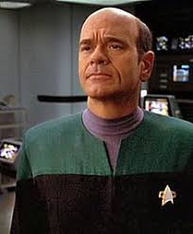
Where do we go from here?

Slide 20
Strategies to Mitigate Bias
TEVV Framework
Transparency
Datasets and Test Evaluation
Validation
Verification

Slide 21
Strategies to Mitigate Bias
Transparency
Transparency and fairness are essential to establish trust in the AI solution.
Explainability important.
AI needs to be held to a higher ethical standard because:
  The need for trust,
  The lack of experience with many of the AI solutions,
  The ability for AI to amplify bias.
Identifying sources of bias is the first step in any bias mitigation strategy.

Slide 22
Strategies to Mitigate Bias
Data Sets and Test Evaluation
Maker sure that the data-sets fully represent the population the algorithm is intended to represent (do they represent real-world data).
Involve subject matter experts early in process (pre-test and training).
Bayesian Inference-prior probabilities are updated with new data.
Even among experts, data-driven technologies can exacerbation confirmation bias, explicitly guided by expected outcomes (Epic’s sepsis bundle, COVID algorithms).

Slide 23
Strategies to Mitigate Bias
Validation and Verification
Assure solid experimental design
Focus on structured data collection
Minimize Conformational Bias
Demonstrate “Construct Validity”
  Retest data to demonstrate that it is still achieving its intended response.
  Validate and verify on new data (preferably external to training and testing data sets).

Slide 24
Strategies to Mitigate Bias
Human-in-the-Loop
Ground Truth is important import in design and validity
Subject Matter Experts should be involved in the testing and validation steps
Fairness often requires supervised learning and labeling of data.
Avoid techno-solutionism.

Slide 25
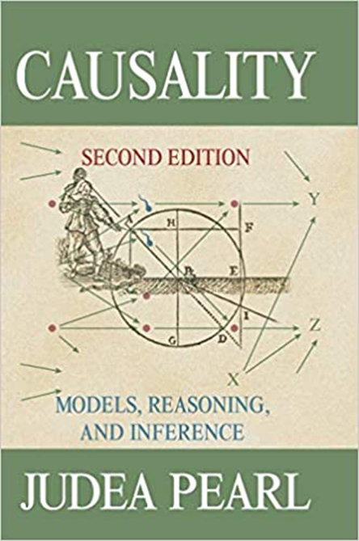
Strategies to Mitigate Bias
Causality
Establish ground truth, knowledge base and causal inference strategy.
Three levels of evidence:
  Level 1-Association
  Level 2-Intervention
  Level 3-Counterfactual
Hypothesis-driven research has causation at its core.

Slide 26
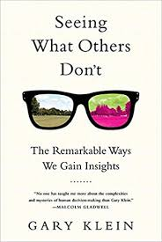
Strategies to Mitigate Bias
Performance Improvement (PI) means reducing errors and increasing insights.
Overemphasis on safety can impede insight.
Overemphasis on safety, especially with unvalidated methods can impede innovation (see Merton’s Law).
Notes:
So there is a strong current of literature that humans are not very rationale or compentent and that we need computer systems to monitor and guide us., to use technology to “overcome” human errors. Gary Klein has a different perspective

Slide 27
Uncovering Bias in Artificial Intelligence
Conclusions:
“To err is human”
What we don’t know can hurt us.
Bias can be mitigated
IRBs will hold an important role in minimizing bias
IRBs should be mindful of the Dunning-Kruger effect, McNamara Fallacy, and balancing safety and innovation.

Slide 28
Uncovering Bias in Artificial Intelligence
Thoughts, Comments, Questions?
Thank you
jrwindle@unmc.edu

