Slide 1
Limits on the Payment of Human Subjects: Are they needed?
Joseph S Brown PhD
University of Nebraska Omaha

Slide 2
Special Thanks to:
Emily A. Largent, JD, PhD, RN
Department of Medical Ethics and Health Policy
University of Pennsylvania Perelman School of Medicine

Slide 3
Things we agree on:
The IRB has, as a primary mission, the role of protecting human subjects.
Among the many regulatory and ethical considerations supporting the protection, is the requirement that informed consent be free of coercion or undue influence
Collectively, research (at least when properly reviewed) constitutes a public good.
Although any particular study only presents the potential for benefit, collectively the public benefit is clear.

Slide 4
Collectively (again), clinical research (at least) creates benefits to subjects
Either through a beneficial intervention
Or through increased access to care

Slide 5
Thus, although the IRB’s primary duty is to the subjects, they also have a duty to the research endeavor.
Further, given the potential benefits to subjects and the public nature of the research endeavor, subjects may have a right to participate in research they deem beneficial.
So, IRB’s have not only an obligation to minimize obstructions to research, but an obligation to expand access to that research.

Slide 6
Payment as a way to increase participation:
Note that we are speaking of payment not reimbursement.
Reimbursement for actual expenses (at least in principle) allows a greater range of participants by removing a barrier to participation
It also seems to lack the features that lead to concerns of undue inducement.
We also note that payment does not serve as a coercive factor (in that it neither affirmatively (force) or passively (withholding critical care to force participation) mandates participation (e.g. Wertheimer & Miller, 2008)
It works. Some of this will be seen in Dustin's data, but if it didn’t work commercial sponsors would forgo the expense

Slide 7
Concerns:
High Payments might influence subjects’ willingness to report things that might prevent participation or end participation. (e.g., conditions that effect eligibility or protocol violations)
High Payments might commodify participation and lower protections (“They knew the risks and they got paid”) (e.g., Macklin, 1989)
High payments might induce subjects to take risks they might not otherwise take (that is, participate in studies they would otherwise consider too risky)
Of course they might, but is this a problem?
Emmanuel (2005) argues that with the IRB review comes a favorable risk benefit ratio, it precludes subjects taking an inappropriate risk.
However, risk assessment may be highly individual and may change over the course of a study.

Slide 8
High payments might induce an unjust situation in which those of lower means are affected more by inducements. Thus, the poor might assume a greater share of research risks
This might be seen as particularly problematic given income-based health disparities.

Slide 9
Undue & Unjust Inducements: What does the data say?
Dustin Krutsinger M.D., M.S.
University of Nebraska Medical Center
2023 Protection of Human Subjects Conference
“Limits on the payment of subjects: Are they needed?
Omaha, Nebraska
September 15, 2023

Slide 10
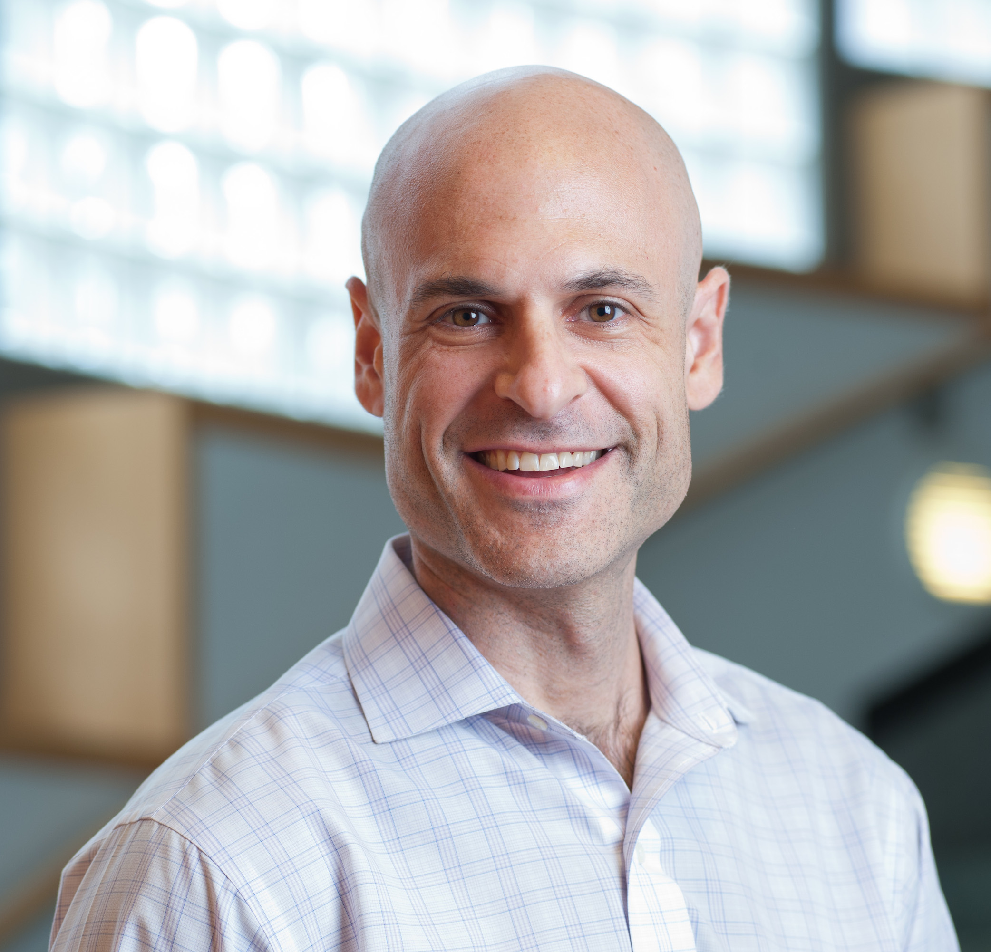
Scott D. Halpern, M.D., Ph.D.
University of Pennsylvania
John M. Eisenberg Professor of Medicine, Epidemiology, and Medical Ethics & Health Policy
Director, Palliative and Advanced Illness Research (PAIR) Center
Director, Behavioral Economics to Transform Trial Enrollment Representativeness (BETTER) Center
Dustin Krutsinger, M.D., M.S.
University of Nebraska
Associate Professor of Medicine
Division of Pulmonary, Critical Care & Sleep Medicine
Surrogate decision making for critical care trial enrollment
Non-financial nudges to encourage enrollment
Disparities in critical care trial participation
Financial incentives for research participation, undue & unjust inducement
Majority of slides courtesy of Scott Halpern MD PhD
Notes:
This slide is to acknowledge that many of the slides in my presentation today are courtesy of Scott Halpern. Dr. Halpern is a Professor of Medicine at the University of Pennsylvania and has been a mentor of mine for the past 7 years. One of his many research interests is on financial incentives for research participation. He has conducted multiple studies in this area, several of which I served as a collaborator.

Slide 11
Pay beyond compensation
Incentivize
Compensates for Risk
Communicates Value
Justice
Notes:
We’ve outlined our agreement. That participants should be compensated for any expenses they incur, such as gas, lodging, and time away from work. However, I propose we go a step beyond. We pay beyond simple compensation.
Incentivizes: encourages enrollment
Compensates for risk: we pay people extra for risky professions, firefighters, surrogate pregnancy, investments (high risk, high reward)
Communicates value: “I have something you need, I am the data”
Justice: everyone else in the research pipeline gets paid, why not the most important person, the participant?

Slide 12
Genuine concerns with payment
Payment may be an undue inducement
Payment may be an unjust inducement
Notes:
Two primary concerns with paying people to participate in research, undue and unjust inducement.
Undue inducement is the concern that in the face of payment, participants may become blinded to the risks involved.
Unjust inducement is the concern that payment may disproportionately influence the enrollment decisions of those less well off financially. If this does occur and payment became a widespread practice, there would be risk of producing a research class, where poor individuals would be exposed to the risk of research participation while the rich would reap the benefits.

Slide 13
Incentives for RCTs: Undue inducement?
Payment:
p = 0.001
Payment-by-risk interaction:
p = 0.12
Halpern et al, Arch Intern Med 2004
Notes:
One of Scott’s earliest studies was specifically designed to evaluate undue and unjust inducement.
He approached patients being seen for high blood pressure. He presented them with 9 hypothetical trials and asked them if they would be willing to participate.
The 9 studies were randomly presented and had two variables which were different in each scenario.
The first was the amount of compensation participants would receive, $100, $1000, or $2000
The second was the amount of risk involved in participating. The risk was described as a 10%, 20%, or 30% chance of experiencing side effects, such as vomiting.
He also collected demographic information, including income. With this information he was able to empirically evaluate undue and unjust inducement.
Results: As expected, participants’ willingness to participate decreased as risk increased and their willingness to participate was higher at any given risk as the payment was increased.
There was no significant interaction between payment and risk, thus no undue inducement. You can see this visually, as the slope is very similar regardless of the amount of compensation offered.

Slide 14
Incentives for RCTs: Unjust inducement?
Payment-by-income interaction:
p = 0.09
Halpern et al, Arch Intern Med 2004
Notes:
Unjust Inducement Results: As expected, as payment increased so did people’s willingness to participate, regardless of income, but were poor individuals unjustly induced? The payment-by-income interaction was not significant but some may be concerned about a trend towards significance at 0.09. Let’s look at the figure. We actually see, if there is a trend, that in the face of increasing payment, the effect of the payment was less influential among poorer patients. This is the opposite of unjust inducement.

Slide 15
Outcomes: Enrollment & Risk
Halpern et al, JAMA Internal Med, 2021
Notes:
However, that early work was only hypothetical, participants were given scenarios and asked if they would be willing to participate, they were not actually being enrolled in a trial.
Fast forward about 15 years and we now have the opportunity to evaluate financial incentives embedded within two actual trials. The Retain trial was a randomized trial of offering different incentive amounts to enroll into a parent trial. One was a smoking cessation trial the other an ambulation trial for hospitalized patients.
Here are the outcomes in each trial, smoking trial on the left, ambulation trial on the right.
In the smoking trial, as payment increased, the enrollment rate increased.
However, in the ambulation trial, payment did NOT increase willingness to participate.
Theories:
- We think that the ”likely explanation is that the benefits of the ambulation trial relative to the risks were perceived to be high, yielding higher baseline consent rates and fewer patients whose decisions could be altered by incentives”
There was no statistical difference in the proportion of participants who perceived participation as conferring some risk across payment arms in either trial.

Slide 16
Unjust inducement: income
iOR ≤ 1.21, p = 0.01
iOR ≤ 1.26, p < 0.001
Notes:
In the smoking trial, as expected, as incentives increased, enrollment rate increased, at a similar rate across income levels. Statistically significant for non-inferiority, in other words, no evidence of unjust inducement.
In the ambulation trial, enrollment rate did not increase as incentives increased. It was also statistically significant for non-inferiority, in other words, no evidence of unjust inducement.

Slide 17
Unjust inducement: financial well-being
iOR ≤ 1.17, p = 0.003
iOR ≤ 1.04, p < 0.001
Notes:
Nearly identical findings for the secondary analysis using measures of financial well-being rather than income.

Slide 18
Tests for undue inducement
Primary: incentives will not modify (inverse) relationship between risk perception and enrollment rate by > △
Secondary: incentives will not significantly modify (direct) relationship between favorable research attitudes and enrollment rate
Notes:
The statistics for measures of undue inducement are quite complex, involving non-inferiority measures of effect modification. However, whether we defined undue inducement using risk perception or favorable research attitudes, we saw no evidence of undue inducement in the RETAIN trial.

Slide 19
Ethical benefits of financial incentives?
Communicates value, compensates for risk, justice
Cost & time savings
Emanuel EJ. The costs of conducting clinical research J Clin Oncol 2003
Counter ‘therapeutic misconception’
Dickert N, Grady C. What’s the price of a research subject? N Engl J Med 1999; 341: 198-203.
Closer IRB scrutiny of risks
Emanuel EJ. Undue inducement: Nonsense on stilts? Am J Bioethics 2005; 5: 9-13.
Closer participant scrutiny of risks
Cryder et al. Informative inducement: Study payment as a signal of risk. Soc Sci Med 2010; 70: 455-64
Notes:
Now that we have looked at empiric evaluations of undue and unjust inducement, lets consider some of the potential benefits of financial incentives.
As outlined earlier, compensation communicates value to the participant, compensates them for risk, and is just. From a participant's perspective, everyone else in the research industry are profiting from the research while they are the ones exposed to the risk. Many see this as unjust and could be corrected by fairly compensating participants.
Recruitment represents one of the largest costs involved in running a trial. It is possible that financial incentives increase the speed at which enrollment occurs and actually save money. Science is discovered and disseminated more quickly and research funds which can be used on additional projects.
Financial compensation may counter therapeutic misconception, which occurs when study participants mistake research participation for treatment. People are not paid to take treatments. Thus, receiving payment for participation serves as a signal that this is different, this is not treatment.
Financial compensation may grab the attention of IRBs and their increased scrutiny could improve safety and research protections. If you want an IRB to pay very close attention to the risks involved in trial participation, offer to pay the participants a significant amount of money.
Financial compensation may increase participants scrutiny of risks

Slide 20
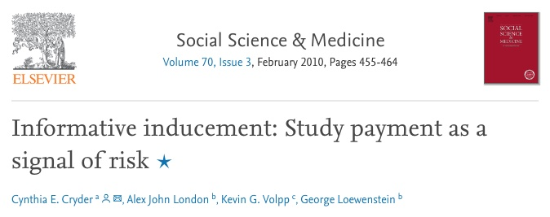
Does the study procedure seem: | Yes | No
More risky than talking on the cell phone while driving?
More risky than receiving the flu vaccine?
More risky than flying on a plane?
More risky than driving 15 mph over the speed limit?
More risky than taking 3 times the recommended dose of a pain killer?
More risky than receiving stitches?
More risky than riding a motorcycle with no helmet?
More risky than getting a body piercing?
More risky than bungee jumping?
Riskiness ratings
$25: 2 (0 – 4)
$1000: 3 (1 – 5)
p < 0.05
Cryder et al, Soc Sci Med, 2010
Notes:
Dr. Cryder and colleagues conducted an online study asked individuals to consider a hypothetical research study involving Transcranial Magnetic Stimulation, a procedure that places a magnet upon the scalp that interferes with brain activity. They chose this intervention because it is more intrusive and poses more uncertain risk than other common procedures.
Participants were randomly assigned to view one of two web pages that informed them of the research study. The only difference was that some were told that the study paid $25, while other were told it paid $1000.
They were then asked to evaluate how risky the study was, using a comparative risk scale. The comparative risk scale asks if the study procedure seems more risky than 9 activities of which the participant probably has more familiarity with than Transcranial Magnetic Stimulation.
Those who were told the study paid $1000, perceived the risk as higher. Payment signaled risk.

Slide 21
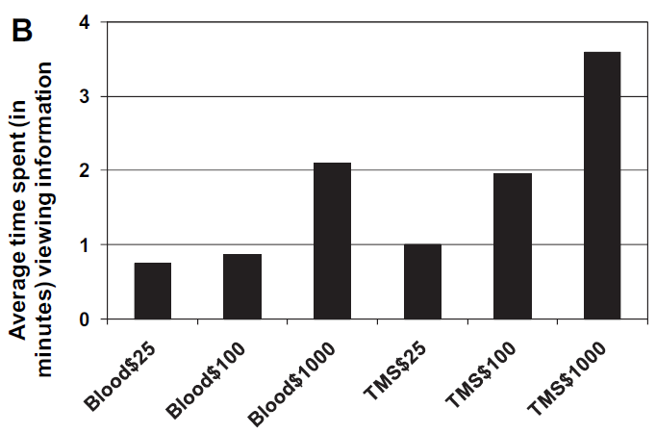
Higher incentives are associated with greater information seeking
Cryder et al, Soc Sci Med, 2010
Notes:
They conducted another online study where participants were randomized to view one of six pages. Half were asked to consider a study which involves a blood draw, half again transcranial magnetic stimulation. Payment was also randomized at $25, $100, and $1000. This time they measured how long they spent viewing the study details.
They found that as the payment amount increased, so did the time participants spent reviewing details.
Suggests that incentives can promote, rather than undermine, autonomy.

Slide 22
Ethical benefits of financial incentives?
Communicates value, compensates for risk, justice
Cost savings
Emanuel EJ. The costs of conducting clinical research J Clin Oncol 2003
Counter ‘therapeutic misconception’
Dickert N, Grady C. What’s the price of a research subject? N Engl J Med 1999; 341: 198-203.
Closer IRB scrutiny of risks
Emanuel EJ. Undue inducement: Nonsense on stilts? Am J Bioethics 2005; 5: 9-13.
Closer participant scrutiny of risks
Cryder et al. Informative inducement: Study payment as a signal of risk. Soc Sci Med 2010; 70: 455-64
Incentives MAY improve enrollment diversity
Unpublished data
Notes:
Lastly, incentives may improve enrollment diversity

Slide 23
Incentives may improve enrollment diversity
Incentive | Black patients | White patients
$0 | 17% | 30%
$200 | 36% | 36%
$500 | 46% | 49%
Notes:
In the tobacco cessation RETAIN trial, as the incentive amount increased, the difference in enrollment rates between black and white patients narrowed.
This is unpublished data and was not part of the original analysis plan. This requires much more investigation.
However, if this is replicated and holds true, then incentives may be a key tool to improving disparities in research participation.

Slide 24
Conclusions
Incentives work for some, but not all trials
Data on undue & unjust inducement are reassuring so far, but need evaluated in more trials with higher risk
With ethical concerns not yet manifesting, and real benefits to compensation, it may be time to shift the burden of proof to those who would bar incentives

Slide 25
UNMC/UNO IRB policies:
Policies apply to greater than minimal risk studies. The area of greatest concern here is that subjects might take inappropriate risks. In addition to the IRB review of risk benefit ration, the determination that the risks are minimal minimizes this concern.
Reimbursement is encouraged as is payment of subjects. This allows maximum participation and avoiding concerns that money would prevent participation for some.
Payments are capped at $20 per hr. This is based on a wage replacement model. This payment is seen as roughly equivalent of what a subject could earn outside of research. This minimizes concerns of “undue” inducement as subject could earn this money with alternative employment.

