Slide 1
Personal Narrative and Research Ethics
UNMC, September 2023
Gianna McMillan, D. Bioethics, MFA
Bioethics Institute at Loyola Marymount University

Slide 2
My experience with narrative
IRB stories about COVID Research
Analysis and reflection

Slide 3
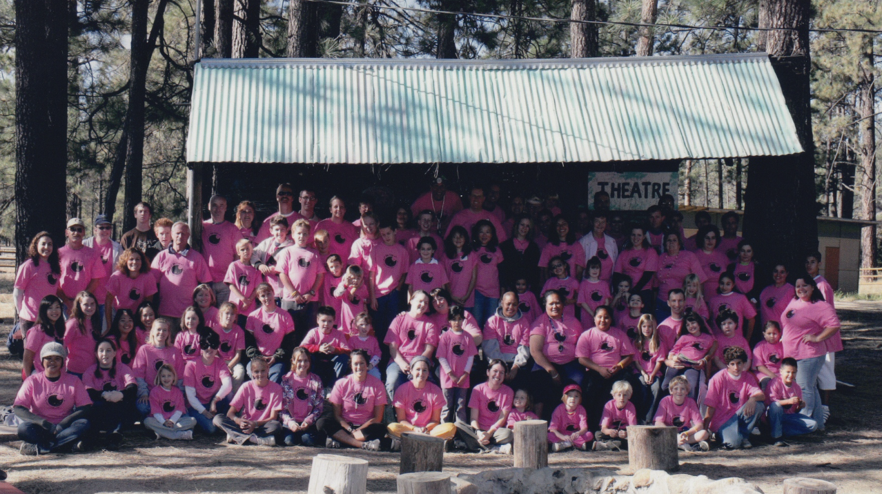
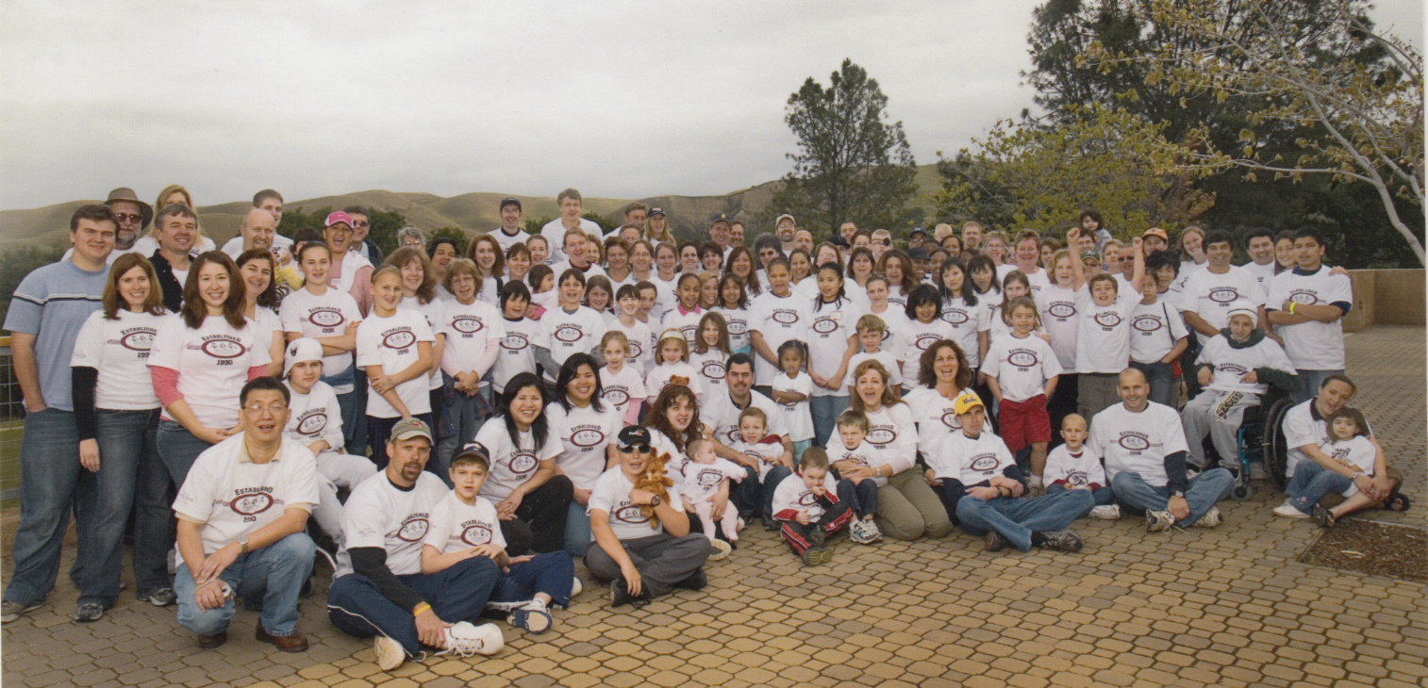

Slide 4
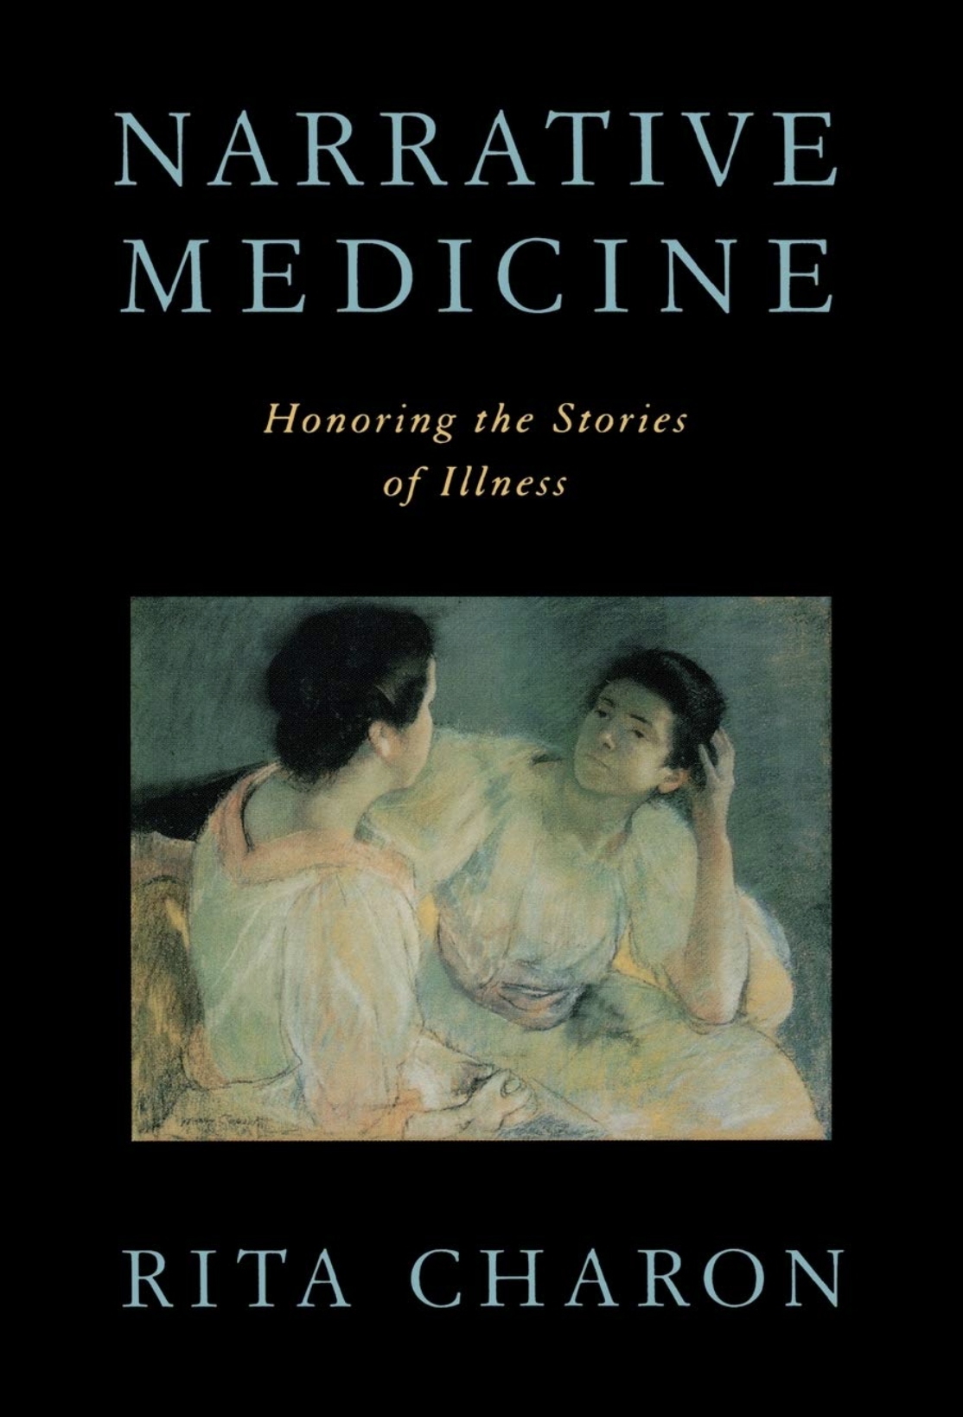
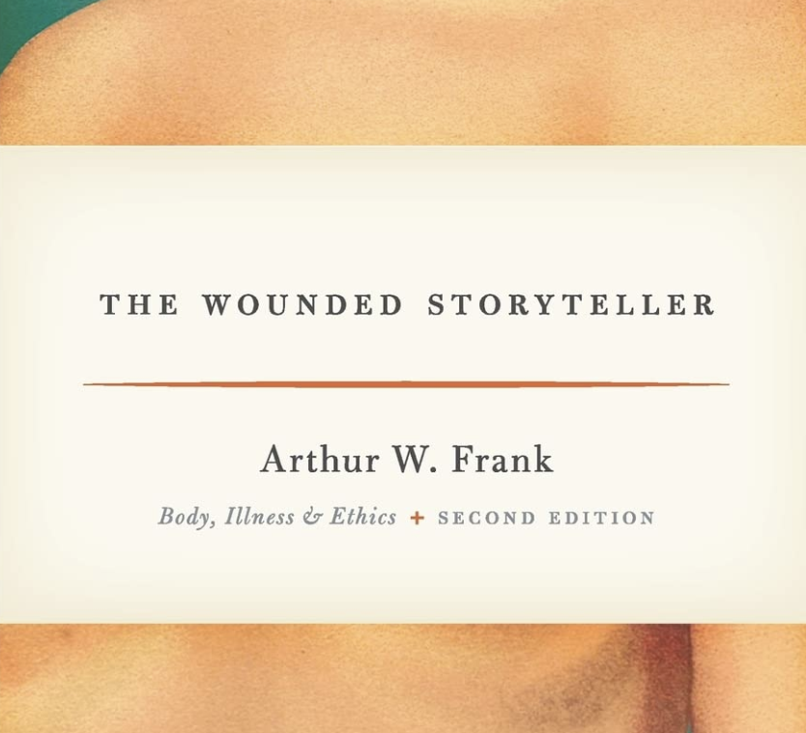

Slide 5
Categories of Health Narratives

Slide 6
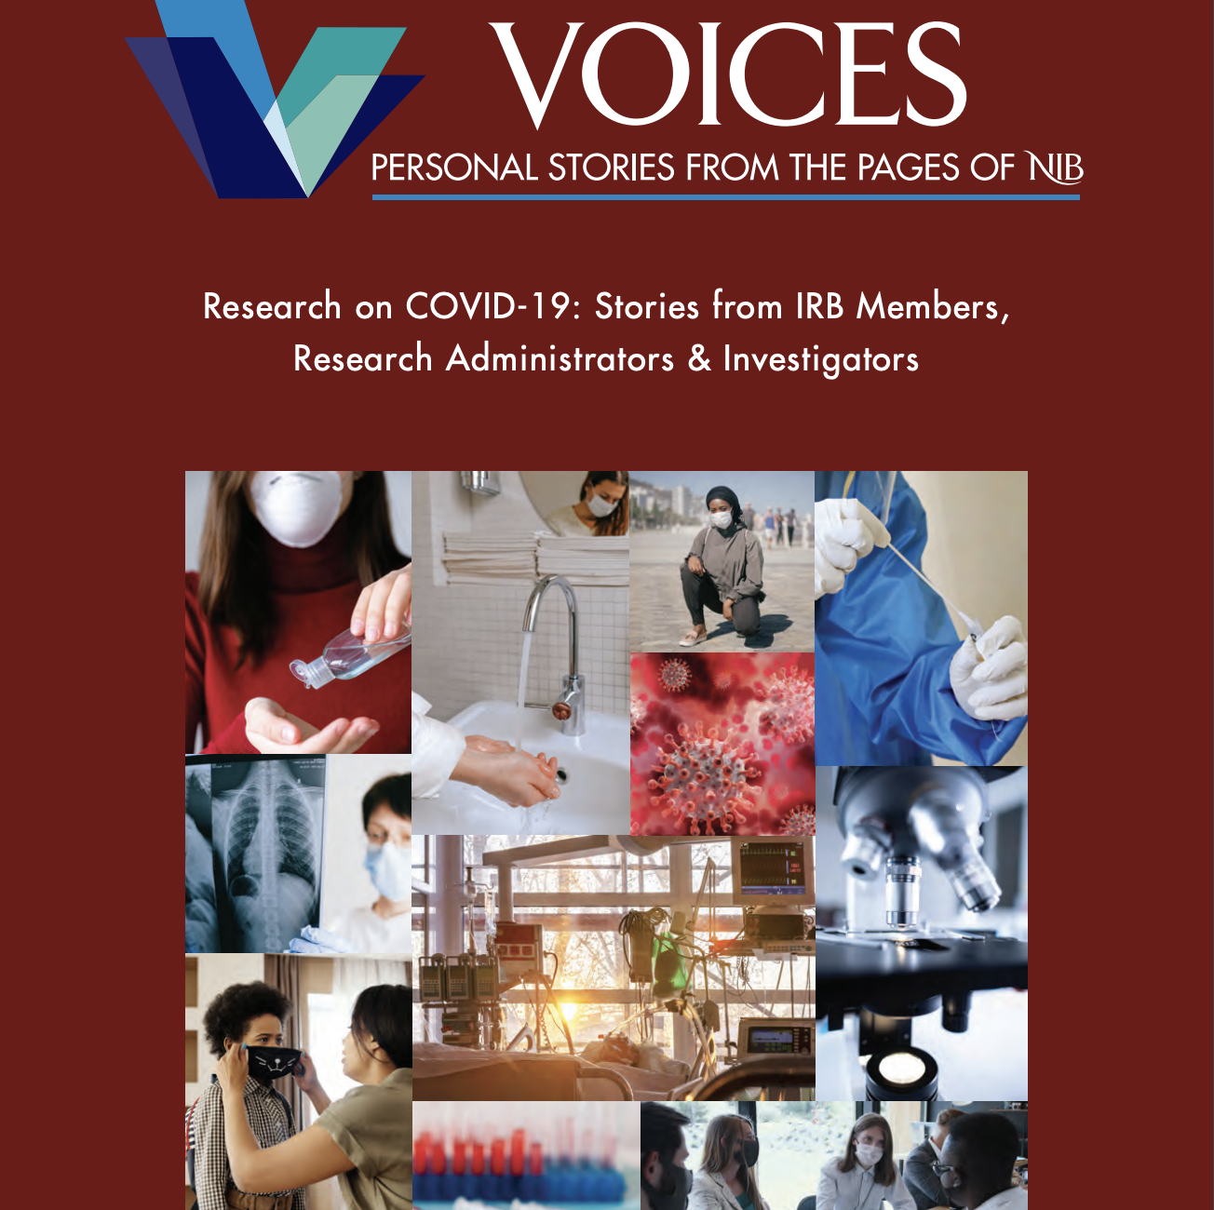
Narrative Inquiry in Bioethics
Personal stories about health care issues and commentaries by experts in relevant fields that discuss bioethical themes woven throughout the collection.
https://nibjournal.org/voices/research-on-covid19/

Slide 7
Walter Dehority – IRB Chair “…panicked physicians, patients and media outlets turned to the research community for answers – desperately hoping for cures, vaccines, and preventative measures…” “… a drowning person will reach for any lifeline thrown their way, whether or not that line is secure.”
Edith Paal – IRB Director
Our standard practice, when emergencies hit, is to allow ourselves about 8 seconds to panic. Then, once that is out of our system, we settle into work. …COVID, we now know, merited a bit more than 8 seconds of panic…”
Stefanie Juell – Assoc. Director of IRB Education and Compliance
“…staff members were on the verge of tears…some even considered quitting because these(mostly women) truly felt their lives were at stake because they were physically present in the office.”

Slide 8
Gabrielle Rebillard – HRPP Director
“I got pulled into countless meetings about closing the University on a temporary and then semi-permanent basis. This morphed into committees and sub-committees about “ramping down” and “ramping up” research.
Walter Dehority
“We wanted to act… but did the medical community really need 104 national trials of hydroxychloroquine that April (all presumably IRB approved, two from our institution), many of which were single-site, underpowered, or uncontrolled studies?”
Sara Griffin – IRB Manager
Most of the dilemmas I faced while reviewing COVID-related studies was the seemingly endless overlapping of research.”
Hallie Kassan – HSP Director
“We needed time rapid turnaround… The struggle was giving IRB members enough time to perform an adequate review.”

Slide 9
Jennifer Randles - IRB Chair “The pandemic reinforced deeply entrenched research inequalities… but also presents an opportunity to consider the benefits, risks and trade-offs of virtual data collection.” “Respect for personhood, beneficence, and justice are collective promises that reflect our core humanity.” “COIVID … required researchers to reassess the unique physical, psychosocial, emotional, social, and identity risks to human subjects… these risks were and are still largely unknown.
Stefanie Juell
“…I could not allow myself to succumb to the pressure of desperation I had to stick to what I knew…”
“Adhere to principles that have always been a guide for your work.”
Gigi McMillan
“… this ‘new situation’ does not mean we need ‘new rules.’ The old rules—our existing tradition of ethical research practice—are still valid … The answer is not to invent new strategies, but to wield, with confidence, the tools that have already stood us good stead.”

Slide 10
Narrative Analysis
Contagious
virus-public panic-the need for vaccine-minimal data-challenges balancing ethical practice with compelling need
Plot
Setting
“Our conference rooms had been turned into hospital rooms…”
“To whom did I owe my loyalty?”
“I wept as my students and I discussed the suffering that would likely ensue…”
Conflict
Characters
Board members-
IRB staff-the media-patients-Institutional Officials-investigators-the public-our families
“We created a running list of pandemic research FAQs…”
Resolutions

Slide 11
Analyze
Consider
Discuss
Feel
Reflect
Share
Appreciate
Envision
Plan
Protagonists
HEROES

Slide 12
We use the cognitive and emotional components of story to process events and make nuanced plans.

