Slide 1
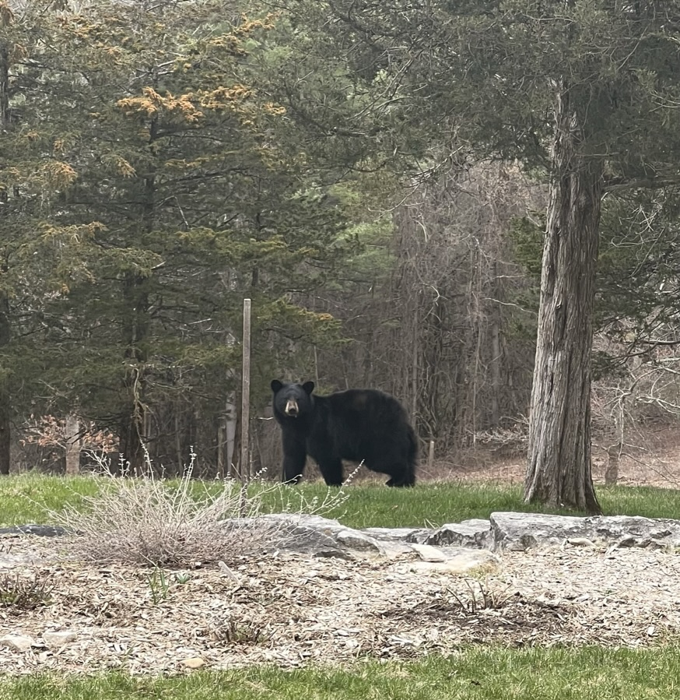
Re-examining the IRB’s Role in Protecting Research Subjects
David H. Strauss, M.D.
Columbia University & MRCT of BWH and Harvard
UNMC IRB Conference
Omaha, Nebraska
September 15, 2023

Slide 2
From an IRB-approved recent consent form:
This new medication has already been studied in 17 people and is generally well tolerated.

Slide 3
Risks to subjects are reasonable in relation to anticipated benefits, if any, to subjects, and the importance of the knowledge that may reasonably be expected to result.
§46.111.2 in Criteria for IRB approval of research.
Notes:
Reasonable to Whom? Notions of what is reasonable have changed over time

Slide 4
Who decides what is reasonable?
(An Overly Cynical Perspective)
A committee of (mostly) career researchers and others in healthcare at institutions whose mission is to advance healthcare and its evidence base and whose business model relies largely on related research funding.
A committee organized by one of only several for-profit entities that now review nearly 50% of all drug studies and are primarily managed by private equity investors?

Slide 5
Institutional Review Boards: Actions Needed to Improve Federal Oversight and Examine Effectiveness*
The Secretary of Health and Human Services should ensure that OHRP and FDA convene stakeholders to examine approaches for measuring IRB effectiveness in protecting human subjects and implement the approaches as appropriate.
These could include effectiveness measures; peer audits of IRB meetings and decisions; mock protocols; surveys of IRB members, investigators, and human research participants; or other approaches.
*GAO-23-104721Published: Jan 17, 2023. Publicly Released: Feb 16, 2023.
Notes:
Here too, can we expect independence

Slide 6
More Cynicism…
How capable of independent judgement are the federal oversight bodies given their reporting structures?
And SACHRP, AAHRPP, PRIMR…given their composition?

Slide 7
OHRP Compliance Actions
Allegations vs. For Cause Compliance Evaluations

Slide 8
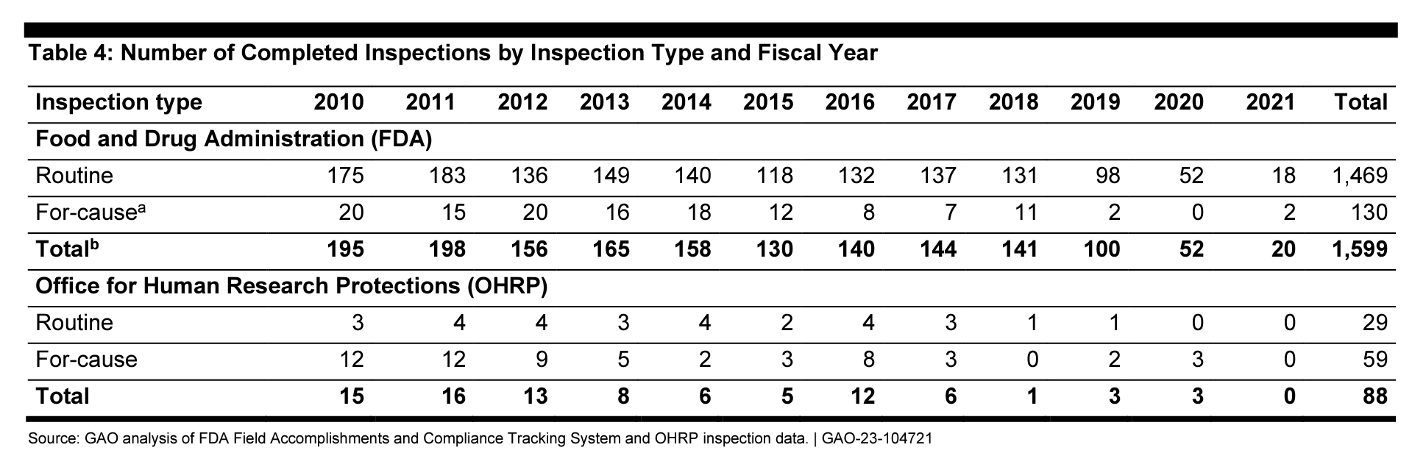

Slide 9
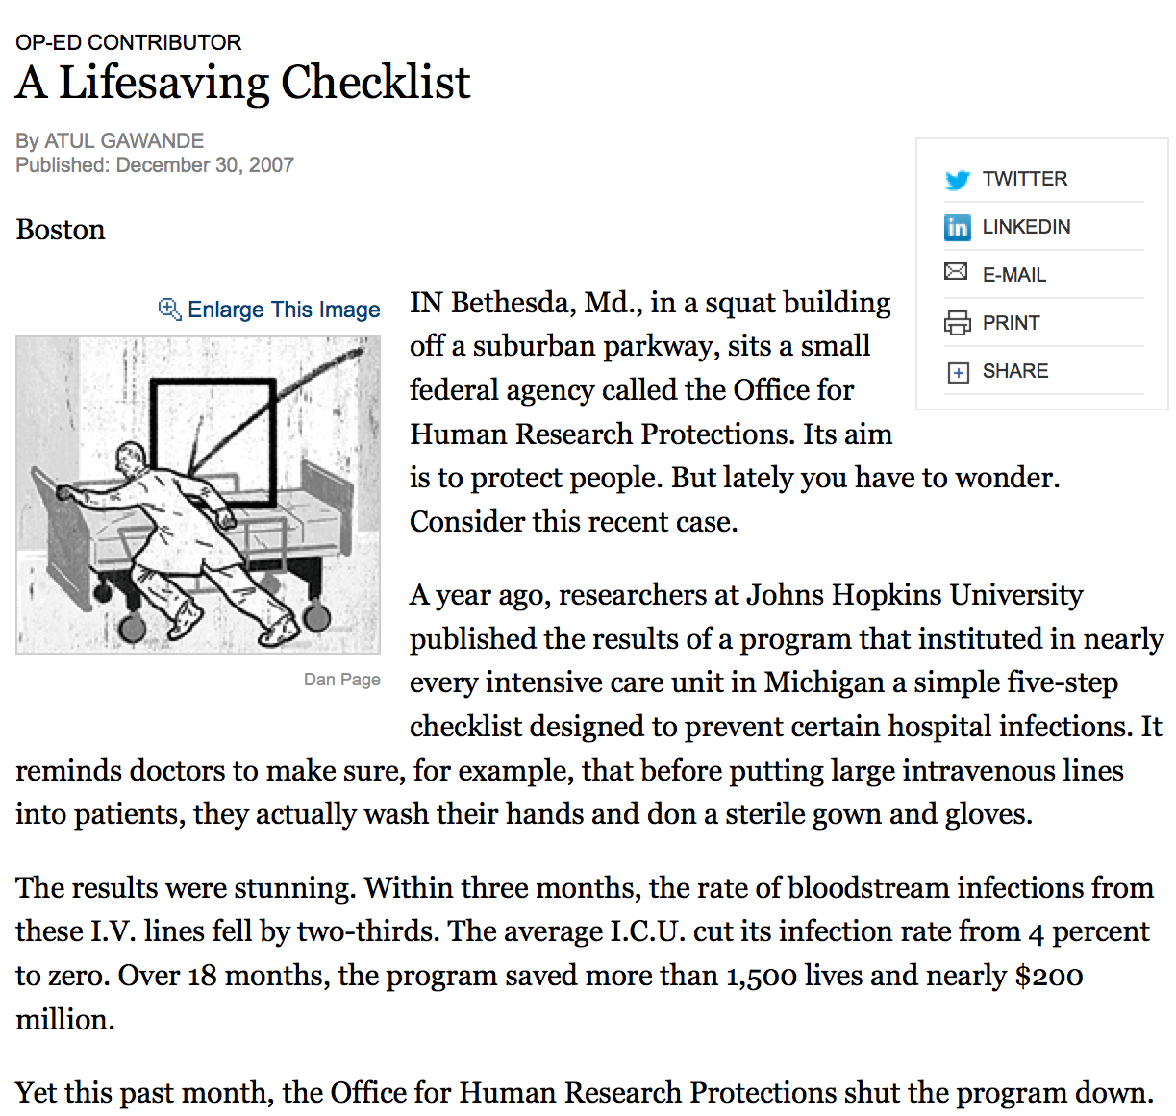
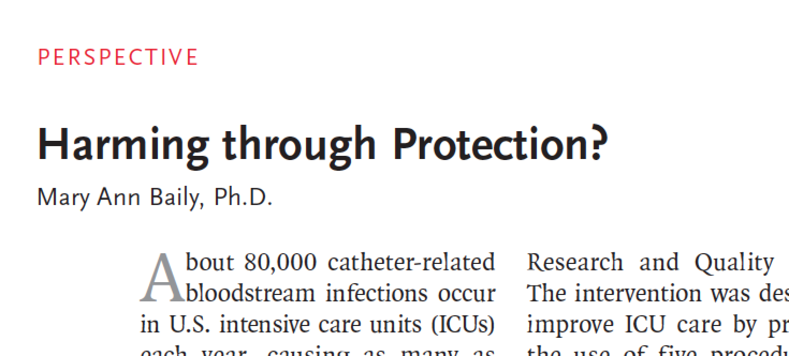

Slide 10
Self-Serving Bias
Self-serving bias is the tendency people have to process information in ways that advance their own self-interest or support their pre-existing views.
Notes:
But not this alone…..

Slide 11

“Self-serving bias”
The empirical literature suggests that self-interest distorts the way that we weigh arguments and make decisions.
We have trouble seeing ourselves as biased when the bias serves our needs or advances our own perceived interests.
Bias is more easily recognized in others
Dana, JAMA 2003
Notes:
One of the reasons that conflict of interest is a difficult topic to discuss is that in general, everyone believes that not not influenced by it—conflict of interest is something that happens to other people.
A study of residents found that while 61% felt that they were not influenced by the marketing effects of pharmaceutical companies, only 16% felt that was true for their colleagues, and other research shows that in general patients are more concerned than their doctors (the good new was, patients are also more likely to think that other peoples doctors are more likely to be biased by such gifts. 1999 chren

Slide 12
“Human experimentation since WWII has created some difficult problems with the increasing employment of patients as experimental subjects when it must have been apparent that they would not have been available if they had been truly aware of the uses that would be made of them.”
Beecher 1966
Notes:
Beecher’s statement that no ordinary patients would agree to be subject to the harms inherent in the 22 cases he details was less an indictment of the consent process (which by the way was lacking), but a statement that no individual would willingly agree to take part in this research because the harms were simply unreasonable...the studies as designed were not ethical.

Slide 13
….we occasionally need to take some blood samples. The blood samples are taken after one test meal which consists of a special breakfast meal containing a certain amount of calcium.
Notes:
How did involving the boys in research align with the childrens’ or their parents’ expectation of the institution’s commitment to them?
With regard to informing the parents and children, does it matter to you how much radioactivity was administered or how low the perceived risk wa?

Slide 14
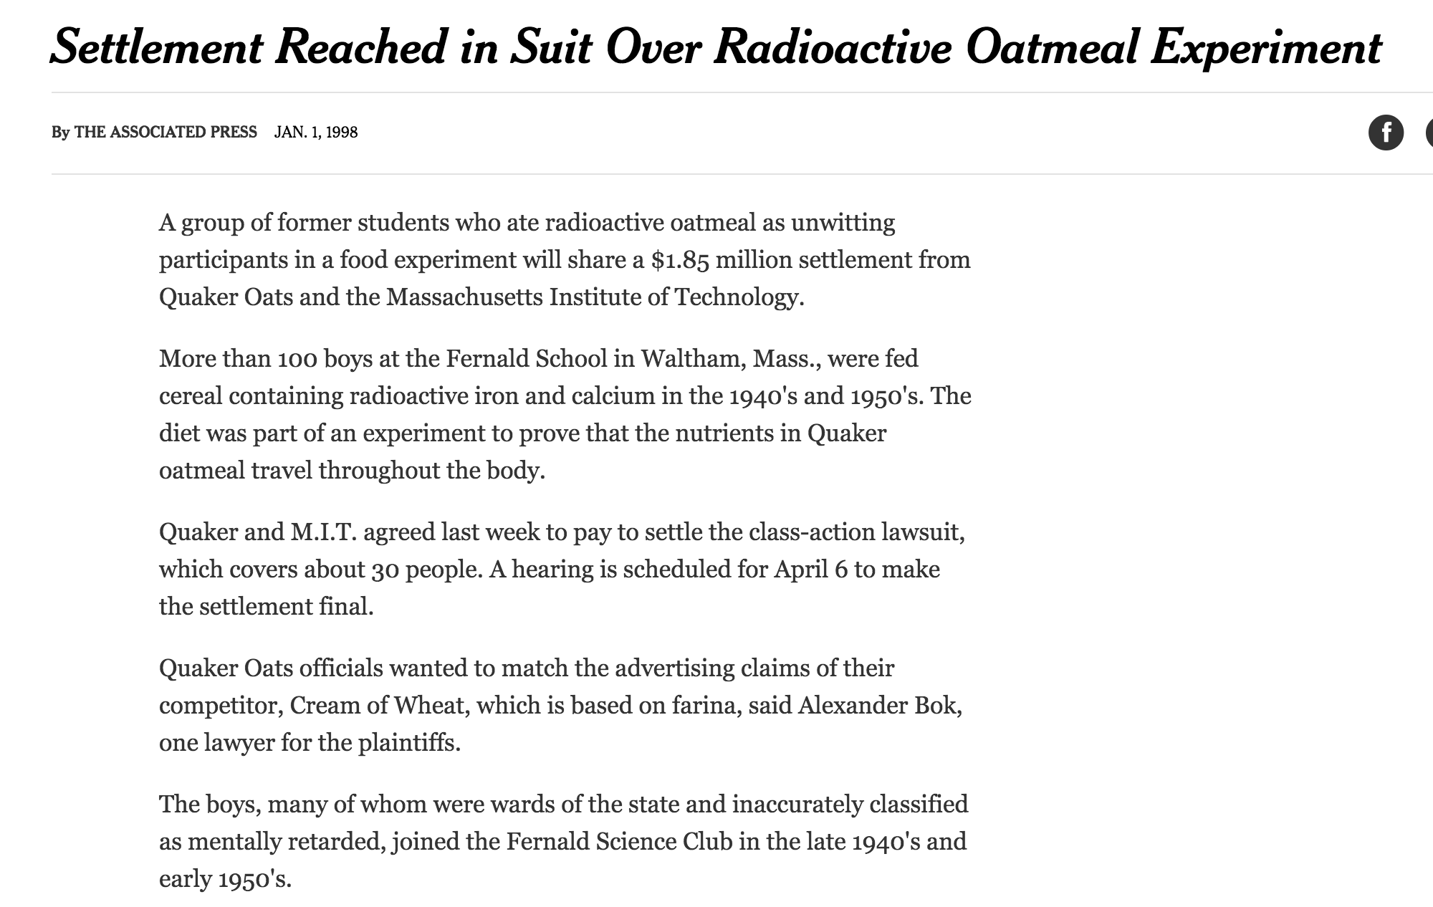
More than 100 boys at the Fernald School in Waltham, Mass., were fed cereal containing radioactive iron and calcium…
Notes:
A group of former students who ate radioactive oatmeal as unwitting participants in a food experiment will share a $1.85 million settlement from Quaker Oats and the Massachusetts Institute of Technology.
More than 100 boys at the Fernald School in Waltham, Mass., were fed cereal containing radioactive iron and calcium in the 1940's and 1950's. The diet was part of an experiment to prove that the nutrients in Quaker oatmeal travel throughout the body.
Quaker and M.I.T. agreed last week to pay to settle the class-action lawsuit, which covers about 30 people. A hearing is scheduled for April 6 to make the settlement final.
Quaker Oats officials wanted to match the advertising claims of their competitor, Cream of Wheat, which is based on farina, said Alexander Bok, one lawyer for the plaintiffs.
The boys, many of whom were wards of the state and inaccurately classified as mentally retarded, joined the Fernald Science Club in the late 1940's and early 1950's.
A $60 million lawsuit was filed in Federal District Court here two years ago asserting that the children were tricked into joining the science club to participate in the experiments. The suit also asserts that some boys were exposed to more radiation than allowed under Federal limits.
M.I.T. said on Tuesday that the exposure to radiation was about equal to the natural background radiation people were exposed to from the environment every year. The university also noted that a state panel in 1994 determined that the students had suffered no significant health effects from the experiment.
The panel did say, however, that the students' civil rights had been violated.
Quaker Oats continues to deny that it played a large role in the experiments. The company donated the cereal and gave a ''small research grant'' to the university, said a Quaker spokesman, Mark Dollins.
Continue reading the main story
TRENDING
Hillary Clinton Appears to Gain Late Momentum on Surge of Latino Voters
2016 Election Forecast: Who Will Be President?
Presidential Election: High Early Turnout Among Latino Voters Could Mean Trouble for Donald Trump
The 2016 Race: Clinton Has Solid Lead in Electoral College; Trump’s Winning Map Is Unclear
Beyoncé’s True Political Statement This Week? It Wasn’t at a Clinton Rally
Op-Ed Columnist: Why This Election Terrifies Me
Latest Election Polls 2016
Opinion: The Men Feminists Left Behind
In 1 Unscripted Moment, Hillary Clinton Finds Joy in the Rain
Op-Ed Contributors: Dalai Lama: Behind Our Anxiety, the Fear of Being Unneeded
View More Trending Stories »

Slide 15
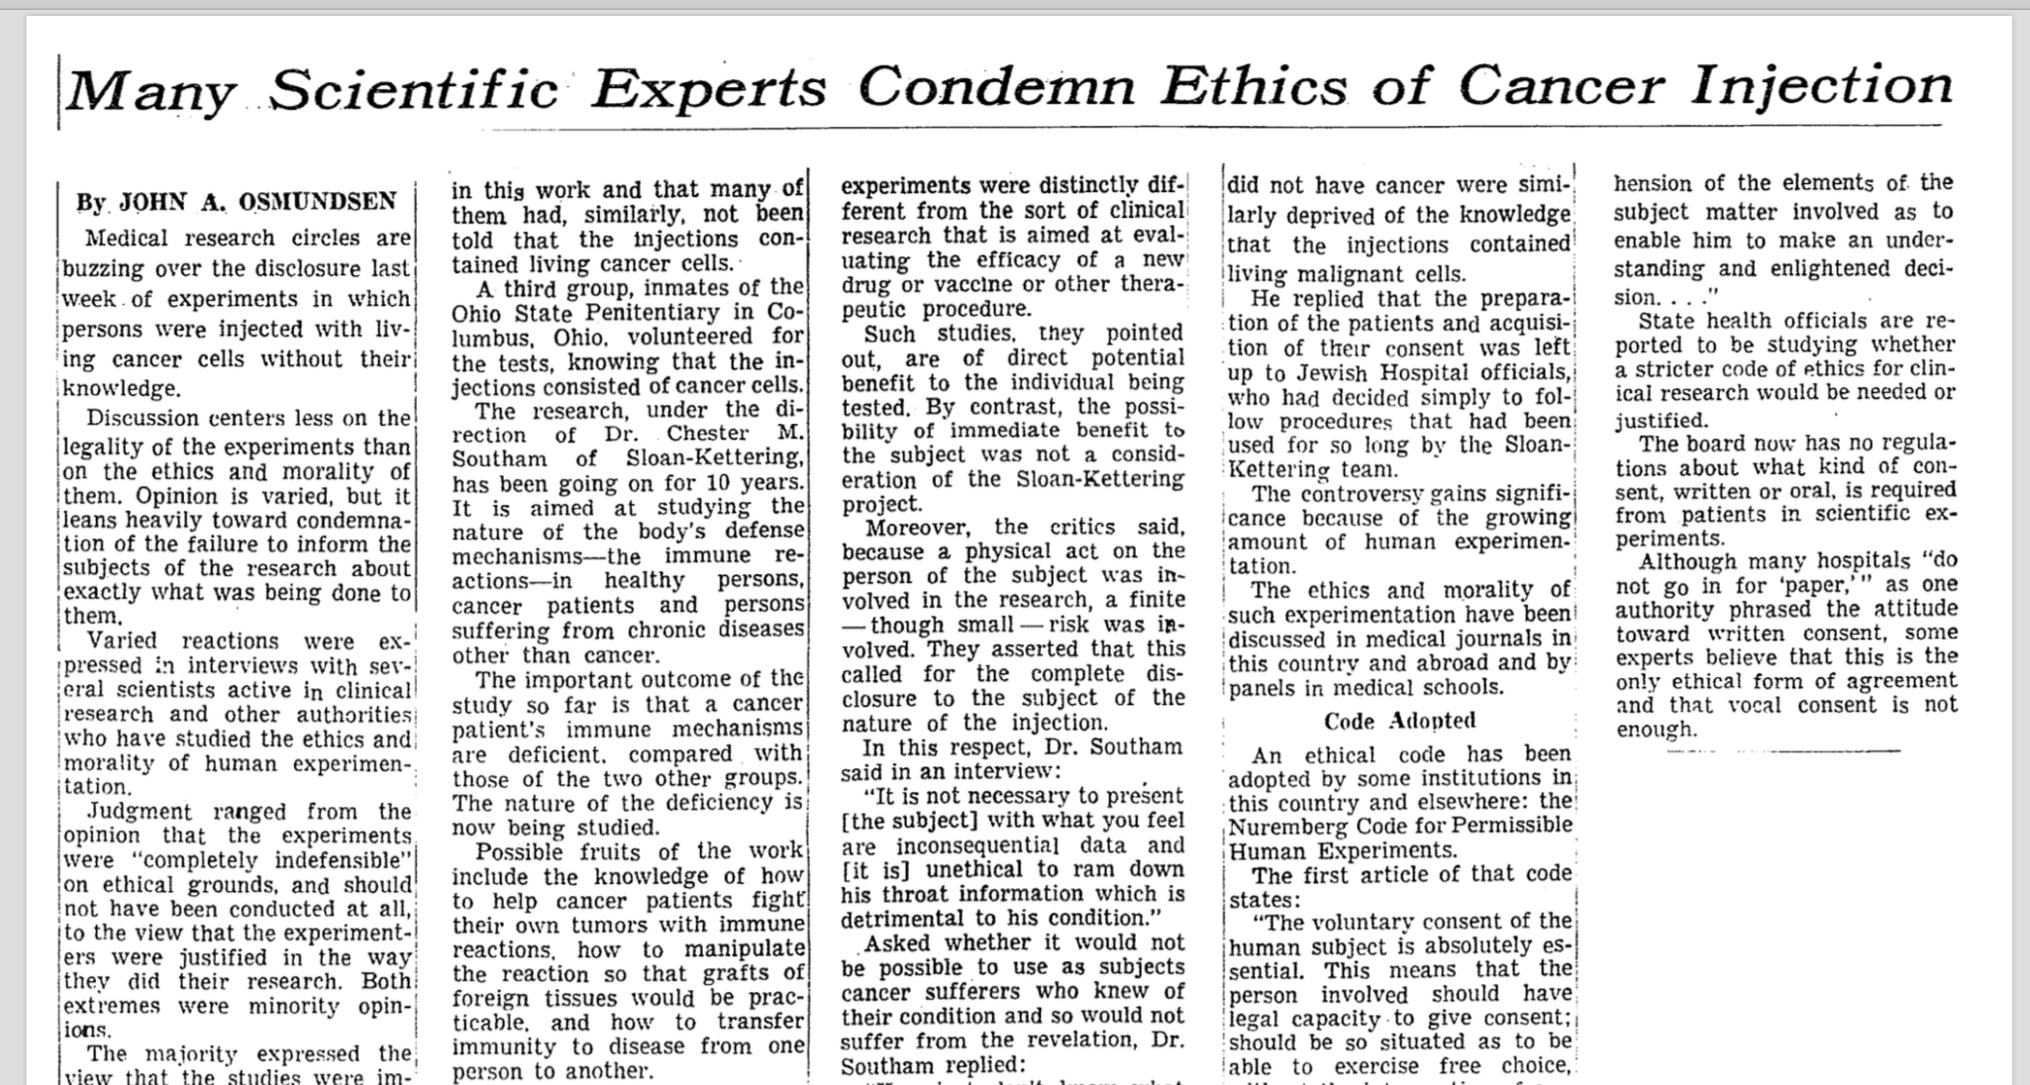
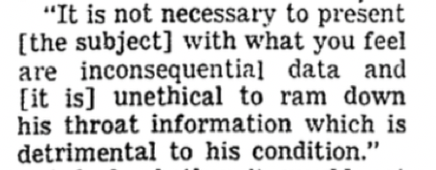

Slide 16
Brooklyn Jewish Chronic Disease Hospital
Regents of the University of the State of New York which found him guilty of fraud, deceit, and unprofessional conduct, and in the end he was placed on probation for a year.
Southam was later elected president of the American Association for Cancer Research
Notes:
Explotation of the vulnerable, the captive and the incompetent
Exposure of people to unreasonable risk as they were not seen as entitled to the same rights as others. Tuskegee.

Slide 17
WHAT WE DON’T KNOW CAN HURT US

Slide 18
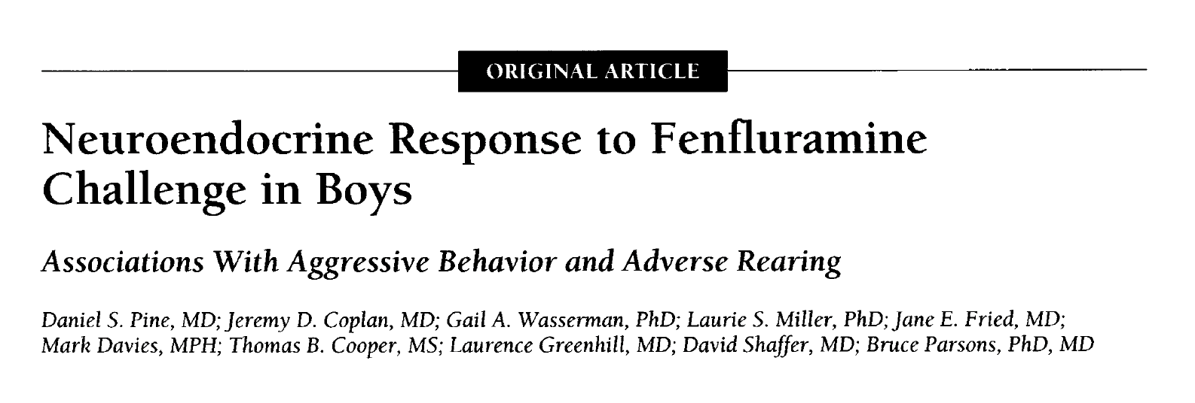
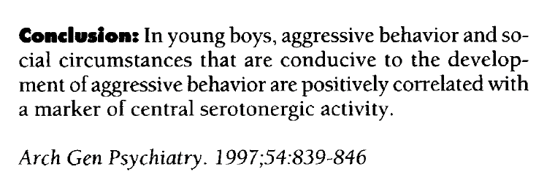
Notes:
Fenflur
amine increases synaptic serotonin levels
by releasing serotonin from nerve termi¬
nals and inhibiting serotonin reuptake.
Increased synaptic serotonin stimulates a
rise in the prolactin level, the magnitude
of which indexes central serotonergic
activity.16

Slide 19
The “fenfluramine study”
Background: evidence of relationships between serotonin levels, aggressive behavior, and childhood hx of socially-adverse rearing conditions.
Subjects: From a population of 126 boys (~8-10 yo) who took part in a study assessing rearing environment and behavior, each with older “delinquent” brothers, 34 were recruited for the fenfluramine challenge study. 44% of the boys were African American, 56% were Latino.
Methods: Following an overnight fast, an intravenous catheter was placed for hourly blood sampling, a single oral dose of fenfluramine was given, and fenfluramine, norfenfluramine, and prolactin levels were quantified.
Notes:
Fenflur¬
amine increases synaptic serotonin levels
by releasing serotonin from nerve termi¬
nals and inhibiting serotonin reuptake.
Increased synaptic serotonin stimulates a
rise in the prolactin level, the magnitude
of which indexes central serotonergic
activity.16

Slide 20
A Perfect Storm
Litigation
Negative Media Attention
A congressional hearing
Condemnation by
  Federal Legislators
  Disability Advocates
  Public
Scrutiny/Investigation by Federal Regulators (OPRR—now “OHRP”)

Slide 21
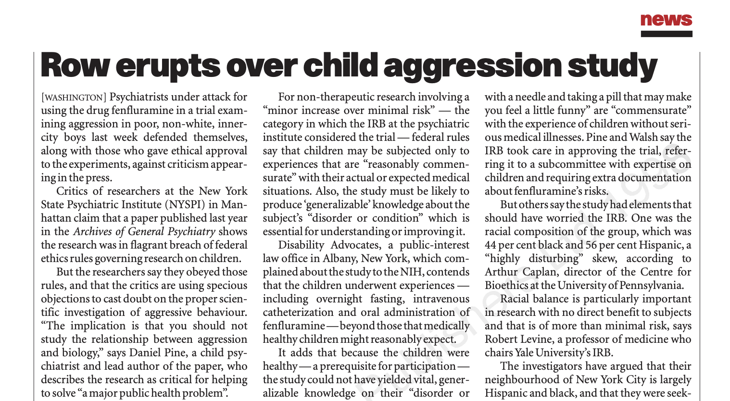
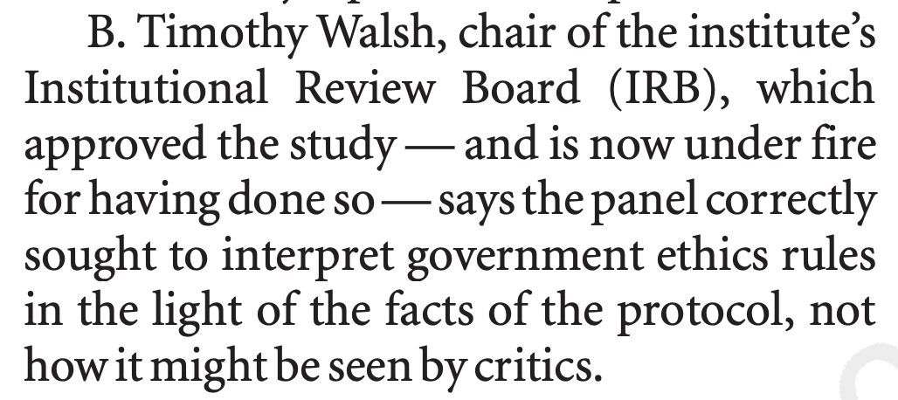
-
Nature 392, 747 (1998).

Slide 22
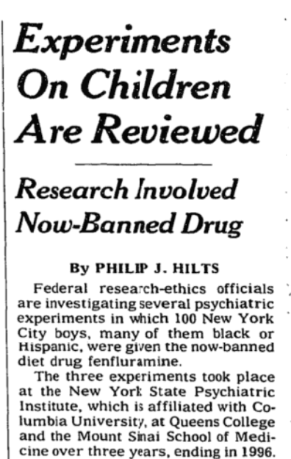
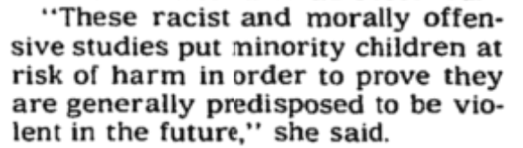

Slide 23
Regulatory Findings
  §46.406 Research involving greater than minimal risk and no prospect of direct benefit to individual subjects, but likely to yield generalizable knowledge about the subject's disorder or condition.
  Minor increase over minimal risk
  The intervention or procedure presents experiences to subjects that are reasonably commensurate with those inherent in their actual or expected medical, dental, psychological, social, or educational situations;
  the intervention or procedure is likely to yield generalizable knowledge about the subjects' disorder or condition which is of vital importance for the understanding or amelioration of the subjects' disorder or condition;
  adequate provisions are made for soliciting assent of the children and permission of their parents or guardians, as set forth in §46.408.
PASS

Slide 24
Category | Outcome
Regulatory Compliance | PASS
Public Perception | FAIL
Fulfillment of Ethical Responsibilities | DEPENDS WHAT YOU MEAN

Slide 25
Harms introduced by the research
Direct harm to subjects related to research procedures
(Group) harm to non-subjects (the communities of color) arising from the study hypothesis and findings
Incomplete disclosure of study purpose during consent

Slide 26
SACHRP on “group harm”
…SACHRP therefore asserts that institutions and investigators have an obligation to consider risks to non-subjects as part of the broad ethical responsibilities of the conduct of human research; this obligation is currently recognized by IRBs and falls within their purview and expertise.
Mar 17, 2022
The Protection of Non-Subjects from Research Harm | HHS.gov

Slide 27
Impact on our IRB Practice
Changes in practice were guided by the principle that some research in a non-representative sample may unnecessarily add risk or stigma to a study population when the population is already burdened, stigmatized, or disadvantaged.
Continued…

Slide 28
Investigators were expected to submit sample demographic information at initial and continuing review.
IRB review examined racial, ethnic, and gender composition of the proposed and accrued study sample.
The IRB considered whether an observed and significant departure from “representative” was scientifically appropriate and ethically justifiable. When it was not, the IRB (and investigator) determined whether alternative or additional recruitment strategies were warranted.

Slide 29
FAST FORWARD

Slide 30
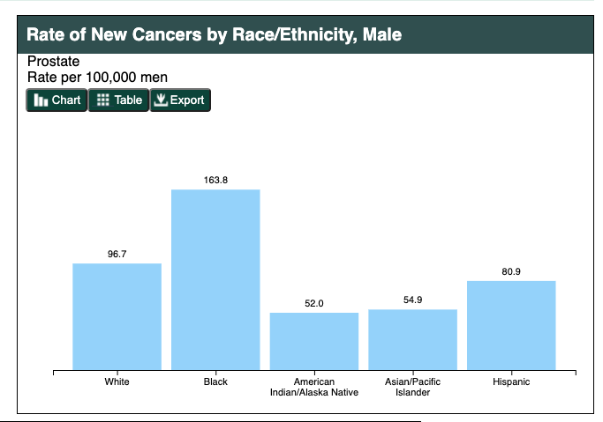
Prostate Cancer (CDC, 2017)
Prostate cancer rates are highest among African-Americans
African-Americans are twice as likely to die from prostate cancer
Increase risk is associated with low SES, unequal access to diagnosis and treatment, and (?) other factors
https://gis.cdc.gov/Cancer/USCS/DataViz.html

Slide 31
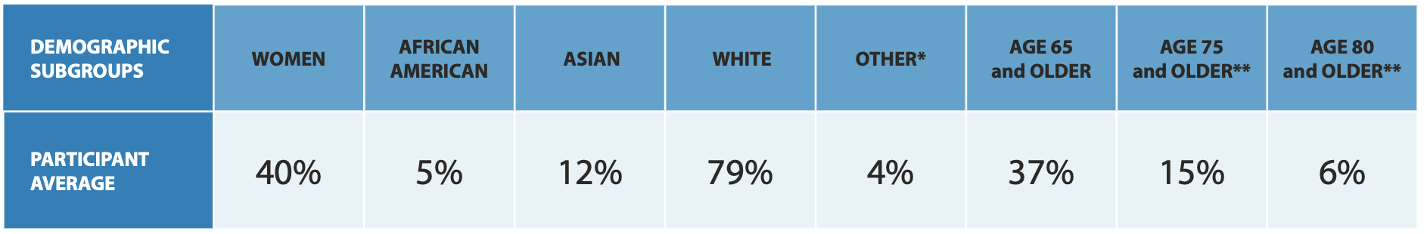
Drug Trial Snapshots: US Food and Drug Administration
In 2015, of 45 novel drugs approved, and with over 105,000 enrolled participants only 5% were African American.
https://www.fda.gov/media/103160/download

Slide 32
Drug Trial Snapshots (2019): US Food and Drug Administration
https://www.fda.gov/media/135337/download

Slide 33
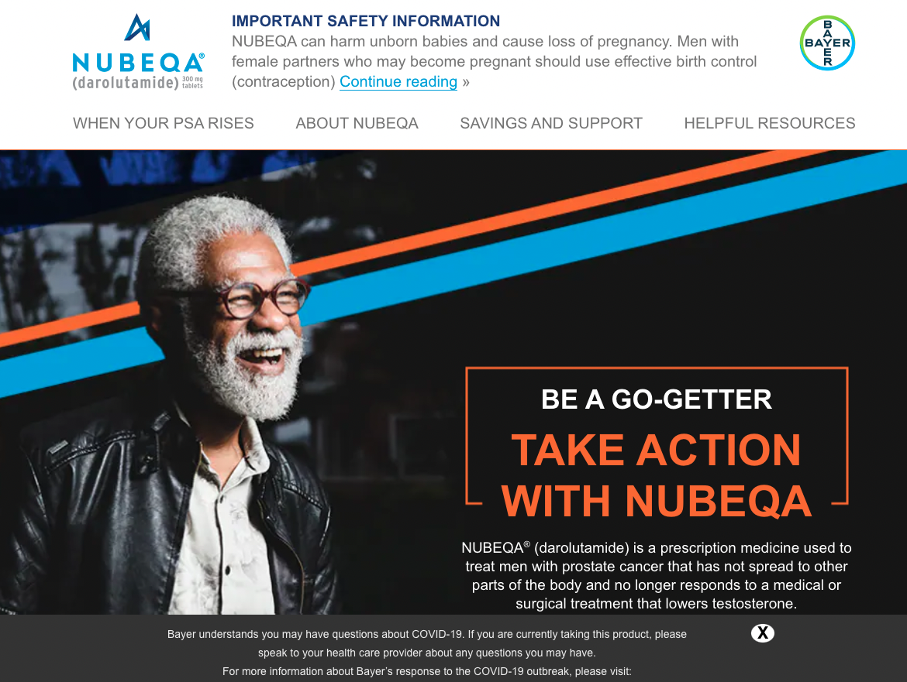

Slide 34
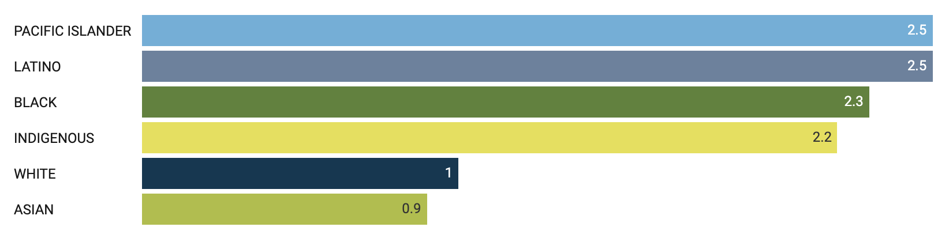
Race and ethnicity widens the gap in mortality compared to Whites from COVID-19 (adjusted for age)
Fold increase
https://www.apmresearchlab.org/covid/deaths-by-race

Slide 35
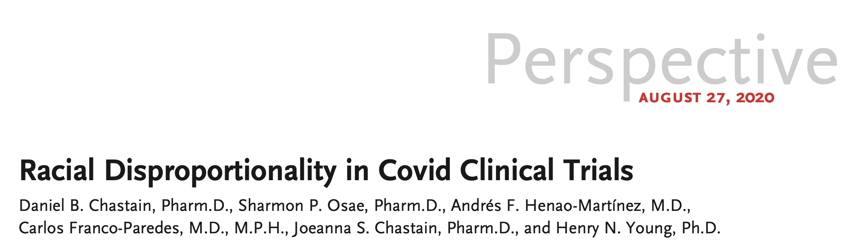

N Engl J Med. 383, e59 10.1056/NEJMp2021971 (2020).

Slide 36
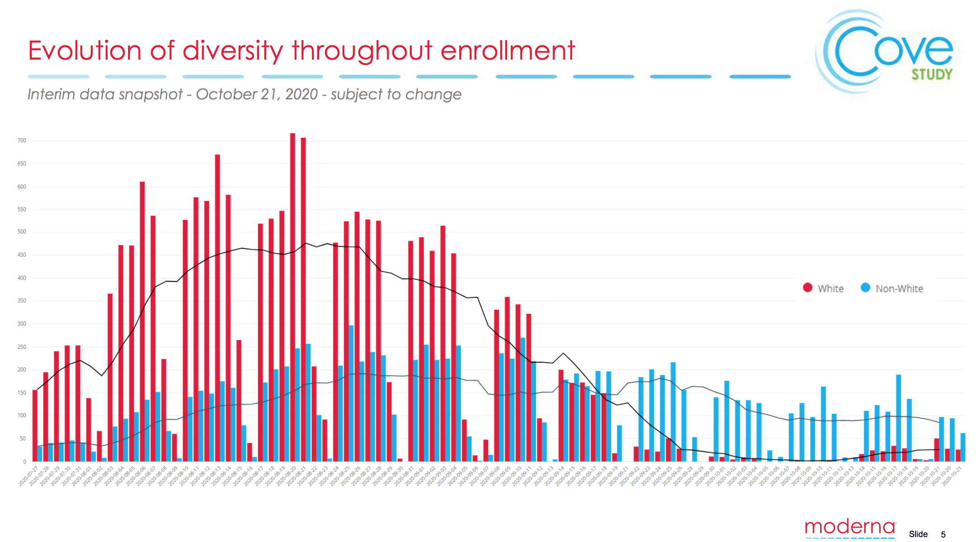
https://www.modernatx.com/sites/default/files/content_documents/2020-COVE-Study-Enrollment-Completion-10.22.20.pdf

Slide 37
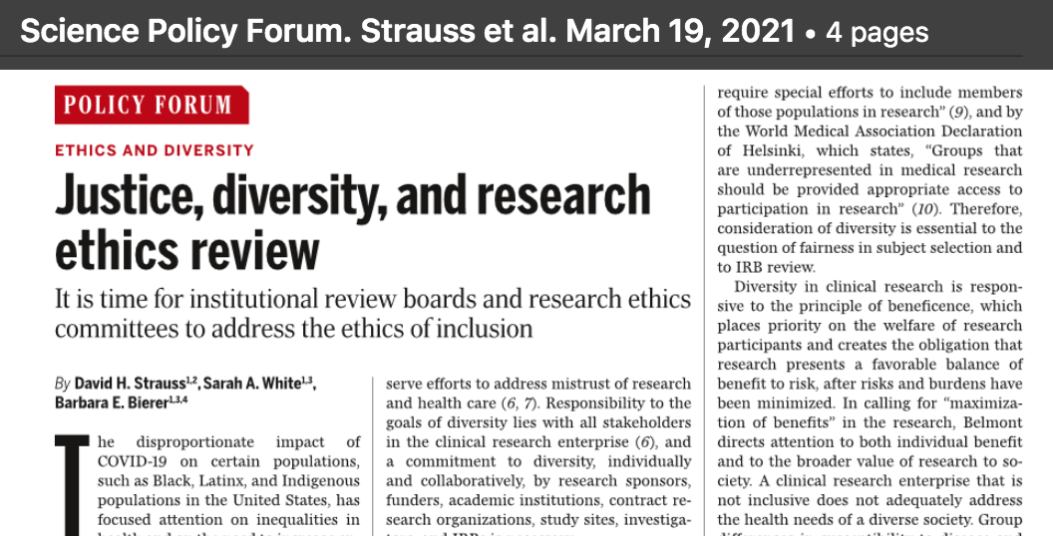


Slide 38
Justice
  “Who ought to receive the benefits of research and bear its burdens? ”
  “…moral requirements that there be fair procedures and outcomes in the selection of research subjects.”
  ”An injustice occurs when some benefit to which a person is entitled is denied without good reason…”
    §46.111 Criteria for IRB approval of research.
      (3) Selection of subjects is equitable.

Slide 39
The importance of inclusion
Analyses of group differences in safety and efficacy among diverse populations can promote identification of both underlying biological factors and socially relevant factors that affect health, the “social determinants of health” (Beneficence)
Fairness in the distribution of the benefits of research (Justice)
Builds public trust (makes us trustworthy)

Slide 40
Diversity and IRB membership
§46.107 IRB membership. The IRB shall be sufficiently qualified through …the diversity of its members, including race, gender, and cultural backgrounds and sensitivity to such issues as community attitudes, to promote respect for its advice and counsel…
Rand (2019)

Slide 41
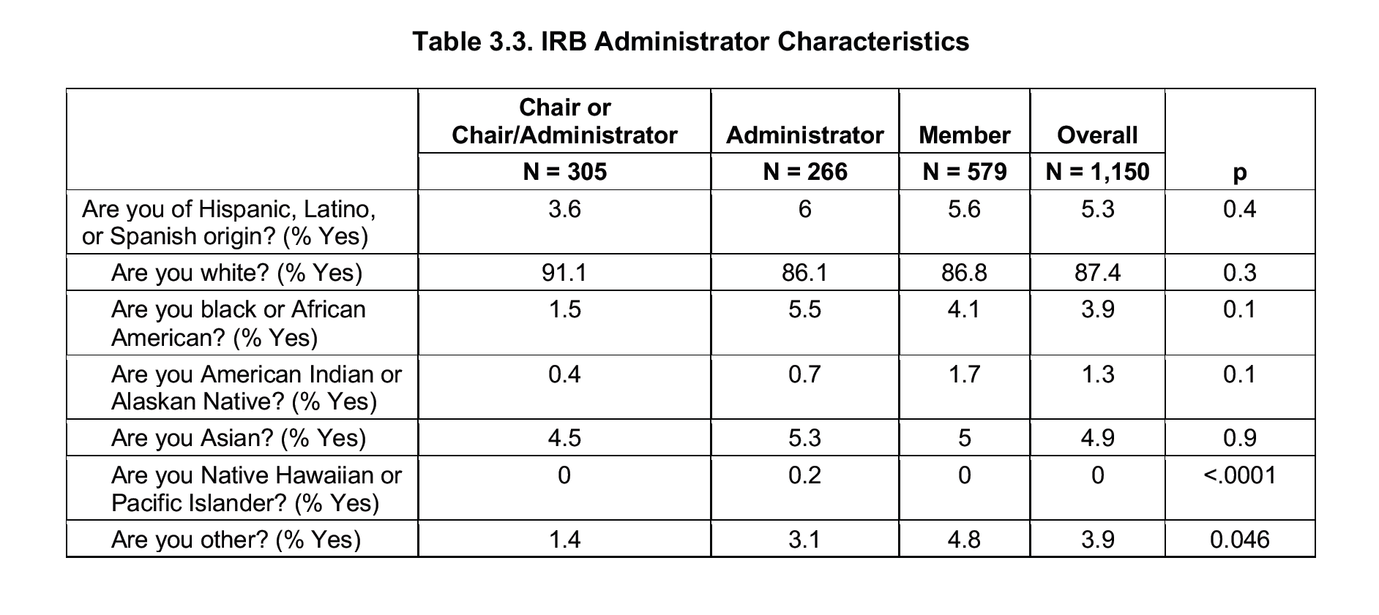

Slide 42
In conclusion
There are limits to our ability to understand the “ethical conduct of research” from the perspective of the subject/participant and the public at large
How can we effectively bring an outside perspective in to the human research protection enterprise?

