Slide 1
Performance Management
The Nuts and Bolts
Carmen Sirizzotti, Associate Director Compensation, Staffing, Records, HRIS & Payroll

Slide 2
Today’s Agenda
Overview of Staff Performance Management
Setting accountabilities, duties, and goals
Developing measures
Ongoing coaching and feedback
How to conduct the annual performance appraisal
Notes:
The Performance Evaluation Policy #1097 (based on BOR) indicates “The University of Nebraska Medical Center requires that management annually evaluate, in writing, the performance of employees.”
Annual online performance evaluations need to be completed by June 15 of every year.
Online Staff Performance Evaluations are housed in UNeVal

Slide 3
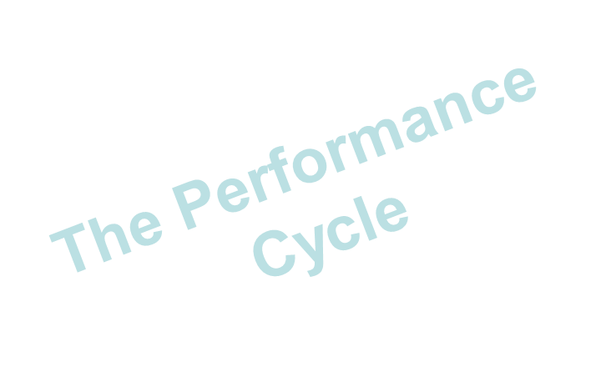
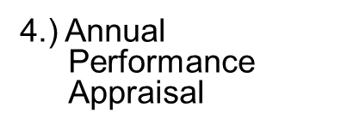
Performance Management Overview

Slide 4
Accountabilities, Duties and Goals

Slide 5
Accountabilities, Duties and Goals

Slide 6
Accountabilities, Duties and Goals

Slide 7
Accountabilities, Duties and Goals
Accountability
Adaptability
Communication
Customer/Quality
Focus
Inclusiveness
Occupational Knowledge/Technology
Orientation
Team Focus
Leadership

Slide 8
Measures

Slide 9
Measures continued…

Slide 10
Ongoing Coaching And Feedback

Slide 11
Ongoing Coaching And Feedback

Slide 12
Annual Performance Appraisal

Slide 13
Annual Performance Appraisal

Slide 14
Annual Performance Appraisal

Slide 15
Writing the appraisal

Slide 16
Promotion
Growth in present assignment (vertical load)
Broadened assignment (horizontal load)
No change in responsibilities
Promotion
Growth in present assignment
No change in responsibilities
Performance correctable
Performance uncorrectable
Review opportunities
Make development plans
Review possibility of extending responsibility
Decide how to maintain current level
Review opportunities
Make development plans
Decide how to maintain/improve current level
Plan correction/gain commitment
Consider reassignment and/or prepare for termination
Superior
Satisfactory
Unsatisfactory
* Source: (Grote, 1996, p. 153).

Slide 19
Annual Performance Appraisal
0 Not Applicable/Insufficient Information: Not Rated due to Applicability or insufficient Information
1 Unsatisfactory Performance: Seldom meets established standards; must improve for continued employment
2 Needs Improvement: Sometimes meets established standards but lack consistency; seldom exceeds and often falls short of desired results; must improve for continued employment.
3 Meets Expectations: Meets and occasionally exceeds established standards.
4 Exceeds Expectations: Consistently meets
The rating scale is used in performance evaluations to indicate an employee’s level of performance or achievement. The rating scale is used because it provides quantitative assessments, and it assists in differentiating performance between employees.
Rating Scale

Slide 20
Annual Performance Appraisal

Slide 21
Annual Performance Appraisal

Slide 22
Annual Performance Appraisal

Slide 23
Annual Performance Appraisal

Slide 24
Annual Performance Appraisal

Slide 25
Annual Performance Appraisal
Rewards and Recognition
Fun
Money
Prizes
Recognition
Assign a favorable project
Increased freedom
Personal growth
Delegate Authority
Advancement

Slide 26
Annual Performance Appraisal
Rewards and Recognition
Gallup’s Study
Looked at over 80,000 managers in 400 companies to determine what keeps your BEST PEOPLE satisfied and came up with 12 factors – 3 of which relate to recognition!
In the last 7 days, have you received recognition or praise for a job well done?
Does your supervisor seem to care about you as a person?
Is there someone at work who encourages your development?

Slide 27
Annual Performance Appraisal

