Slide 2
Welcome!
Our Mission
Our Vision
Our Values
We exist to train, empower and inspire volunteer advocates to improve the lives of abused and
neglected children.
To provide a Court Appointed Special Advocate (CASA) to every child who needs one.
Diligence
Service
Inclusivity
Tenacity
Collaboration
Courage
Innovation

Slide 3
History of CASA
• The CASA concept was established 1977 in Seattle by Juvenile Court Judge David Soukup
• CASA for Douglas County established in 1998 by Judge Douglas F. Johnson
• CASA for Douglas County is an independent nonprofit agency
• We are members of National CASA-GAL and Nebraska CASA

Slide 4
How we're funded
As an independent, private nonprofit, we're able to be impartial. But it means we rely on donors to get the job done.
76%
16%
8%
PRIVATE FOUNDATIONS
GOVERNMENT AGENCIES
INDIVIDUAL DONORS
Where it's spent
73%
27%
PROGRAMMING & EVENTS
MANAGEMENT & GENERAL
27%
73%

Slide 5
Our volunteers are the heart of what we do.

Slide 6
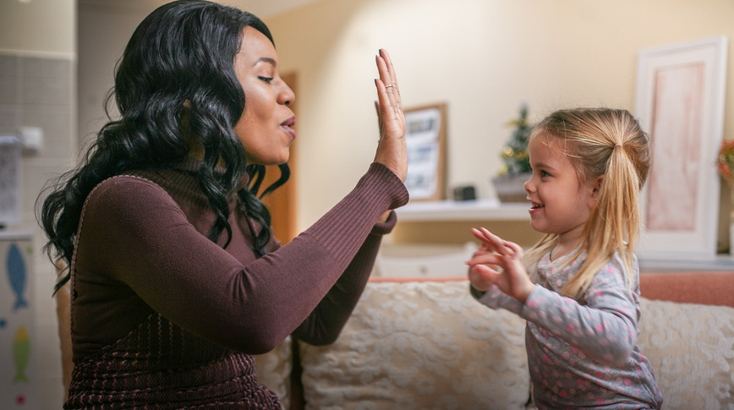
CASA VIDEO:

Slide 7
A CASA volunteer advocate
Researches case history
Meets with the child monthly
Meets with case professionals monthly
Meets with teachers, therapists, medical doctors, etc.
Writes fact-based court reports
Attends court hearings
10 - 12 hours average per month
Commits to minimum of 2 years

Slide 8
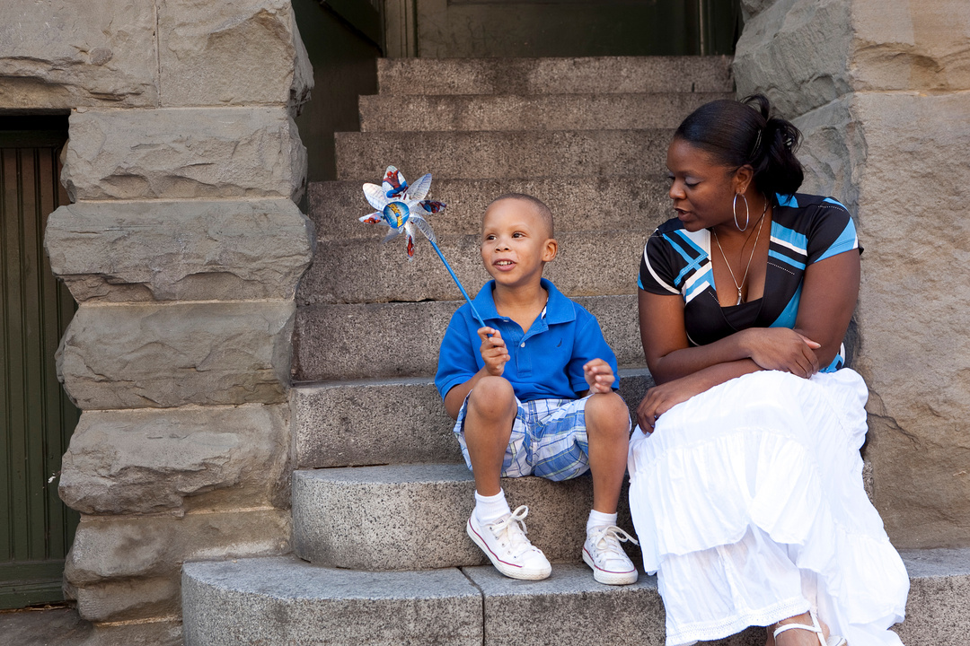
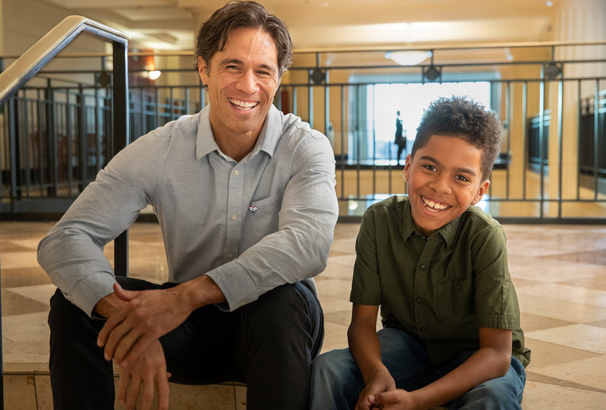
Advocate Profile
Over 70% of our CASAs are employed
Our CASAs range in age from 21-84
Nearly 10% speak a second language
82% of CASAs identify as female
85% identify as Caucasian (inc. Hispanic)
8% identify as African American
3% identify as Multi-racial
1% identify as Pacific Islander/Asian
THERE IS NO "AVERAGE" ADVOCATE!

Slide 9
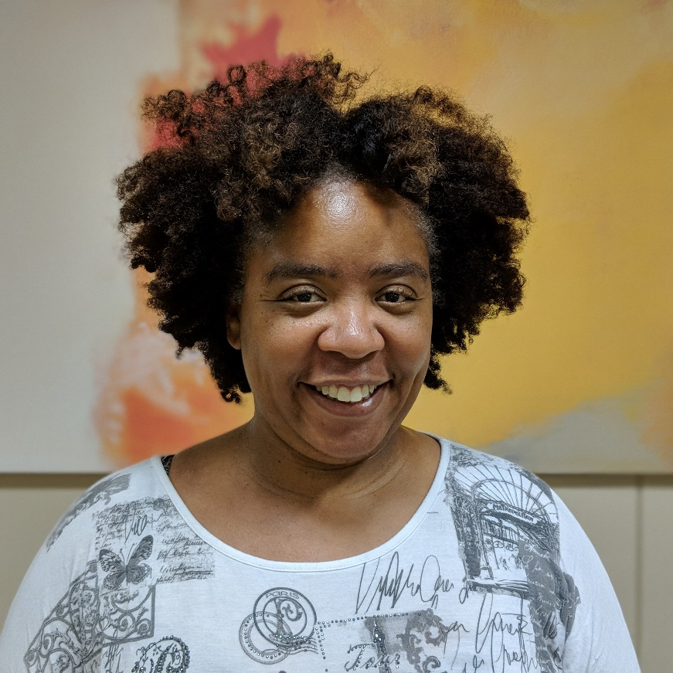
Monique – CASA Volunteer
CASA Volunteer for 2 years
Full time nurse
Has had 2 cases and advocated for 2 children
“Knowing that I helped to protect this child fills my heart with more joy than most anything else I could do in a professional context”
“Honestly, as much work and emotion that goes into these cases, I get so much more back than I ever feel like I put in”
“The people here genuinely care about these kids regardless of politics, money, where they live, etc.”

Slide 10
CASA VOLUNTEER APPLICATION
01
02
03
04
05
Apply
Interview with CASA staff
Pass background check
Complete pre-service training
(30 hours)
Sworn in by the court
CASE ASSIGNED!

Slide 11
Child Demographics
85% of CASA-appointed kids have been removed from neglectful homes.
45% identify as male | 55% identify as female
68% of kids are ages 0-13 years old
28% identify as Caucasian
44% identify as African American
14% identify as Hispanic
14% identify as Native American
THERE IS NO "AVERAGE" CHILD!

Slide 12
CASA volunteers have real impact.
In FY 2019-2020, 520 children were served by 296 CASAs. 81 New CASA Volunteers were sworn in by the court and 82% of CASA’s recommendations were accepted by the court.
Children with CASAs spend less time in foster care.
They are also more likely to find a safe, permanent home.
The kids also benefit from:
more help, support and guidance while in the care system.
a consistent, responsible adult presence.
positive behavioral and educational outcomes.

Slide 13
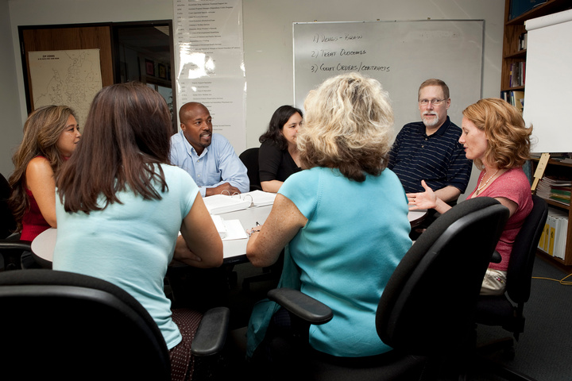
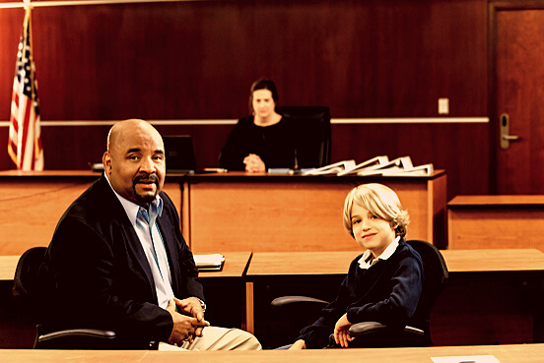
CASAs help kids find permenancy.
Last year:
70 kids were reunified with their families.
37 kids were adopted into safe, loving homes.
11 kids were given guardianships.

Slide 14
We know not everyone is able to be a CASA.
But there are other ways you can help!
Join FRIENDS OF CASA.
Membership starts at just $35/year
Make us your AmazonSmile charity of choice.
Donate while you shop at no additional charge to you!
Buy needed items from our Amazon Wishlist.
Search for "CASA for Douglas County"
Donate monthly to our organization - no donation is too small.
We're grateful for any amount you can contribute towards helping children who have been abused or neglected in our community.

Slide 15
We know not everyone is able to be a CASA.
But there are other ways you can help!
Participate in our annual CASA Classic
Our first annual golf tournament will occur on 8/23 at Oak Hills Country Club. There are opportunities for sponsorship and foursomes open as well.
Participate with the Holiday Party
Volunteer your time wrapping gifts
Volunteer your time at the Holiday party in a variety of roles
Purchase a gift off the wish lists
Make a general donation to the holiday party
Make Connections
Are you involved with an organization or have friends you think would be a good fit for CASA?! We would love to present information to anyone interested – please reach out!

Slide 16
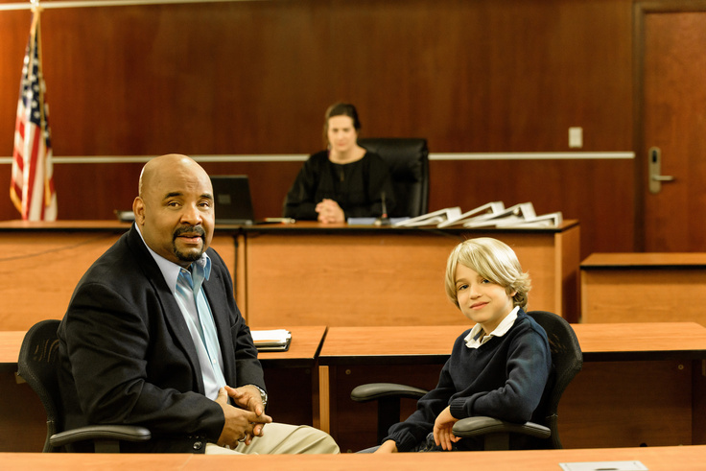
Thanks for your time!
@CASAOmaha
join us to
CASA for Douglas County (Omaha)
CASA for Douglas County
Call 402-932-5683 ext 117
Email jfletcher@casaomaha.org

