Slide 1
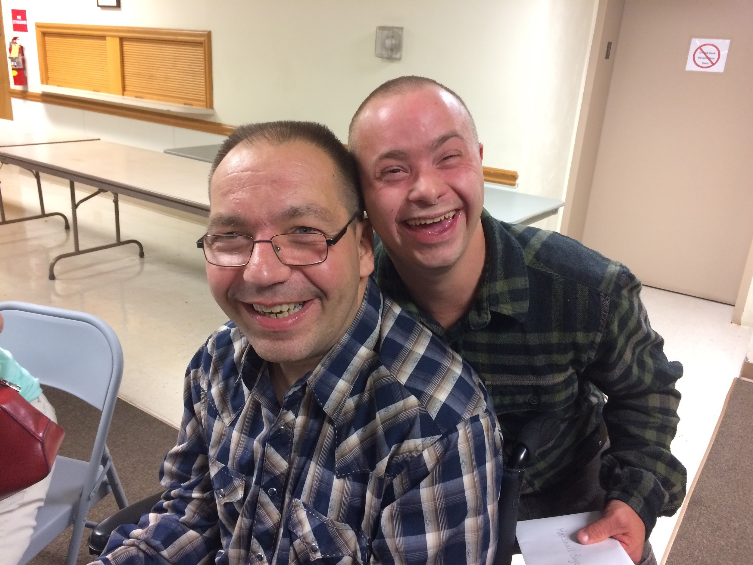
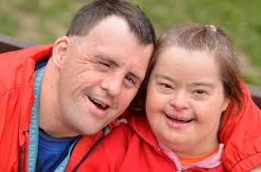
Endearing Smiles
Oral Health Care for Adults with Intellectual/Developmental Disabilities

Slide 2
People with Intellectual / Developmental Disabilities (I/DD)
Experience
Diminished oral health status
Reduced access to dental services compared to the general population

Slide 3
Barriers
Attitude:
Reduced comprehension / awareness of importance of dental health
Lack of cooperation
Health Literacy:
Relationship of oral health to systemic health
Reliance on caregivers for access to dental care

Slide 4
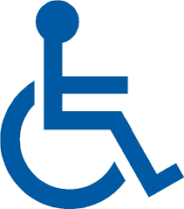
Barriers
Physical:
Architectural barriers (e.g., handicapped entrances)
Sensory deficits
Overstimulation in the dental office
Financial:
Limited income
Lack of dental insurance/provider acceptance

Slide 5
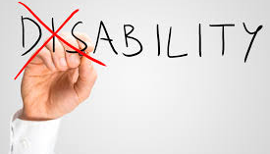
Why do individuals with intellectual disabilities need special dental care?
Common forms of I/DD:
Autism Spectrum Disorder
Cerebral Palsy
Down’s Syndrome
Fetal Alcohol Spectrum Disorder
Spina Bifida

Slide 6
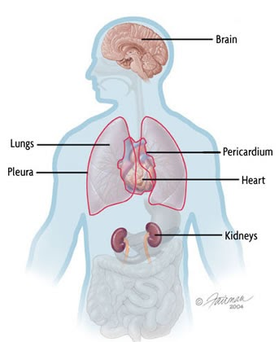
Why do individuals with intellectual disabilities need special dental care?
These individuals have higher incidence of:
Developmental conditions of the heart or kidneys
Respiratory conditions
Diabetes
Obesity
Dental decay

Slide 7
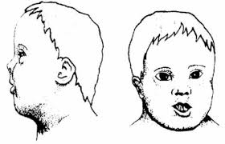
Common Oral Manifestations
Malocclusion
Oral and Craniofacial Anomalies
Damaging Oral Habits

Slide 8
Common Oral Manifestations
Evidence of trauma or injury
Weakness or paralysis of facial muscles
Drooling or impaired swallowing

Slide 9
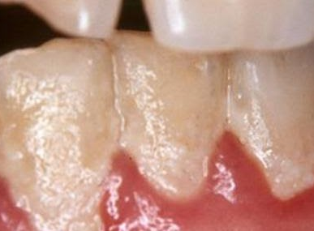
Why is plaque removal so important?
Dental Biofilm (plaque)
Substance filled with bacteria which forms daily.
Thick biofilm forms if a person does not brush regularly.
May be clear, white or stained and appear yellow.
If not removed can harden into calculus (tartar), which can’t be removed with a toothbrush.

Slide 10
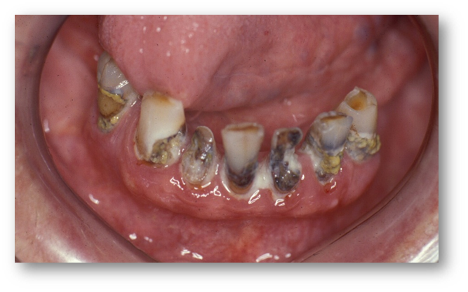
Why is plaque removal so important?
Acids from dental biofilm cause dental caries (tooth decay)

Slide 11
Why is plaque removal so important?
Dental biofilm causes gum diseases: gingivitis and periodontal disease

Slide 12
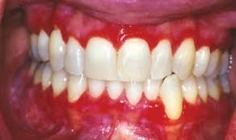
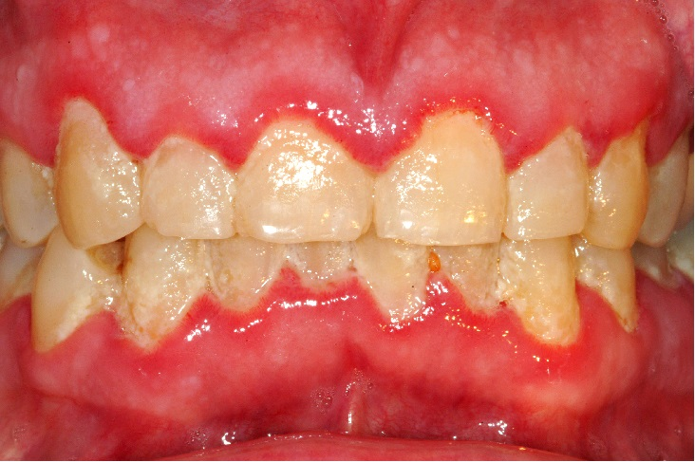
Why is plaque removal so important?
Gingivitis

Slide 13
Why is plaque removal so important?

Slide 14
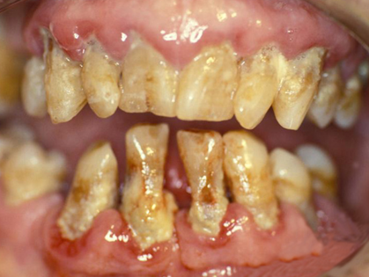
How can we prevent this from happening?

Slide 15
Special Needs
Basic Activities of Daily Living (BADLs)
Activities required for personal care
Feeding
Dressing
Grooming
Bathing
Toileting

Slide 16
Special Needs

Slide 17
Special Needs
Instrumental Activities of Daily Living (IADLs)
More complex tasks required for independent living
Using phone
Preparing meals
Cleaning the house
Driving a car / using public transportation

Slide 18
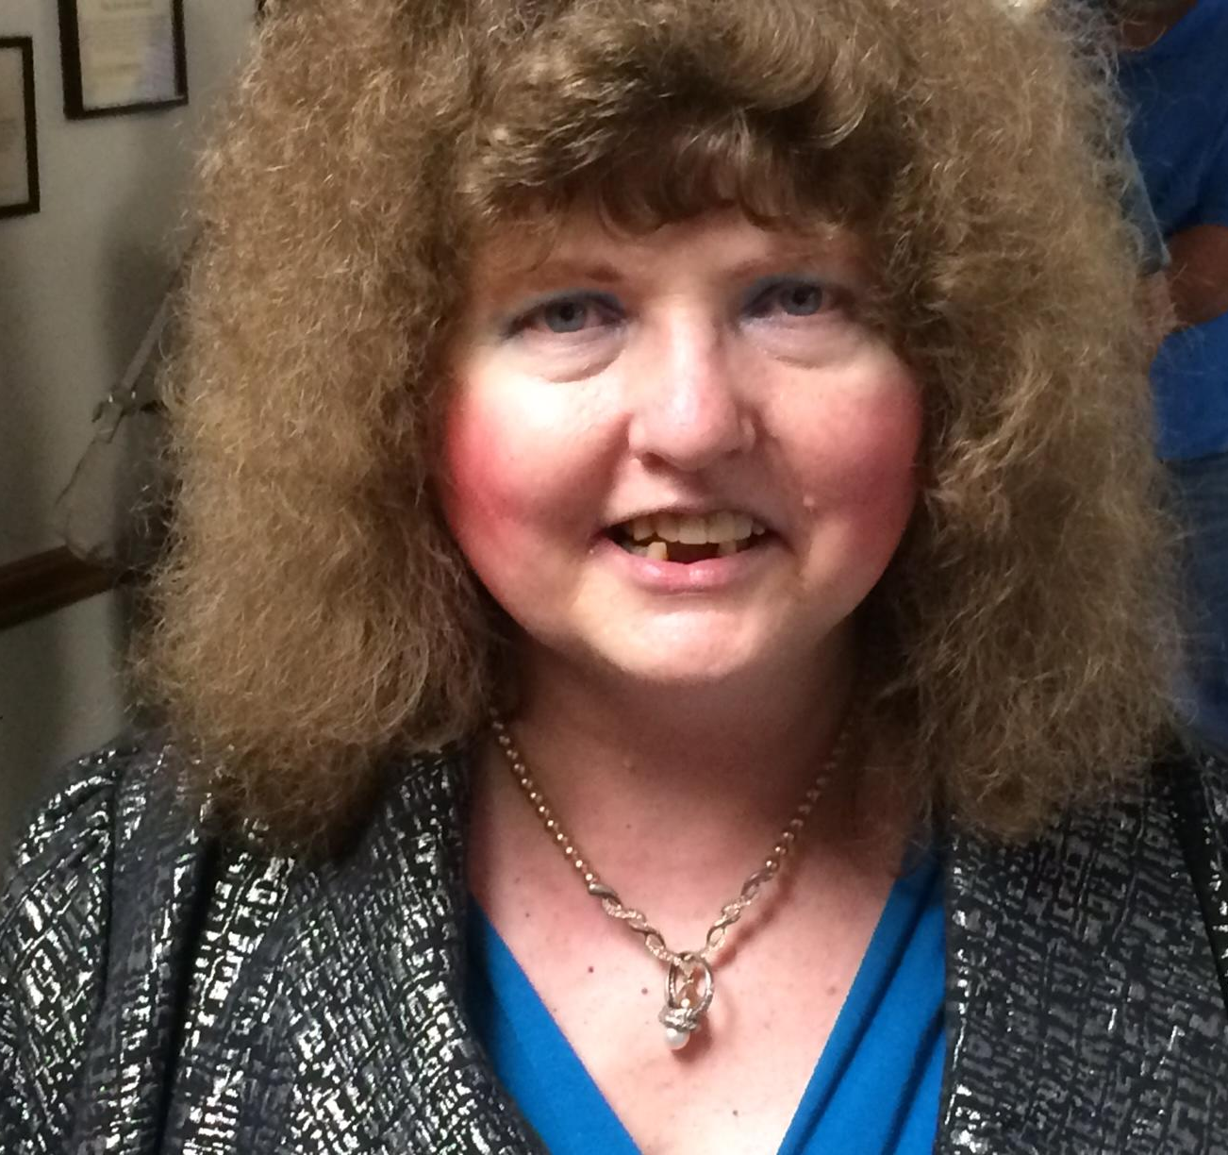
We’re not different.

Slide 19
We just do things a little differently

Slide 20
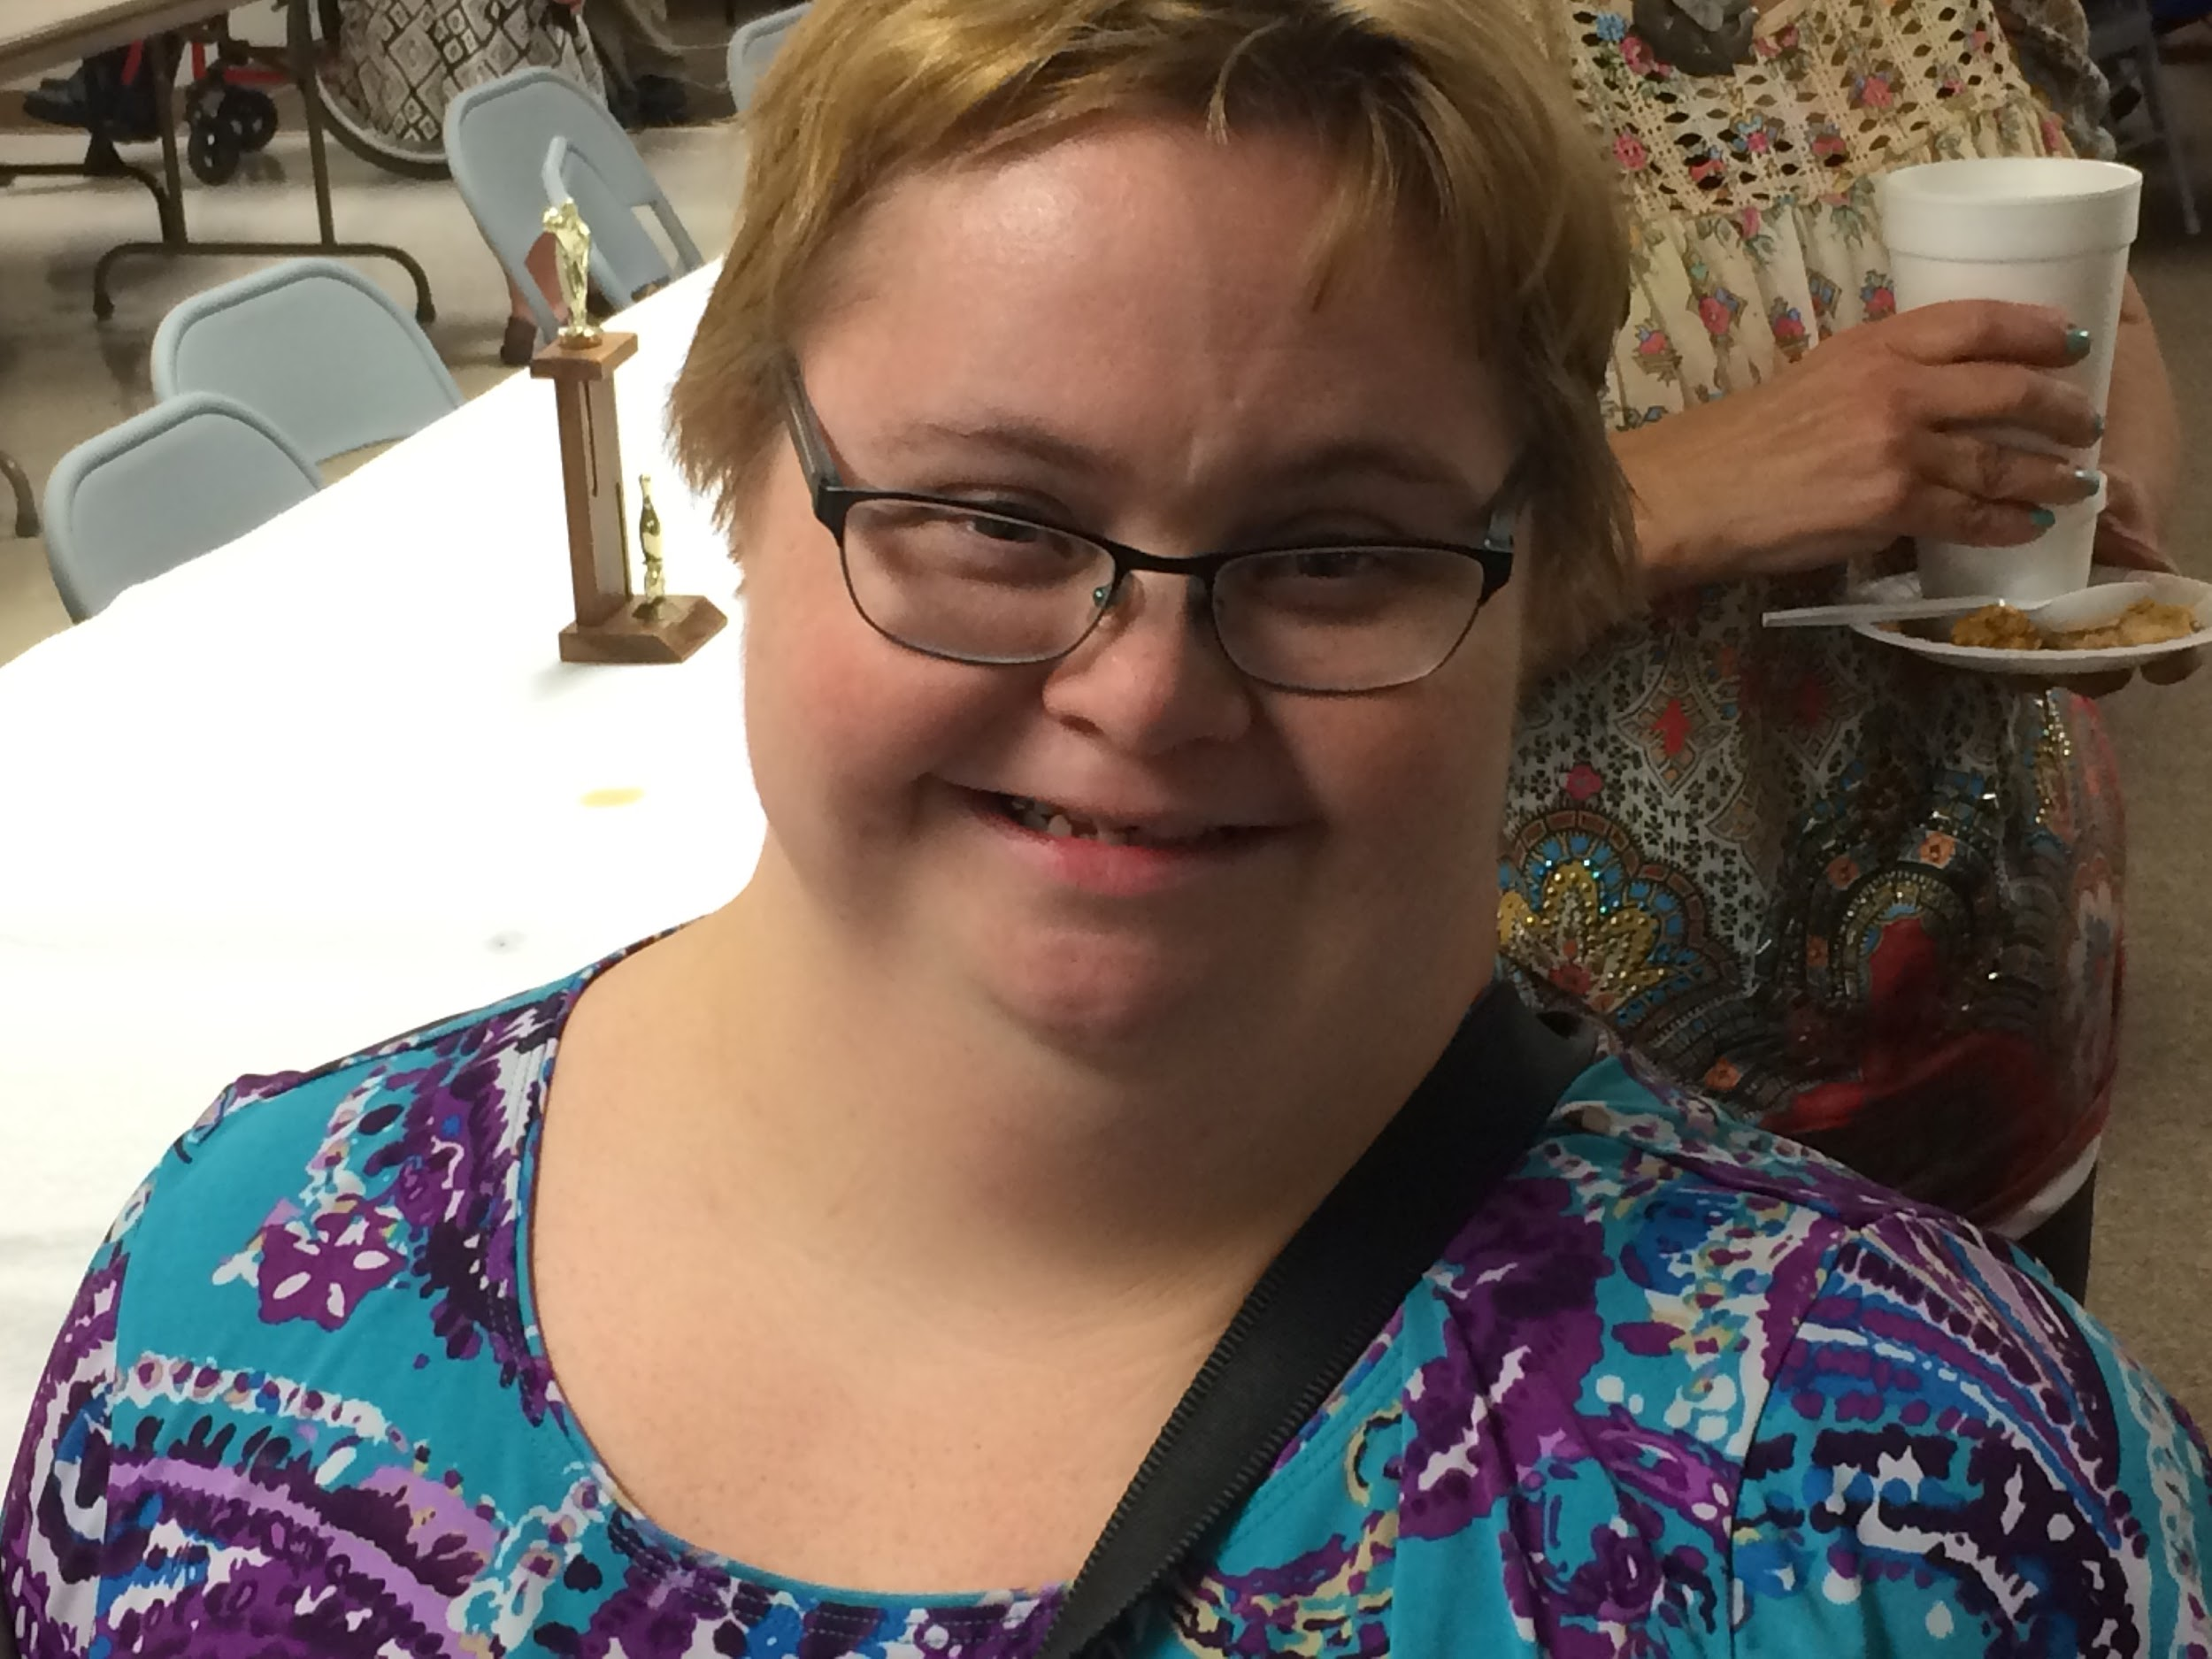
And may need a little extra help.

Slide 21
When we brush our teeth!

Slide 22
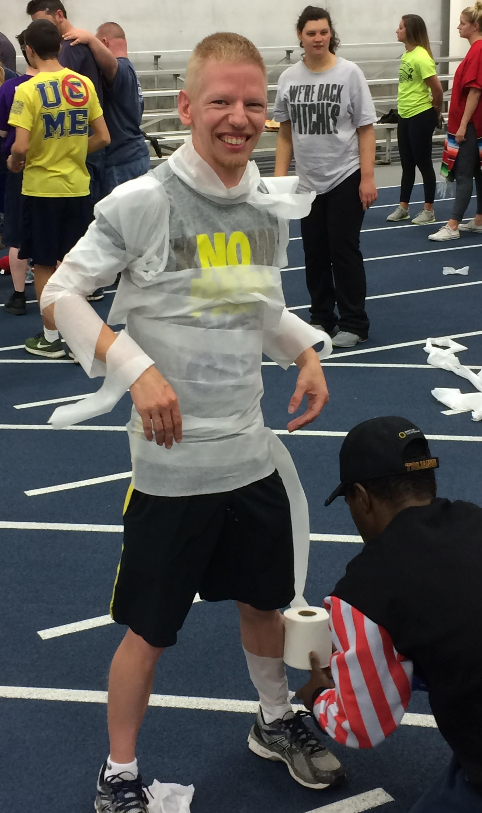
As a direct care provider, what is YOUR role?
It is important to TEACH as well as assist.

Slide 23
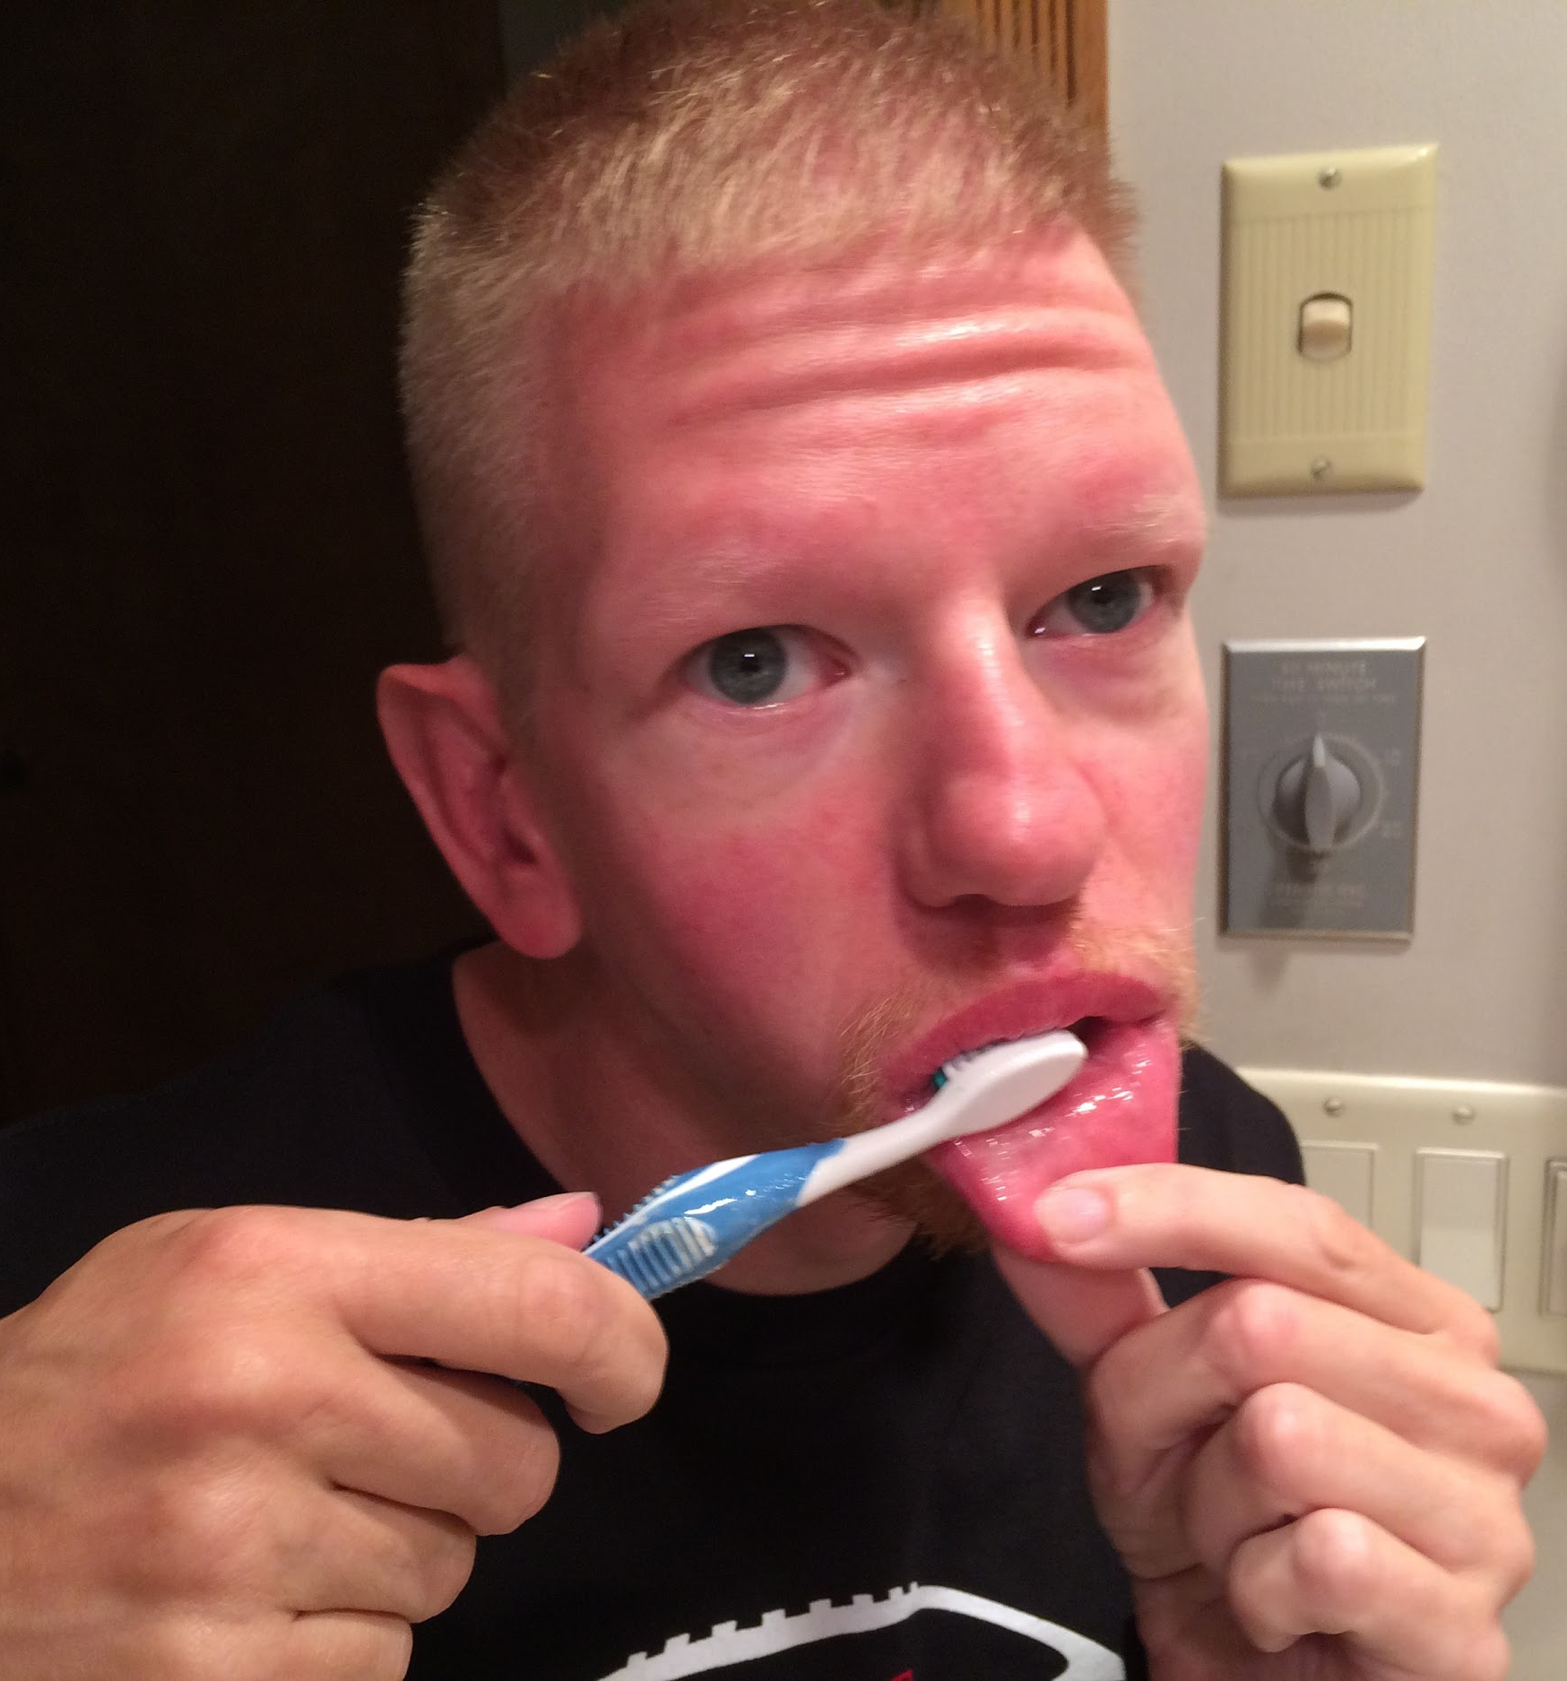
Functional Ability
Determine what oral self-care tasks the individual can do
No assistance

Slide 24
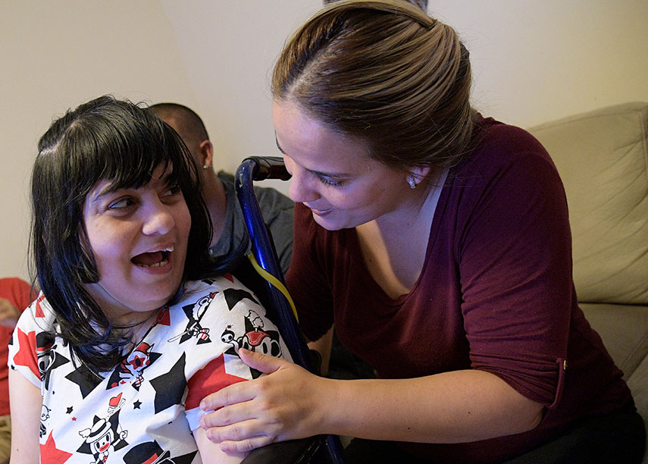
Functional Ability
Determine what oral self-care tasks the individual can do
Partial assistance

Slide 25
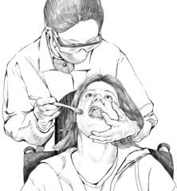
Functional Ability
Determine what oral self-care tasks the individual can do
Total assistance

Slide 26
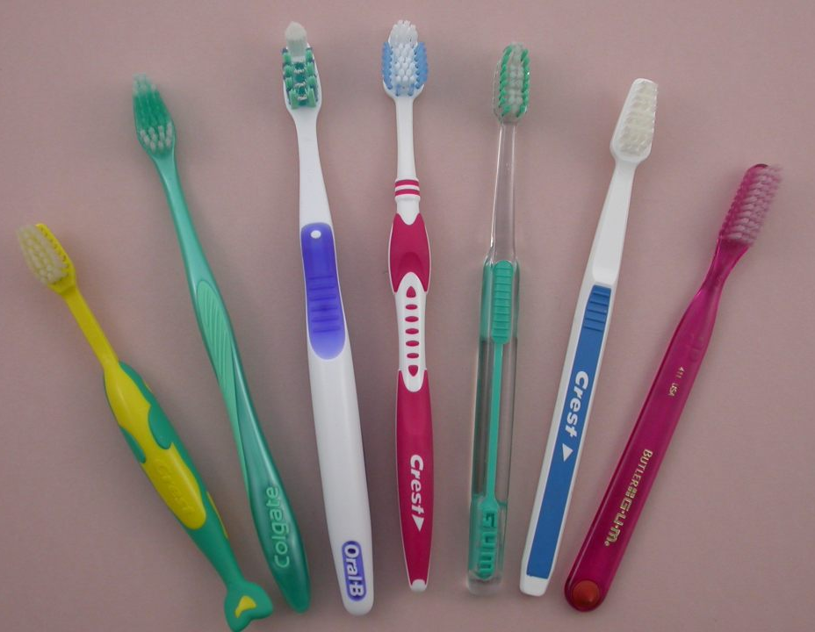
Toothbrushes
Choose a toothbrush with soft bristles and a small head.
You may find that a child’s toothbrush works best for some individuals.

Slide 27
Toothbrushes
Should be replaced every two-three months

Slide 28
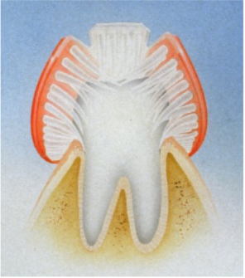
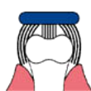
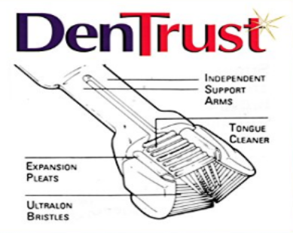
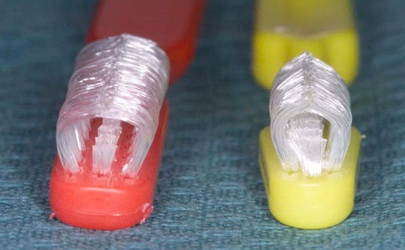
Toothbrushes - Manual
Some special options include:
DenTrust
The Collis Curve Brush

Slide 29
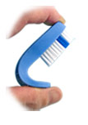
Toothbrushes - Manual
The Loops Flexbrush

Slide 30
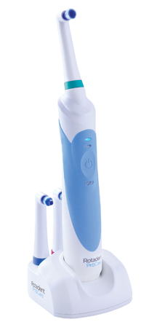
Toothbrushes - Power
Rotadent
If a power toothbrush can be tolerated, the Rotadent has a larger handle better for grasping

Slide 31
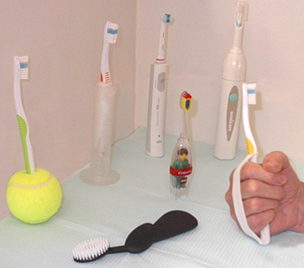
Special Brushing Aids
Many aids for better grasping can be purchased or made at home.

Slide 32
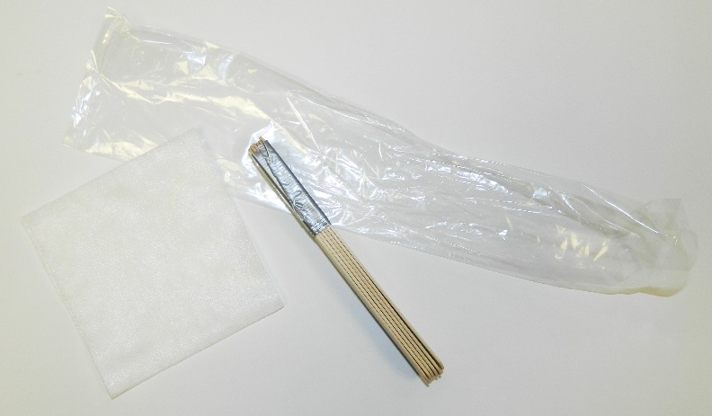
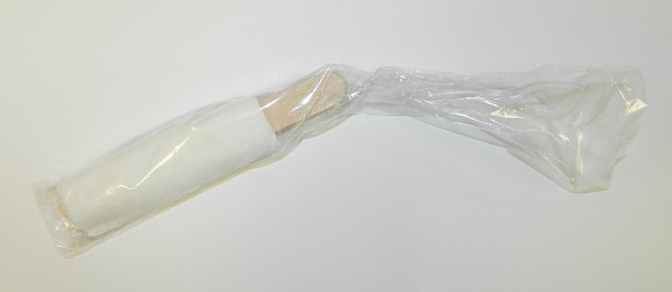
What if the individual can’t hold their mouth open for tooth- brushing?
Mouth props may be purchased for this purpose
May place taped tongue blades wrapped in gauze and plastic between the back teeth.

Slide 33
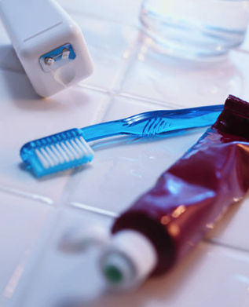
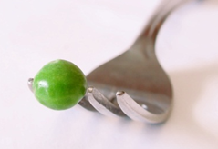
How much toothpaste?
Only a pea-sized amount of toothpaste is needed for adequate brushing.

Slide 34
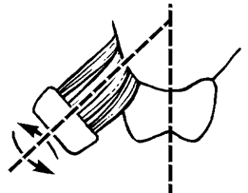
Technique
Start on upper right side
Place brush on cheek side of back tooth
Place tips of the bristles at a 45° angle to the gums
Press lightly to spread the bristles under and around the gums

Slide 35
Technique
Move the brush (wiggle) in a back-and-forth motion to remove plaque.

Slide 36
Technique
Brush the outside, inside, and tops of the upper teeth

Slide 37
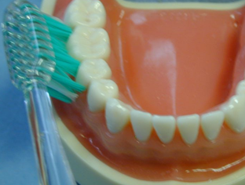
Technique
Move to the bottom teeth
Brush the outside, inside and tops of the lower teeth

Slide 38
Other Factors Influencing Oral Health of Individuals with I/DD
Physical Limitations
Eating Habits
pH Balance
Medications

Slide 39
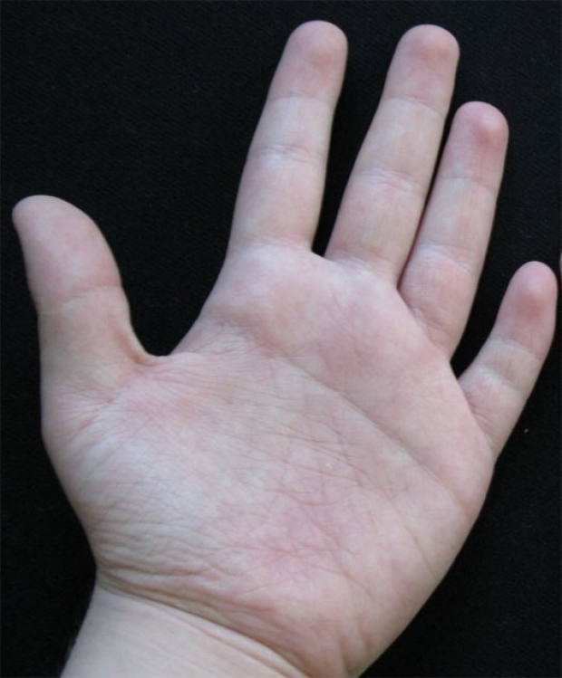
Other Factors Influencing Oral Health of Individuals with I/DD
Physical Limitations
Facial musculature integrity compromised
Problems chewing or swallowing
Dexterity and fine motor skills compromised

Slide 40
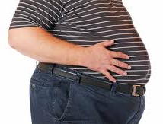
Other Factors Influencing Oral Health of Individuals with I/DD
Eating Habits
Current eating and snack habits
Dependence on others for preparation, shopping, etc.
Finances
Sweets as rewards
Obesity

Slide 41
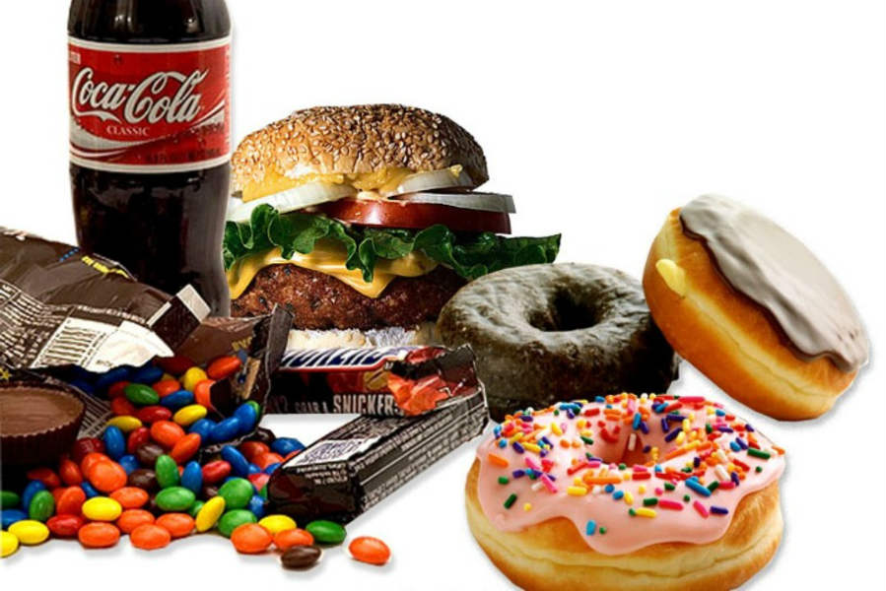
Other Factors Influencing Oral Health of Individuals with I/DD
Eating Habits
Cavity-causing effects are dependent on:
Composition
Texture and retentiveness
Solubility
Frequency of consumption

Slide 42
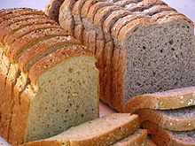
Other Factors Influencing Oral Health of Individuals with I/DD
Eating Habits
Composition:
Foods that contain both sugars and starches are more cavity promoting than high sugar snacks

Slide 43
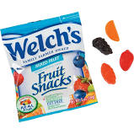
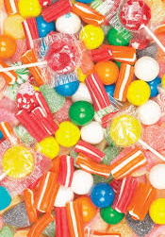
Other Factors Influencing Oral Health of Individuals with I/DD
Eating Habits
Texture and retentiveness:
Sticky foods stick to the teeth increasing acid exposure

Slide 44
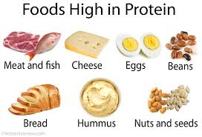
Other Factors Influencing Oral Health of Individuals with I/DD
Eating Habits
Solubility:
Sugary foods are less harmful to the teeth when eaten with proteins and limited amounts of fat.

Slide 45
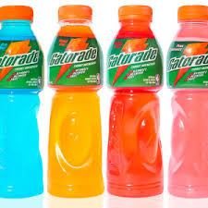
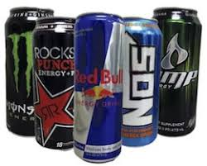
Other Factors Influencing Oral Health of Individuals with I/DD
Eating Habits
Frequency of consumption:
Frequent nibbling or sipping of highly processed foods increases the risk of cavities

Slide 46
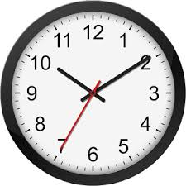
Other Factors Influencing Oral Health of Individuals with I/DD
Eating Habits
It’s not about how MUCH you eat, it’s how OFTEN.

Slide 47
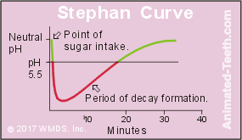
Other Factors Influencing Oral Health of Individuals with I/DD
pH Balance
Did you know that it can take as long as 20 minutes for the pH of the oral environment to neutralize after eating refined foods?

Slide 48
Other Factors Influencing Oral Health of Individuals with I/DD
pH Balance
Battery Acid | 1.0
Fruit Juices | As low as 2.0
Sports Drinks | 2.4
Soda | 2.5-3.0
Energy Drinks | 3.3
Milk | 6.8
Tap Water | 7.0

Slide 49
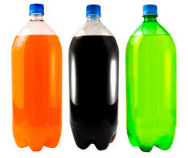
Other Factors Influencing Oral Health of Individuals with I/DD
Behaviors to Discourage:
Frequency of refined sugars/ starches in the diet
Frequent between-meal snacking
Using sugary/refined foods and drinks as rewards or incentives
Using government assistance money or petty cash to buy soda/candy
Late-night eating

Slide 50
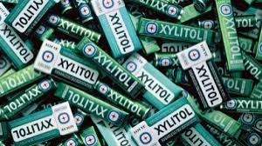
Other Factors Influencing Oral Health of Individuals with I/DD
Behaviors to Encourage
A balanced diet
Smart food/drink purchases
Limiting intake of sweetened foods/drinks to mealtime
Substituting with sugar-free options

Slide 51
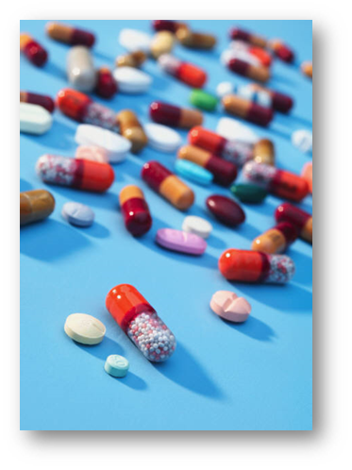
Other Factors Influencing Oral Health of Individuals with I/DD
Medications
Polypharmacy:
The use of multiple medications (five or more) by an individual, which is common in persons with special needs.

Slide 52
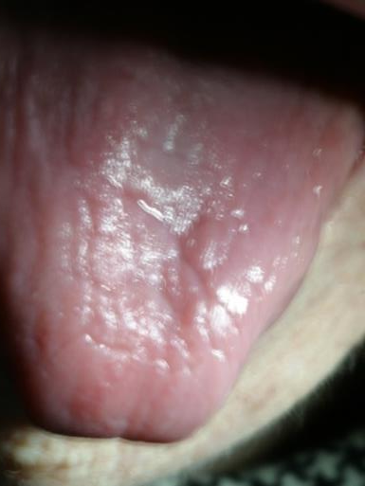
Common Oral Side Effects of Medications
Xerostomia
Chronic dry mouth
Increase in dental caries
Sucrose-based liquid medications

Slide 53
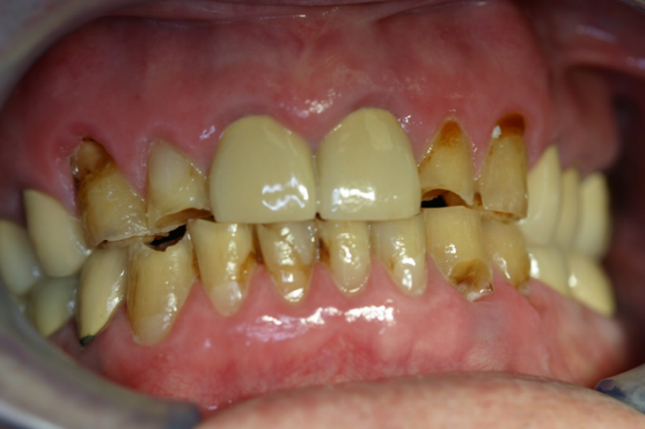
Common Oral Side Effects of Medications
Xerostomia
Symptoms:
Difficulty in swallowing and speaking
Altered taste perception
Oral discomfort, burning sensation
Gumline tooth decay

Slide 54
Common Oral Side Effects of Medications
Xerostomia
Medication classes causing dry mouth:
Stimulants
Methylphenidate (Ritalin)
Amphetamine salts (Adderall)

Slide 55
Common Oral Side Effects of Medications
Xerostomia
Medication classes causing dry mouth:
Antidepressants
Aripiprazole (Abilify)
Wellbutrin (Bupropion)

Slide 56
Common Oral Side Effects of Medications
Xerostomia
Medication classes causing dry mouth:
Antipsychotics
Risperidone (Risperdal)
Paliperidone (Invega)

Slide 57
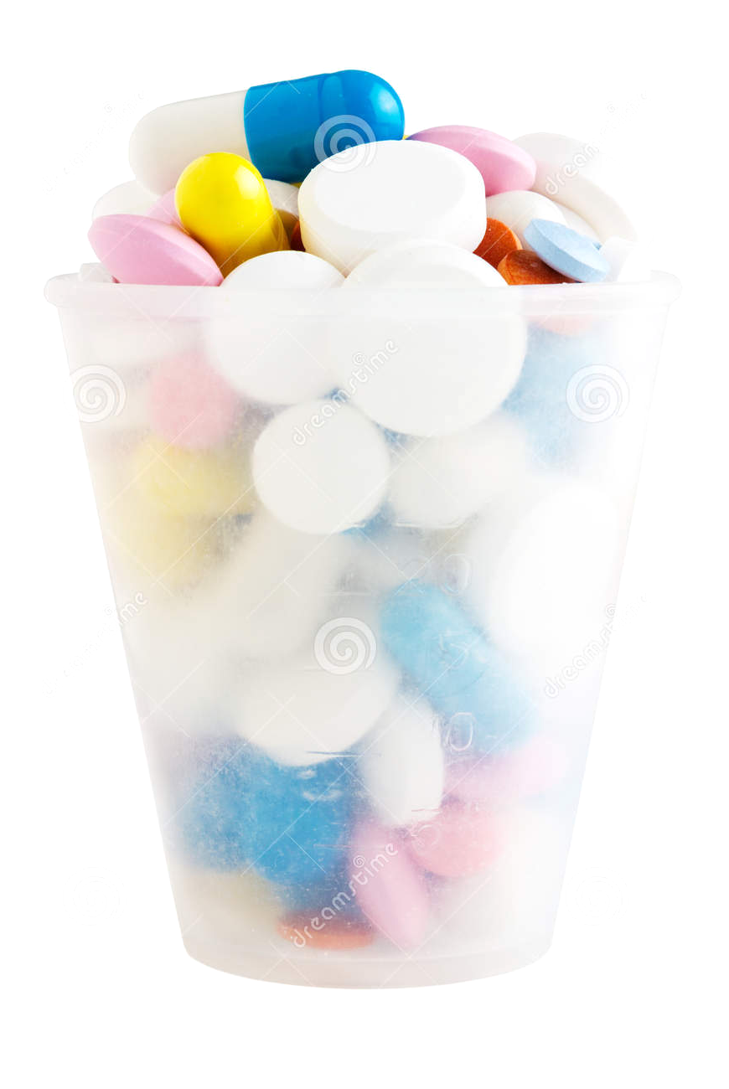
Common Oral Side Effects of Medications
Xerostomia
Medication classes causing dry mouth:
Anticholinergics
Olanzapine (Zyprexa)
Quetiapine (Seroquel)

Slide 58
Common Oral Side Effects of Medications
Xerostomia
Medication classes causing dry mouth:
Anticonvulsants
Divalproex sodium (Depakote)
Lamotrigine (Lamictal)

Slide 59
Common Oral Side Effects of Medications
Xerostomia
Medication classes causing dry mouth:
Antianxiety
Lorazepam (Ativan)
Diazepam (Valium)

Slide 60
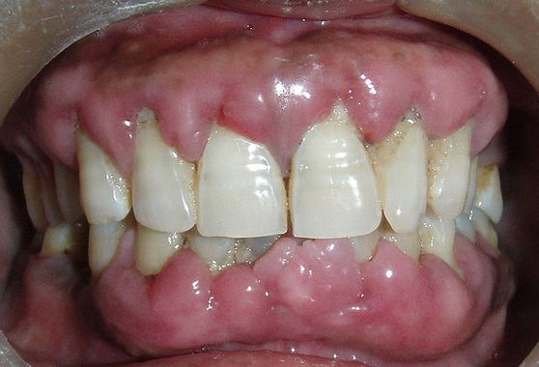
Common Oral Side Effects of Medications
Gingival Hyperplasia
Side effect of:
Nifedipine
Dilantin
Cyclosporine

Slide 61
Xerostomia Management
Suggest individuals do the following:
Sip water frequently especially when eating
Chew xylitol gums, mints and/or candies
Use saliva substitutes
Good oral hygiene
Use prescription fluoride toothpaste
Calcium phosphate such as MI Paste

Slide 62
Please Remember
My oral health is important for my overall health.

Slide 63
Please Remember
Your role is vital in helping me maintain my oral health.

Slide 64
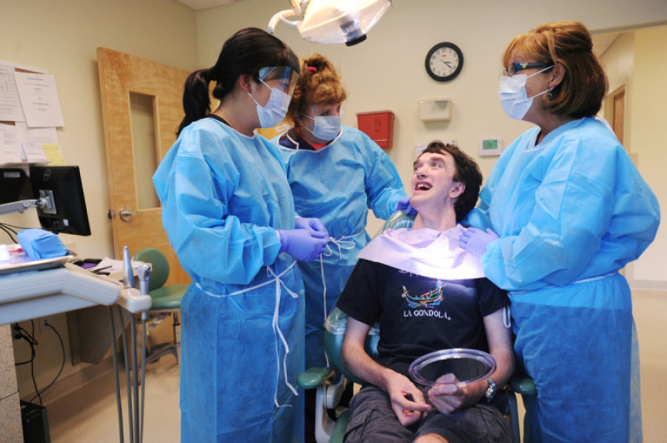
Please Remember
I need regular check-ups

Slide 65
Please Remember
Tell me what you are going to do before you do it

Slide 66
Please Remember
I am NOT a child, I am an adult.

Slide 67
Thank You!

Slide 68
Additional Credits
This presentation produced in part with cooperation with the University of Nebraska Medical Center College of Dentistry and the Nebraska Department of Health & Human Services.

