Slide 1


Oral Health Issues for the Aged Adult in
The 21st Century
2024

Slide 2

Oral health and life expectancy of Americans dramatically improved during the 20th century.

Slide 3
Current Generation of Older Adults
Matured during a
time of “prevention”
in dentistry
Majority of older adults have some, or all, of their natural teeth.
Benefactors of prevention
GOAL: Keeping your teeth for your lifetime

Slide 4

Increasing Oral Health Needs
In the past 60 years, complete tooth loss:
Declined from 50% to 18%
  Water fluoridation
  Improved dental care
  Prevention

Slide 5
Increasing
Oral Health Needs
Compromised by:
Reduction in dexterity
Chronic diseases / mental decline
Increased medication use
Nutritional deficiencies
Economically disadvantaged
Limited access to dental care

Slide 6
CDC: Elders with oral disease is common.
One in five adults > 60 have untreated dental decay.
One in six older adults experience root-surface decay.
70% of adults > 65 have periodontal (gum) disease.

Slide 7
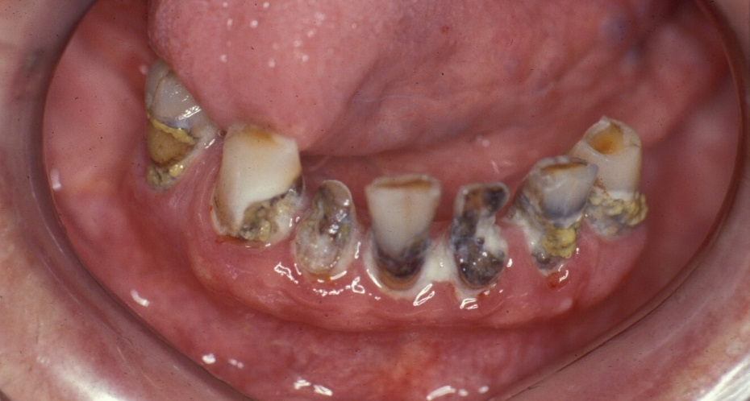
Acids from dental biofilm cause dental caries (tooth decay).
TOOTH DECAY
BIOFILM

Slide 8
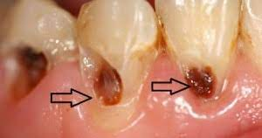
Root caries are more prevalent in senior population.

Slide 9
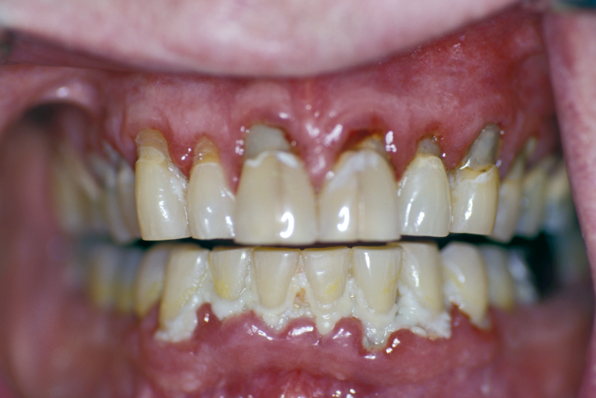
Dental biofilm causes gum diseases: gingivitis and periodontal disease.
BIOFILM
Note gums – very red and swollen. This person has gingivitis.

Slide 10
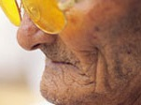
Tooth decay and gum disease can lead to:
Pain
Infection
Tooth loss
Many people believe there is nothing they can do to prevent tooth loss or dental problems. But this is not true…

Slide 11
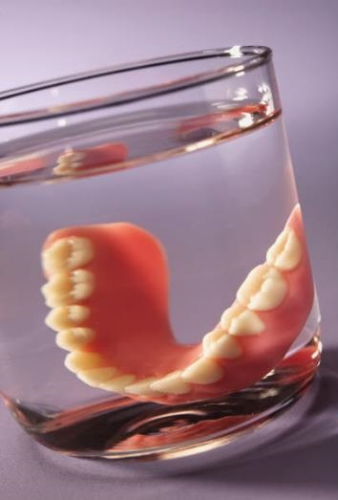
As we age, dentures are not the answer for everyone.

Slide 12
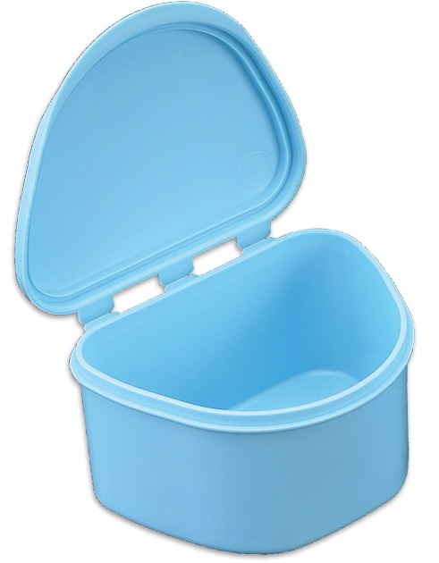
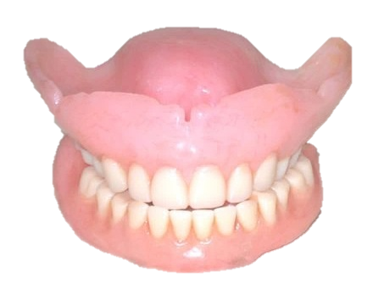
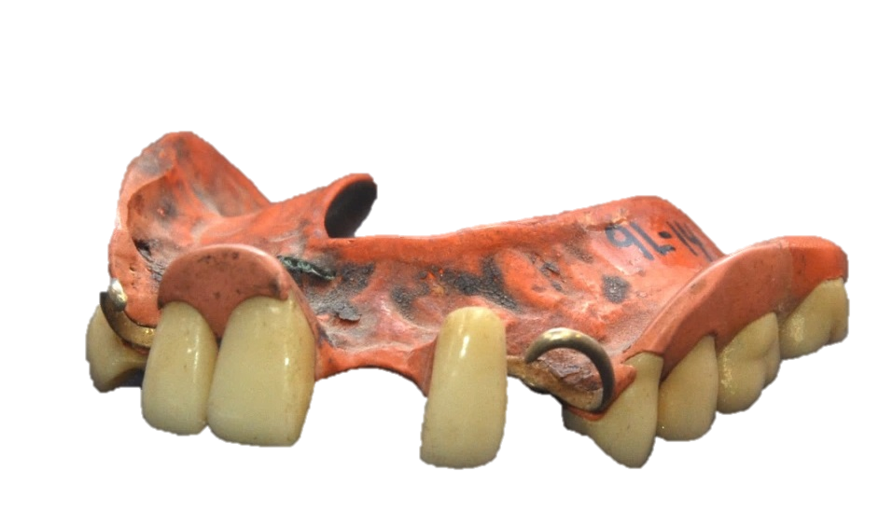
Although dentures can restore many oral functions, when a person experiences tooth loss, there are limitations of tooth replacement and their effectiveness as substitutes for natural teeth.

Slide 13
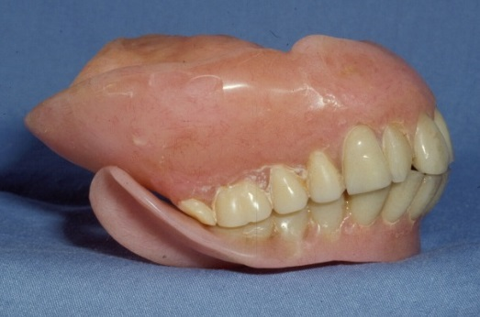
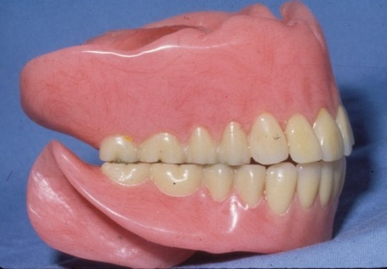
It is erroneously perceived that dentures last a lifetime without future modifications.
OLD DENTURES
NEW DENTURES

Slide 14
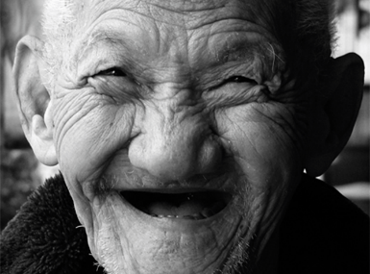
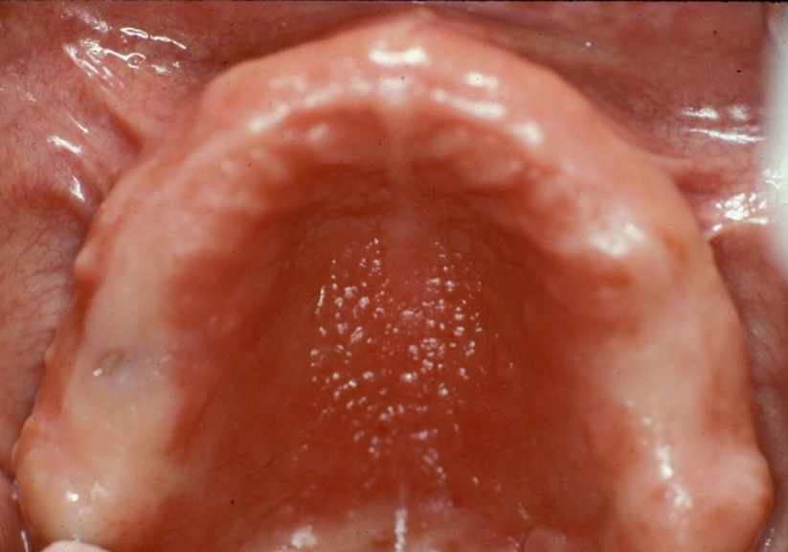
Denture placement introduces unfamiliar forces that contribute to:
Residual ridge and alveolar bone resorption
Oral mucous membrane remodeling
Loss of orofacial muscle tone

Slide 15
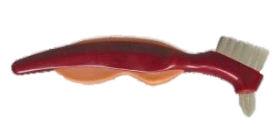

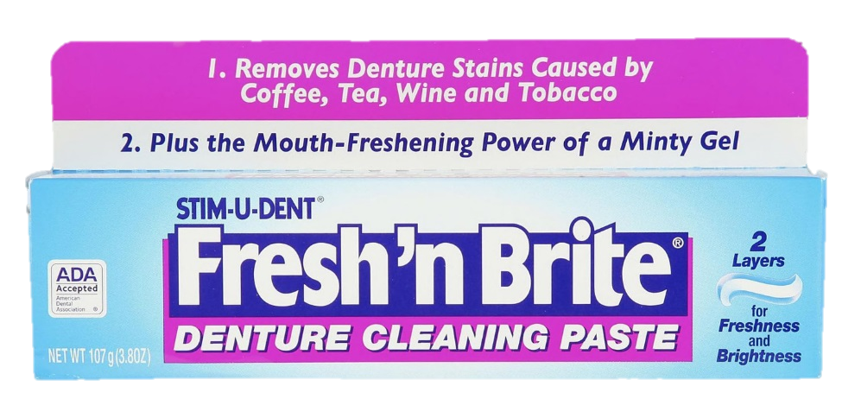
Regular maintenance care provided at a dental office should continue for edentulous denture wearers to:
Ensure well-fitting dentures
by providing denture adjustment/relines
Evaluate oral soft tissues
for lesions and/or trauma
Advise importance of daily care of dentures and oral soft tissues

Slide 16
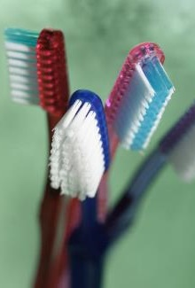
Why oral health matters in the geriatric population
Geriatric oral and systemic health – closely interconnected:
  Poor oral hygiene – associated with increased incidence of nosocomial pneumonias
  Several medications cause dry mouth – leads to many oral problems

Slide 17
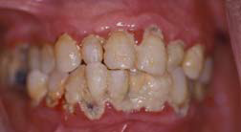
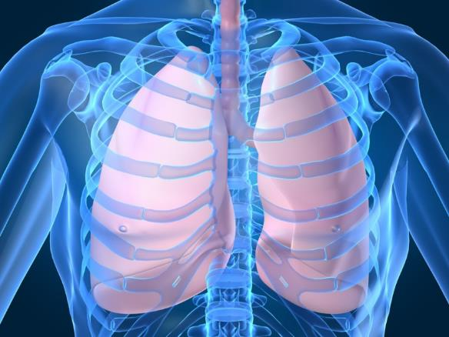
Breathing in germs from a dirty mouth
is a significant risk factor for pneumonia.
Germs from this biofilm can get into the lungs and cause pneumonia.
Quagliarello V et al. Modifable risk factors for nursing home acquired pneumonia.
Clin Infect Dis 2005; 40: 1-6.

Slide 18
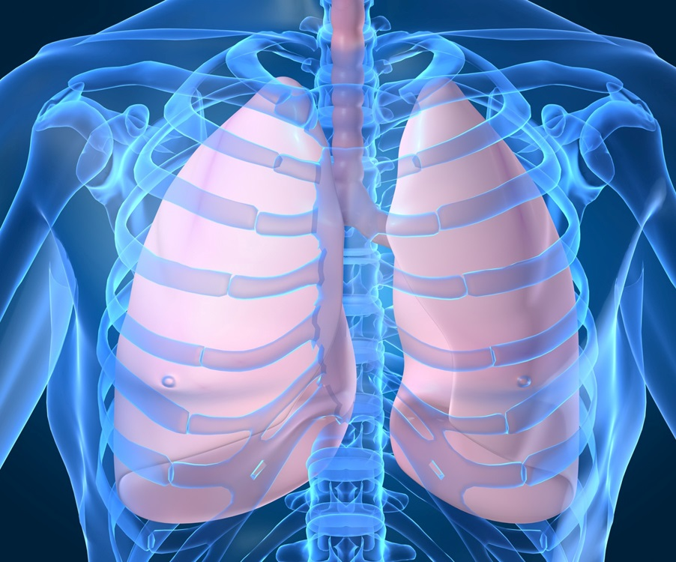
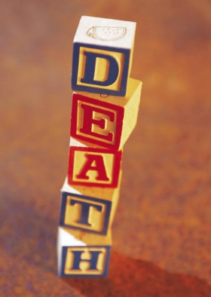

Pneumonia is the number one cause of death in nursing homes.
TYPES OF PNEUMONIA
Aspiration • Community-acquired
• Atypical • Bacterial •
Viral • Hospital-acquired

Slide 19
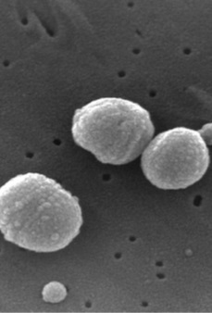
Pneumonia
Bacterial
  Community acquired – commonly strep (immunization pneumococcal vaccine) - staph
  Facility acquired – associated with vents (VAC), hospital (HAP), and health-care associated
Streptococcus pneumoniae
Image: Wikipedia.org/wiki/Pneumonia (Feb. 20, 2024)

Slide 20
Pneumonia
Viral
  Rhino viruses – influenza
Fungal infections – weakened immune system
Aspiration
Streptococcus pneumoniae
Image: Wikipedia.org/wiki/Pneumonia (Feb. 20, 2024)

Slide 21
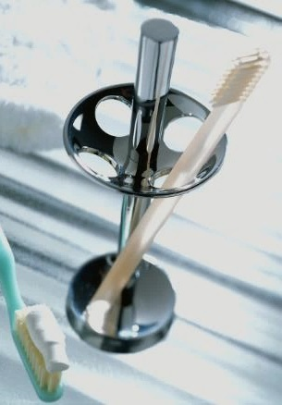
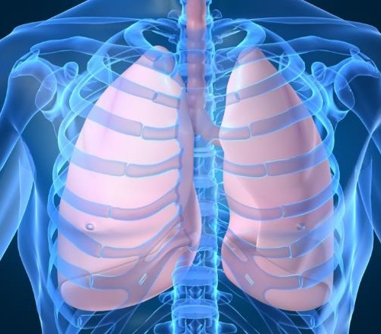
Fifteen Studies: Brushing the teeth reduces pneumonia in nursing home residents.
Brushing removes bacteria in the mouth and lowers the chance of pneumonia.
Sjogren P et al. A systematic review of preventive effect of oral hygiene on pneumonia and respiratory infections in elderly people in hospitals and nursing homes. J Am Geriatr Soc 2008;56:2124-2130.

Slide 22
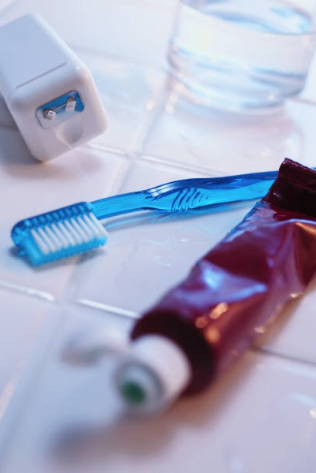
Brushing & Flossing Can Prevent
Gum disease
Tooth decay
Tooth loss
Daily mechanical removal of plaque by brushing and flossing the teeth: best way to prevent decay and gum disease.

Slide 23
Increasing
Oral Health Needs
Compromised by:
Reduction in dexterity
Chronic diseases / mental decline
Increased medication use
Nutritional deficiencies
Economically disadvantaged
Limited access to dental care

Slide 24
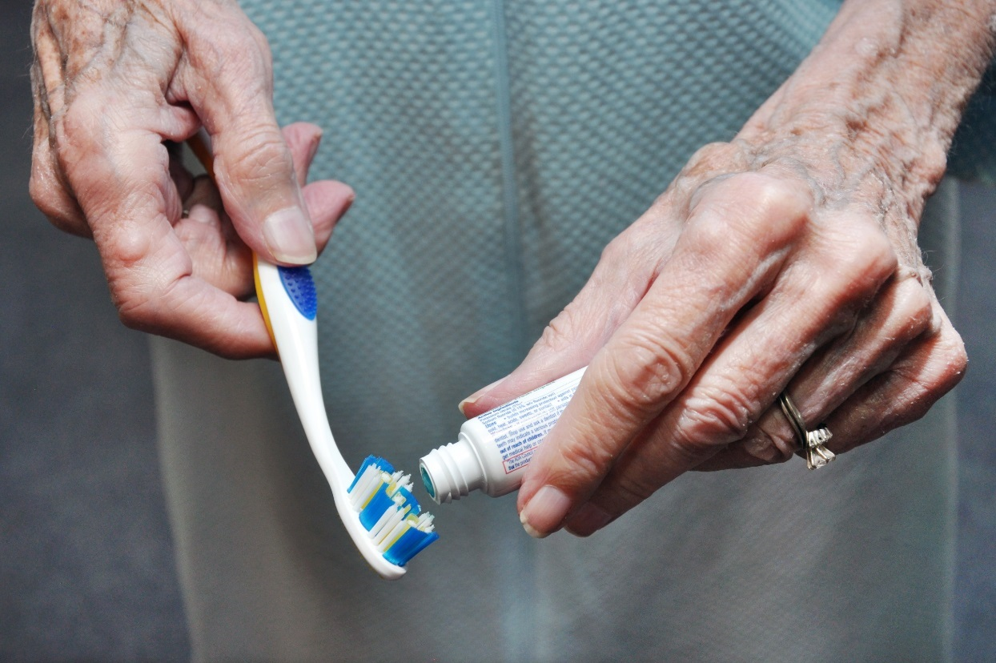
Reduction in dexterity
Rheumatoid arthritis
Osteoarthritis

Slide 25
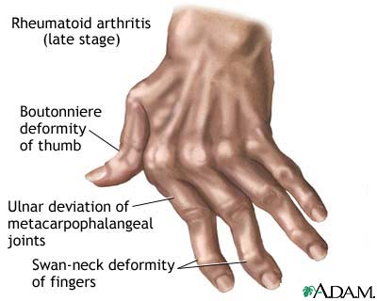
Rheumatoid arthritis
(late stage)
Boutonniere
deformity
of thumb
Ulnar deviation of
metacarphohalangeal joints
Swan-neck deformity of fingers

Slide 26
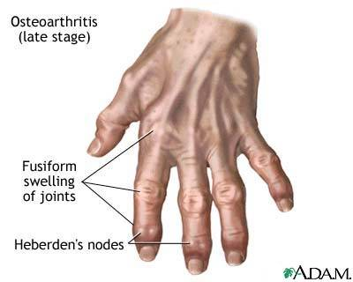
Osteoarthritis
(late stage)
Fusiform swelling
of joints
Heberden’s nodes

Slide 27
Increasing
Oral Health Needs
Compromised by:
Reduction in dexterity
Chronic diseases / mental decline
Increased medication use
Nutritional deficiencies
Economically disadvantaged
Limited access to dental care

Slide 28
Chronic diseases
Diabetic Glucose Control
Compromised
in presence of periodontal disease
Periodontal
Disease
Poor
Oral Health
Increased destruction in diabetics
Common cause of weight loss and failure
to thrive

Slide 29

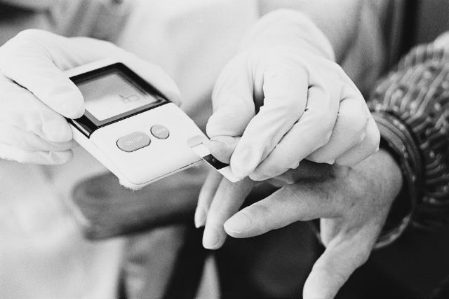
Diabetic residents with severe gum disease
Have more trouble controlling their blood sugar levels.
So this…
…can affect this.

Slide 30
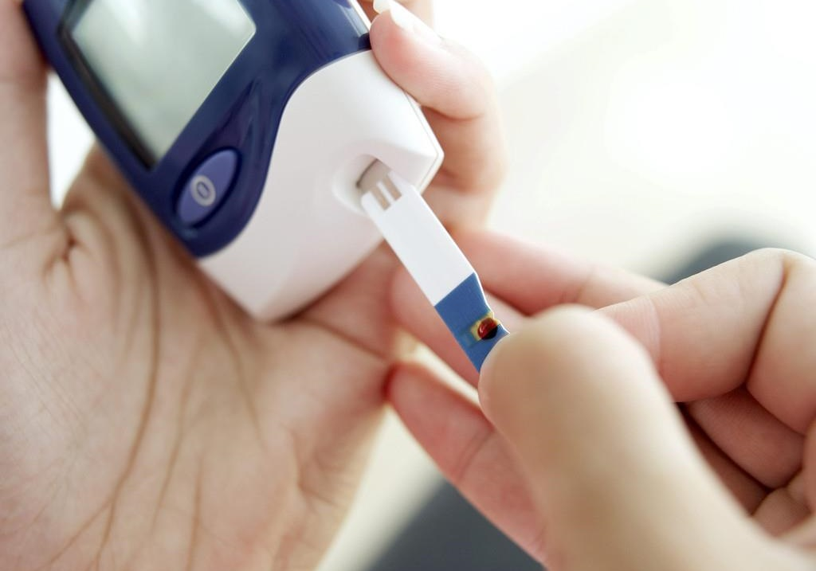
Studies have shown that treating gum disease improves blood sugar levels.

Slide 31
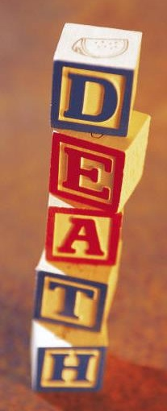
Diabetes residents with severe gum disease
More likely to die from complications
Three times the risk of death from heart disease and/or kidney disease compared with those who had no gum disease, or mild or moderate gum disease.
  11-year study of 628 people with
  Type 2 diabetes
Saremi et al. Periodontal disease and mortality in Type 2 diabetes. Diabetes Care. 2005;28:27-32.

Slide 32
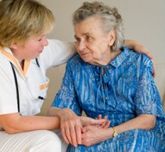
Declining mental health

Slide 33

Oral health affects mental health and vice versa
Researchers have discovered a significant link between oral care and mental health.
Researchers are discovering a strong connection between gum disease and dementia.
People who develop gum disease are also at an increased risk of developing anxiety and depression.

Slide 34

Poor oral health leads to:
Lower self-esteem – feeling ashamed about their smile, affects how one thinks and feels about themselves
Anxiety – about interacting with others because they don’t want people to notice bad breath. Also nervous about dental treatment.

Slide 35
Poor oral health leads to:
Deepening depression – strong link between people with gum disease and those with depression

Slide 36
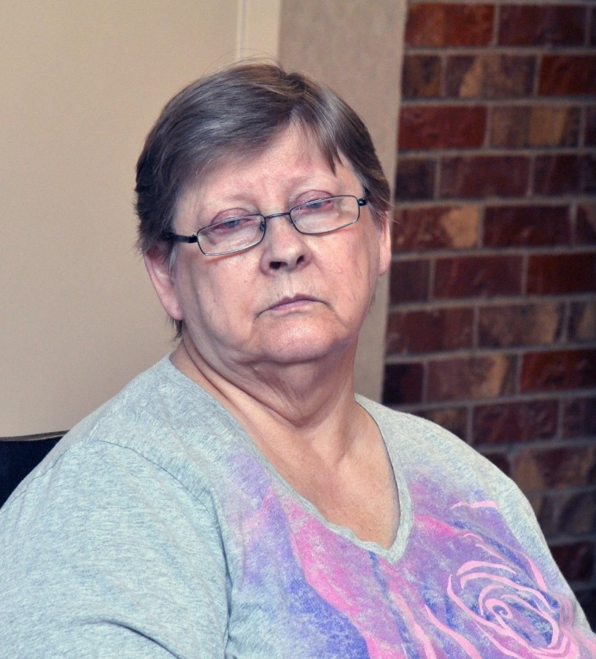
Poor oral health leads to:
These symptoms lead to:
  Losing interest in personal hygiene
  Neglecting daily oral care
  Poor diet – eating unhealthy foods
  Substance abuse
  Skipping appointments to the dentist
  Xerostomia (dry mouth) due to medications
Notes:
These symptoms lead to:
Losing interest in personal hygiene
Neglecting daily oral care
Poor diet – eating unhealthy foods
Substance abuse
Skipping appointments to the dentist
Xerostomia (dry mouth) due to medications

Slide 37
Increasing
Oral Health Needs
Compromised by:
Reduction in dexterity
Chronic diseases / mental decline
Increased medication use
Nutritional deficiencies
Economically disadvantaged
Limited access to dental care

Slide 38
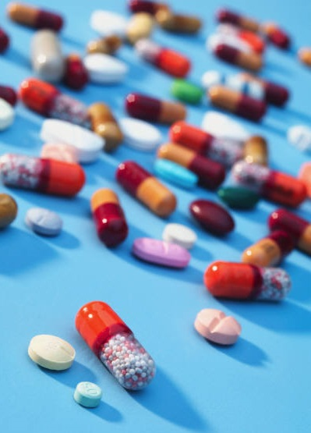
Increased medication use
Polypharmacy:
More than 90% of the elderly take prescription medication each week
57% take five or more medications daily
12-20% take more than ten medications daily

Slide 39

Medications: Common oral side effects
Xerostomia (chronic dry mouth)
Taste alteration
Candidiasis
Gingival hyperplasia
Stomatitis and mucositis

Slide 40
Medications: Common oral side effects
Lichenoid drug reaction
Dental erosion due to gastric reflux
Dental caries

Slide 41
Increasing
Oral Health Needs
Compromised by:
Reduction in dexterity
Chronic diseases / mental decline
Increased medication use
Nutritional deficiencies
Economically disadvantaged
Limited access to dental care

Slide 42
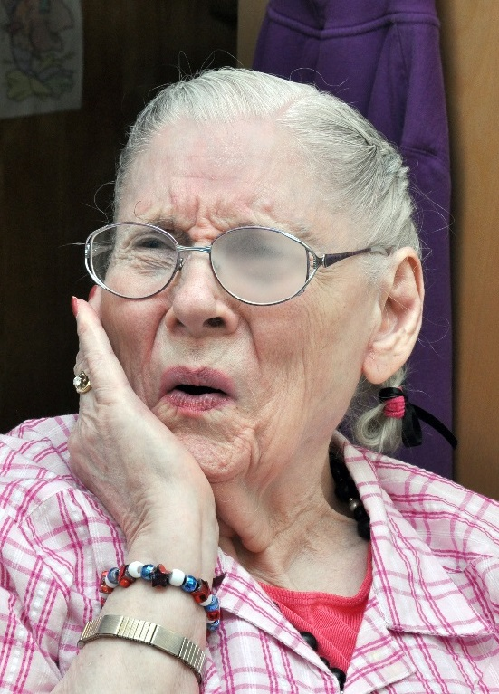
  Nutritional deficiencies
Dental causes leading to alteration in diet
  Loose or broken teeth (pain)
  Tooth loss
  Dentures
  Decreased saliva (xerostomia)

Slide 43

  Nutritional deficiencies
Elders may experience the following:
  Changed sensory perception of eating (texture and taste)
  Decreased masticatory efficiency
  Reduced intake of important nutrients
    Fruits, vegetables and fiber
    Vitamin C and beta-carotene
Notes:
This Photo by Unknown Author is licensed under CC BY-ND

Slide 44
Increasing
Oral Health Needs
Compromised by:
Reduction in dexterity
Chronic diseases / mental decline
Increased medication use
Nutritional deficiencies
Economically disadvantaged
Limited access to dental care

Slide 45
Economically disadvantaged
Dental insurance
  70% lack dental insurance
  Medicare does not cover dental treatment.
  Medicaid dental coverage varies by state.

Slide 46
Increasing
Oral Health Needs
Compromised by:
Reduction in dexterity
Chronic diseases / mental decline
Increased medication use
Nutritional deficiencies
Economically disadvantaged
Limited access to dental care

Slide 47
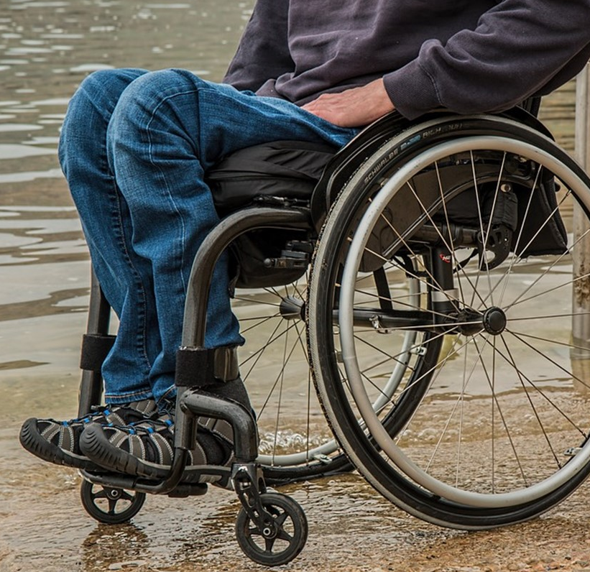
Limited access to dental care
Transportation
Disability
Residential long-term care
Lack of dental care guidelines
Few dentists trained
in geriatric dentistry

Slide 48

21st century dentistry continues to:
Expand access to dental care
Improve existing technology
Develop new technology (artificial intelligence)

Slide 49
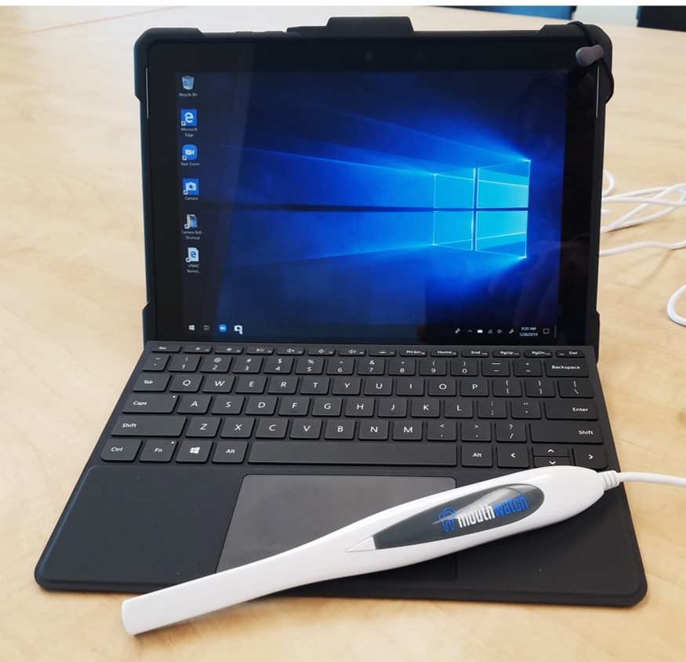
Teledentistry
Use of technology to facilitate delivery of oral healthcare and oral health education services from a provider in one location to a patient in a physically different location
Notes:
Use of technology including digital radiographs, digital photos and videos and electronic health records, to facilitate delivery of oral healthcare and oral health education services from a provider in one location to a patient in a physically different location.

Slide 50
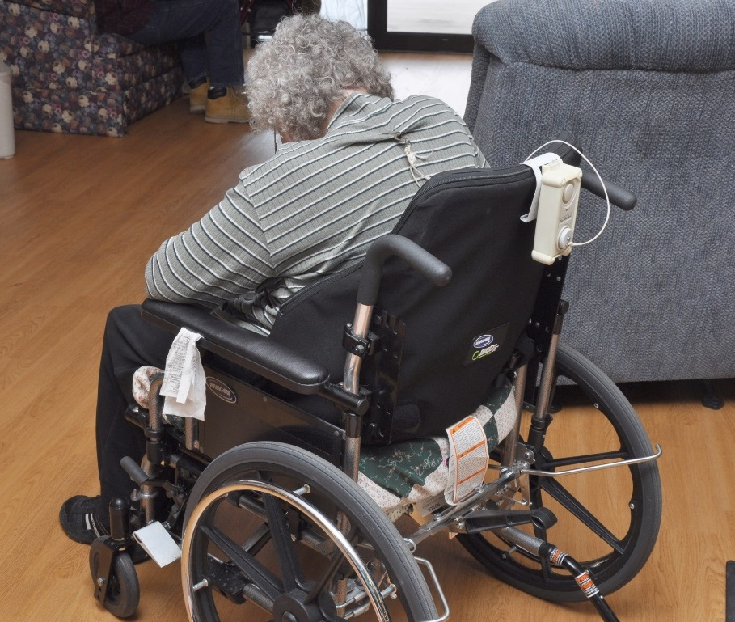
Development of teledentistry to address access to dental care if a person is:
Homebound
Has limited access to transportation
Lives in residential long-term care

Slide 51
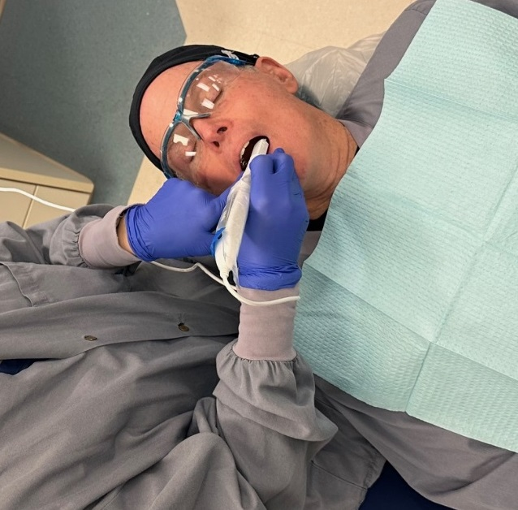
Teledentistry
May include digital radiographs, digital photos and videos and electronic health records

Slide 52
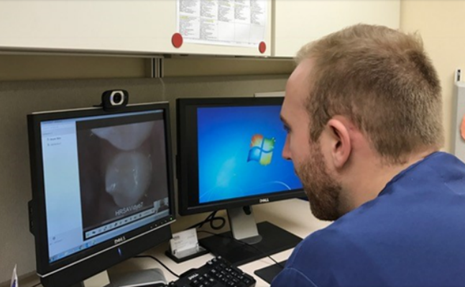
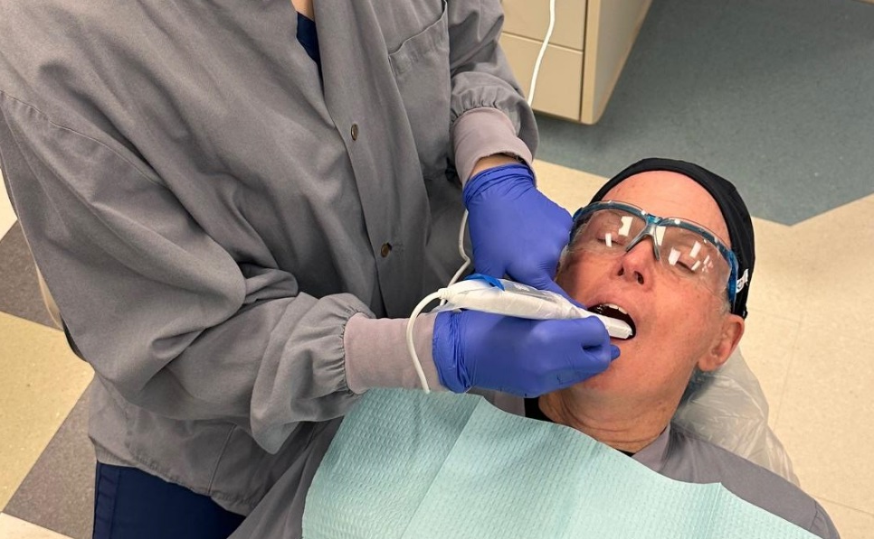
Teledentistry Consults
Synchronous – “real time” (live two-way interactions) for consultations and diagnosis
Asynchronous – (store and forward) where consultations are not real-time

Slide 53
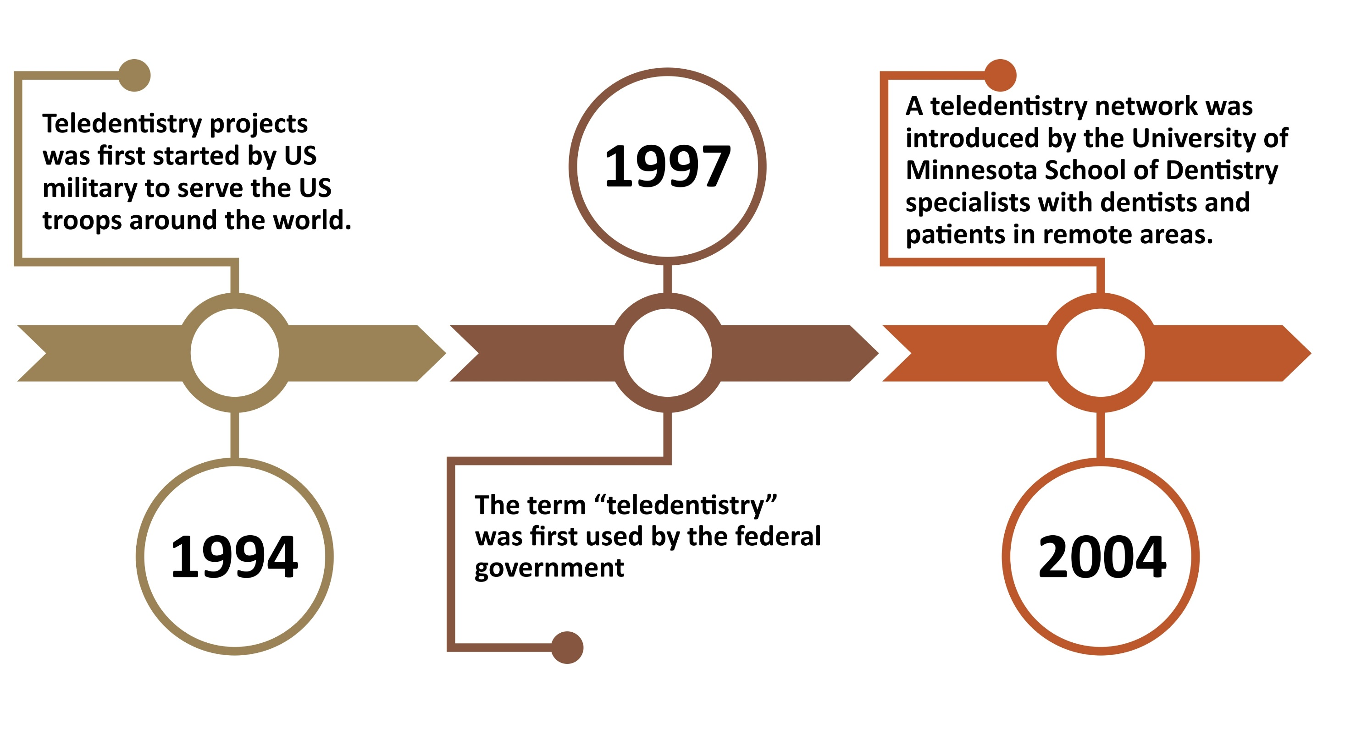

Slide 54
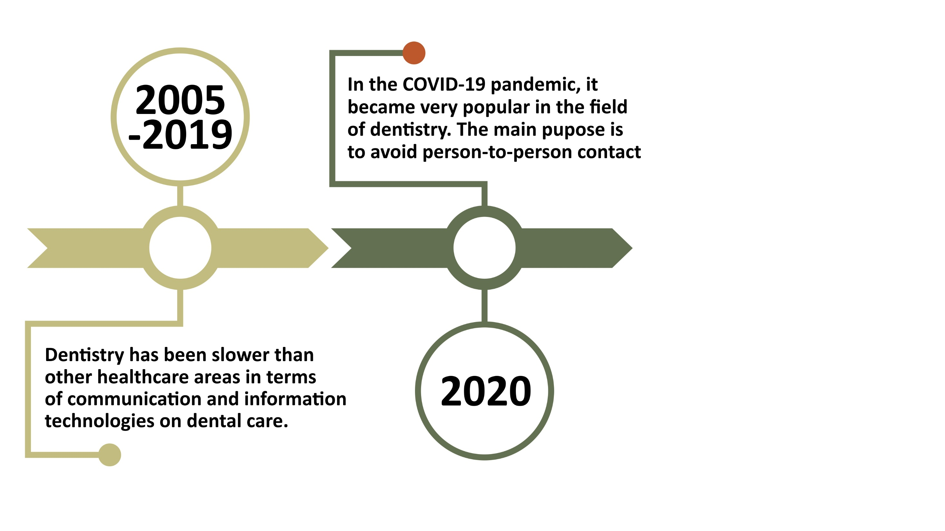

Slide 55
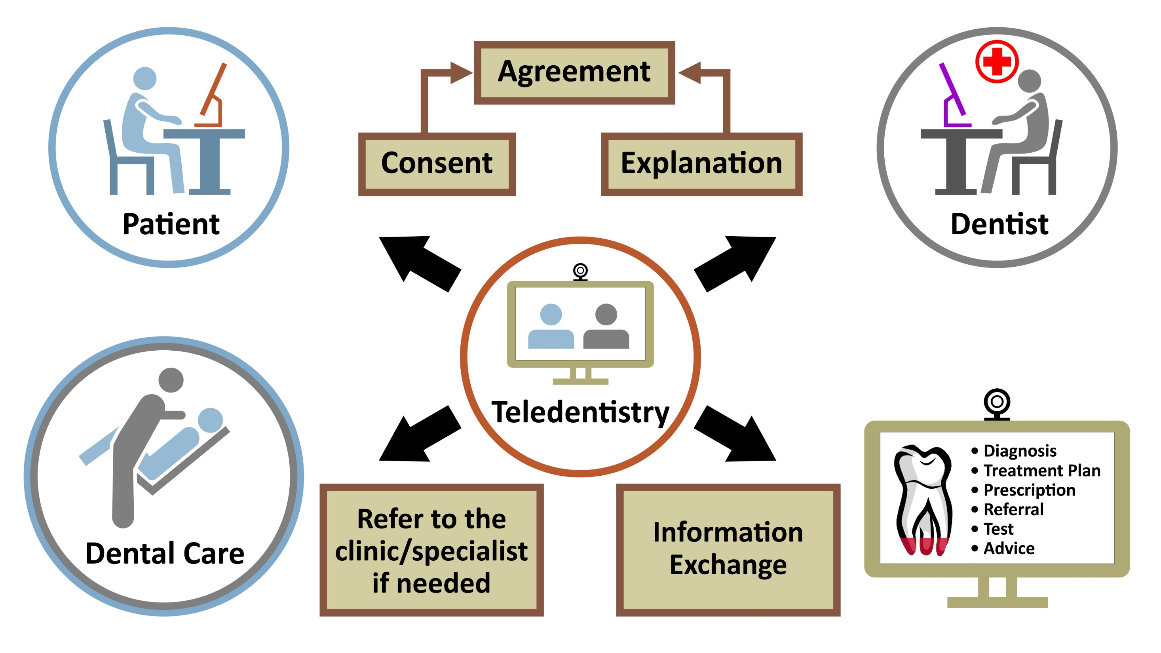
Notes:
I may need to clean up this one.

Slide 56
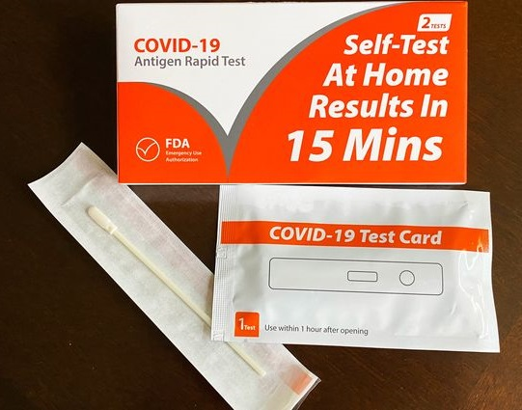
Having survived the COVID-19 Pandemic, lets look at some of the safeguards you may encounter in today’s dental office.
Image : news.llu.edu/health-wellness/what-know-about-home-covid-testing

Slide 57
Post-COVID-19
Pandemic Considerations
Covid-19 questionnaire
Air purifiers
PPE
Pre-procedural rinse

Slide 58
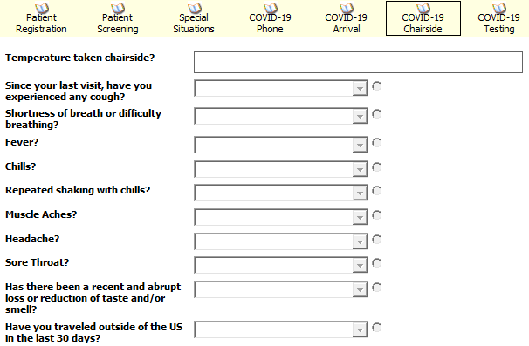
Assessment of COVID-19 Symptoms
Temperature taken at appointment

Slide 59
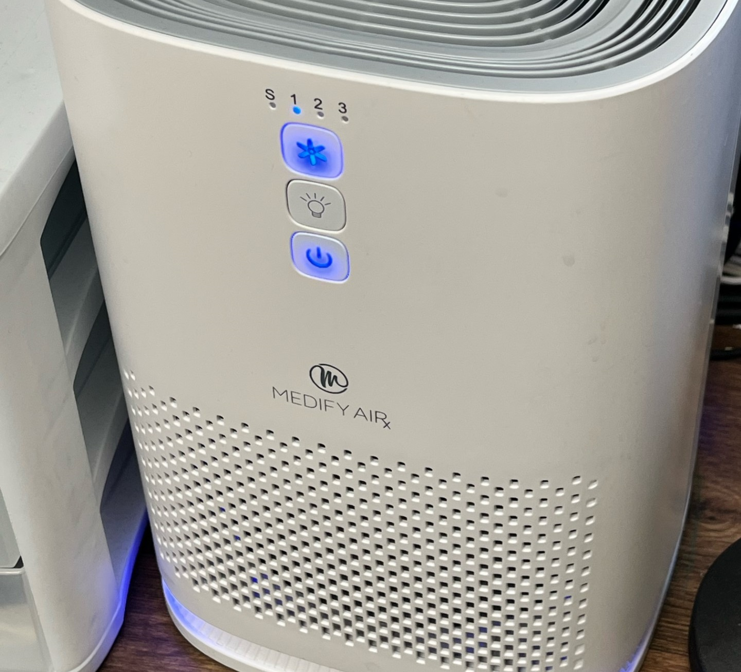
Air purifier/
Air handling Systems for Aerosols

Slide 60
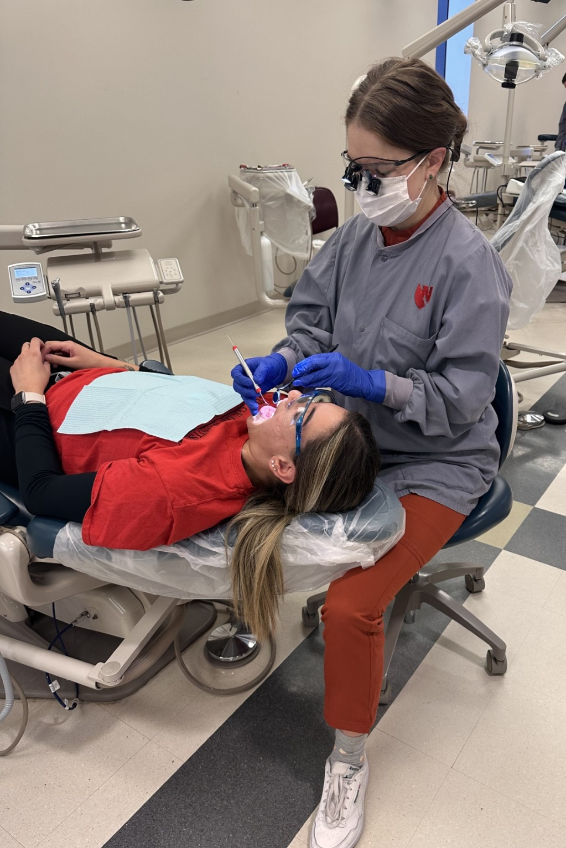
Proper Personal Protective Equipment (PPE)
Masks worn – either N95 or surgical
Lab coat
Gloves
Loupes or glasses
Hand scaling vs ultrasonic scaling – to reduce spread of aerosols

Slide 61
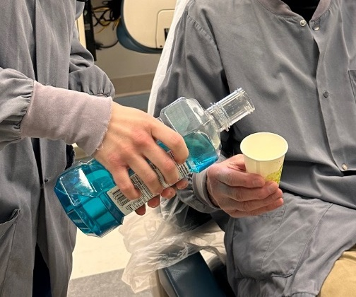
Pre-procedural rinse
To reduce bacteria exposed to aerosol

Slide 62
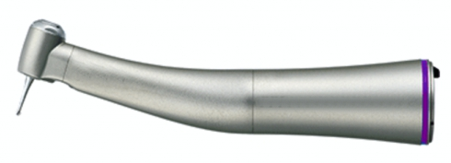
Electric Handpiece
To reduce bacteria exposed to aerosol

Slide 63
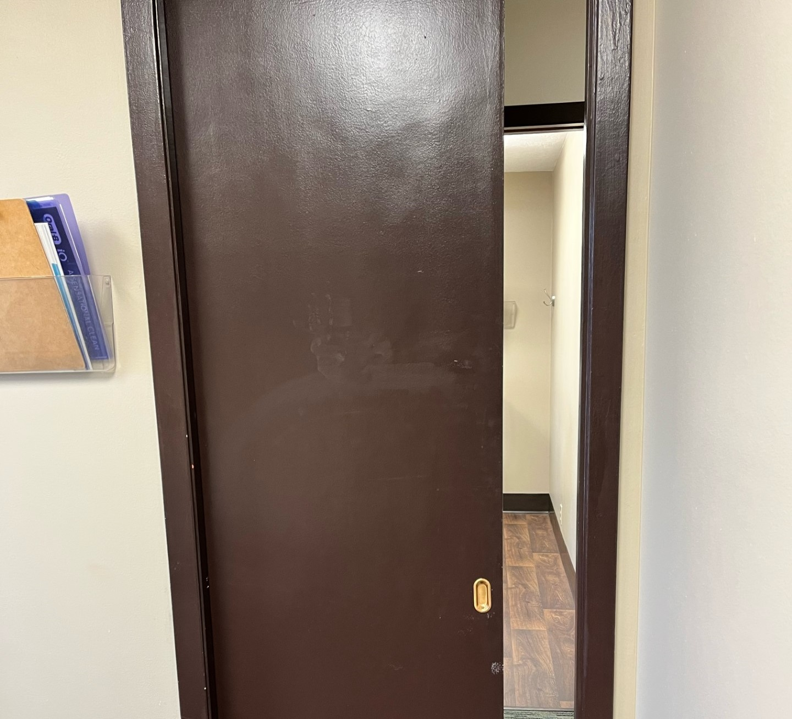
Closed Operatory to Limit Aerosol Spread

Slide 64
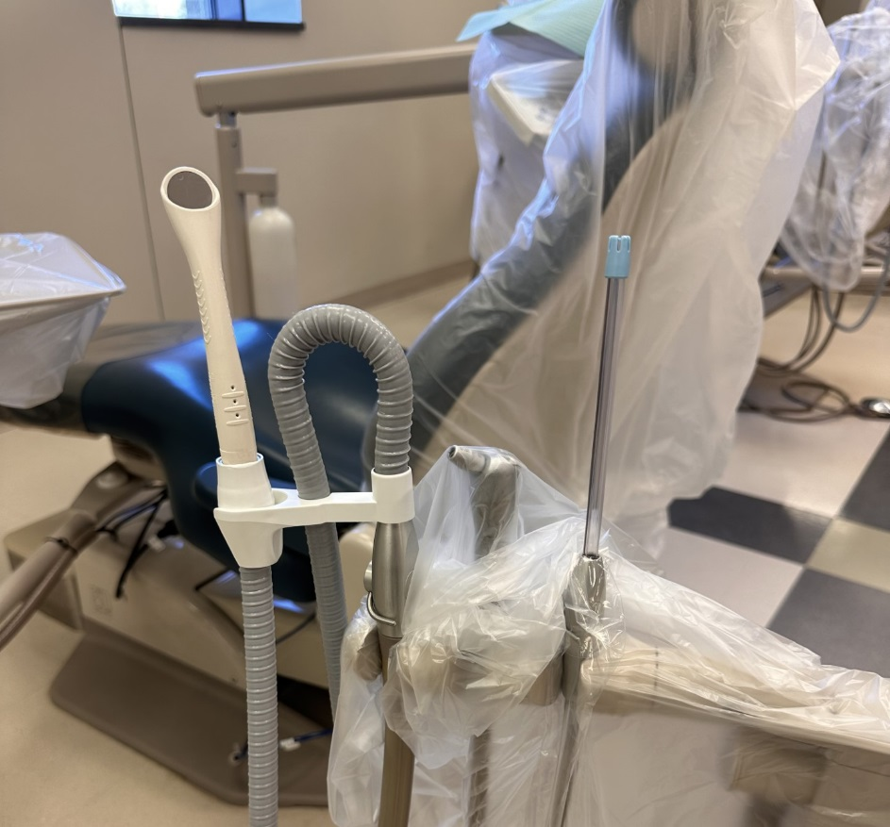


Utilizing high evacuation devices during dental procedures for aerosol reduction

Slide 65

Silver
Diamine Fluoride
and other Atraumatic Restorative Techniques to Manage Caries

Slide 66

Dental Caries
One of the most prevalent chronic diseases in the population
  1 in 5 people > 65 have untreated decay
  96% of people > 65 have had at least one cavity

Slide 67



Dental Caries
If left untreated, caries
can lead to
  Abscesses
  Infection
  Pain
  Other problems in the body

Slide 68

What is SDF?
Silver diamine fluoride
  Used for the remineralization and arresting of caries
  FDA cleared for use of managing dental hypersensitivity in 2015

Slide 69

What are the active ingredients?
24-28% silver
  Antimicrobial effects
5-5.9% fluoride
  Promotes remineralization
8% ammonia
  Stabilizing agent/solvent

Slide 70

Where is it used?
Nursing homes or long-term healthcare facilities
Other populations with minimal access to oral healthcare
Often in children
In dental offices

Slide 71

Methods of Application
Tooth cleaned and free of debris
Isolate tooth site with gauze or air
Apply SDF using a small brush
Let dry for 1-3 minutes
No eating or drinking restrictions

Slide 72

Benefits of SDF
Low cost
Easy application
Non-invasive treatment
Control of pain and infection

Slide 73


Considerations
Turns the tooth surface black permanently
Possible metallic taste
Could irritate the gums/surrounding tissues
Recommended application semi-annually for best results

Slide 74


Source:
Centerforevidence
basedpolicy.org
Notes:
http://centerforevidencebasedpolicy.org/wp-content/uploads/2018/06/SDF-Patient-Fact-Sheet-FINAL.pdf

Slide 75
Source:
Centerforevidence
basedpolicy.org
Notes:
http://centerforevidencebasedpolicy.org/wp-content/uploads/2018/06/SDF-Patient-Fact-Sheet-FINAL.pdf

Slide 76

The Toothbrush
Take-home Message
Still the first line of defense to prevent tooth decay, gum disease and aspiration pneumonia
Notes:
Started with sliver fillings or gold crowns, now tooth colored, same day crowns.
Recession - 'gums shrinking, root caries

Slide 77

Oral swabs (Toothettes)
Designed to moisten oral tissues only
Does not remove plaque or biofilm

Slide 78

Choose a toothbrush with soft bristles and a small head
You may find that a child’s toothbrush works best for some adults.

Slide 79

Adapt the toothbrush or try different types of toothbrushes

Slide 80



The Collis Curve Toothbrush
Three layers of bristles
All three sides of teeth brushed at one time
Notes:
A special toothbrush called the Collis Curve brush was especially designed to clean all 3 sides of the teeth at once. It is very helpful when trying to clean the teeth of a dependent patient who cannot clean her/his own teeth. It is easy to adapt to all areas of the mouth.

Slide 81


Take-home Message
Quality of life and chronic disease management of elders are improved with attention to their oral health.

Slide 82
Sources
Centers for Disease Control
American Dental Association
Wilkins Clinical Practice of Dental Hygiene.
Jones & Bartlett Learning, (2024)
Dimensions of Dental Hygiene, the Journal of Professional Excellence. Belmont Publications, Inc.

Slide 83
Sources
CDC Facts About Older Adult Oral Health, released May 5, 2021 -Periodontal disease statistics.
Journal of International Society of Preventive & Community Dentistry, Vol. 1 (2); Jul-Dec 2011.
NIH (.gov) Applications of Teledentistry: A literature review and update.
Generation of Smiles, digital magazine, Issue #6, May 2022.
Dr. Charles Rodgers, VP of Clinical Quality at Pacific Dental Services.
Notes:
Smilegeneration.com is the name of the website
Generations of Smiles is the name of the digital magazine

Slide 84
References
Smiles for Life: A national oral health curriculum
Course Steering Committee Author: A. Stevens Wrightson, MD
Dental Consultants: Pamela S. Stein, DMD, MPH; Robert G. Henry, DMD, MPH; Joanna M. Douglass, BDS, DDS
Smiles for Life Editor: Melinda Clark, MD
Reviewers: Kathy Kemle, MS, PA-C; Leslie-Faith Morritt Taub, ANP-C, GNP-BC, CDE, C BSM, DNSc

Slide 85
References
The Southern Association of Institutional Dentists. Preventive dentistry for person with severe disabilities: self study course, Module 11: 2001.
Jablonski, R, Therrien B, Mahoney E, Kolanowski A, Gabello M, Brock A. An intervention to reduce care resistant behavior in persons with dementia during oral hygiene: a pilot study. Spec Care Dentist, 21:77-87, 2011
Teepia Snow. Expert in dementia care who trains health care providers and families.
Saxe SS, Henry RG, Wekstein MW. Keeping the Older Person’s Mouth Healthy, A Caregiver’s Handbook. Dept of Oral Health Science, University of Kentucky College
of Dentistry, 1988.
Chalmers JM. Behavior management and communication strategies for dental profess-sionals when caring for residents with dementia. Spec Care Dentist 20:147-155, 2000.

Slide 86
Acknowledgements
For their assistance with this project, the authors of this program would like to thank:
  Joanna Aalboe, MPH, Registered Dental Hygienist, Assistant Professor, University of Kentucky
  College of Dentistry
  Ada Carlile, Registered Dental Hygienist
  Sandy Challman, Master of Instructional Technology, University of Kentucky College of Dentistry
  Kathryn Cunningham, MS Ed, Center for the Enhancement of Learning and Teaching,
  University of Kentucky
  Tom Dolan, Senior Medical Illustrator and Multimedia Developer, University of Kentucky
  Stephanie Harper, Social Services/Butterfly Program Coordinator
  Dr. Robert Henry, Chief of Dental Services, Veteran's Administration Hospital, Lexington Kentucky
  Esther Nealy, Certified Nursing Assistant
  Dr. Judith Skelton, PhD, Director of Outreach and Engagement, University of Kentucky College of Dentistry

Slide 87
Production Credits
Project Coordinator & Principal Investigator:
Darlene Carritt, RDH, BSDH
Project Contributors:
Noni Henderson, RDH, BSDH
Emily Lindquist, RDH, BSDH
Jaimee Shropshire, RDH, MHPTT
Erik White, MS, RDN, LMNT, Nebraska DHHS Program Coordinator Medicaid and Long Term Care
Dr. Charles F. Craft, Nebraska State Dental Director
Jessica O. Ball, Nebraska Oral Health Program Manager

Slide 88
Production Credits
Presentation & Design:
Kim R. Theesen
Photography:
Peggy Cain
Consultant:
Nagamani Narayana, DMD, MS

Slide 89





Additional Credits
This presentation produced in part with cooperation with the University of Nebraska Medical Center College of Dentistry, Nebraska Department of Health & Human Services, and the Nebraska Health Care Association.

