Slide 1


Why is My Mouth So Dry? How to Live
With Xerostomia
2024

Slide 2
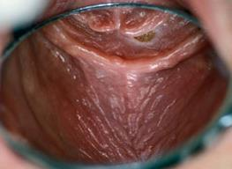
What is dry mouth?
Sensation of dry mouth due to decreased salivary flow
Xerostomia

Slide 3
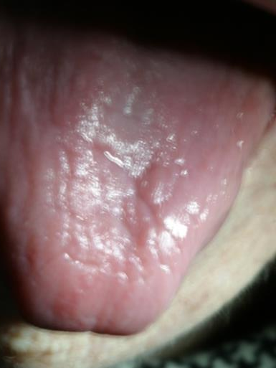
Xerostomia
Symptoms
Difficulty in swallowing and speaking
Altered taste perception
Oral discomfort, burning sensation
Poor denture retention (if worn)

Slide 4
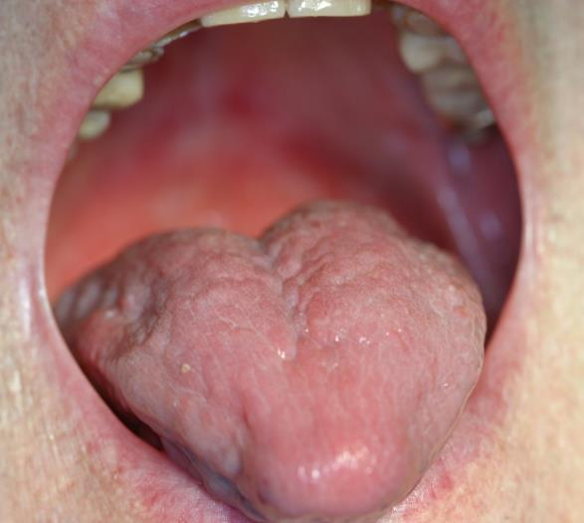
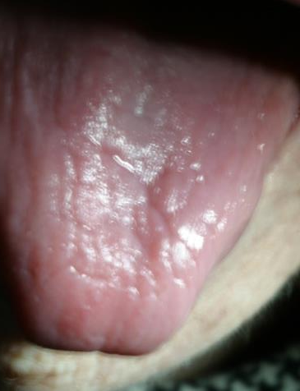
Xerostomia
Abnormal looking tongue
(slick looking, no taste buds)

Slide 5
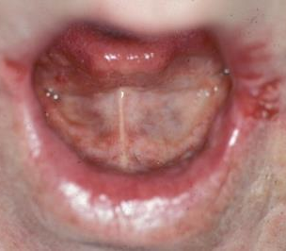
Xerostomia
Symptoms
Evidence of fungal infection or angular cheilitis (sores in the corners of the mouth)

Slide 6
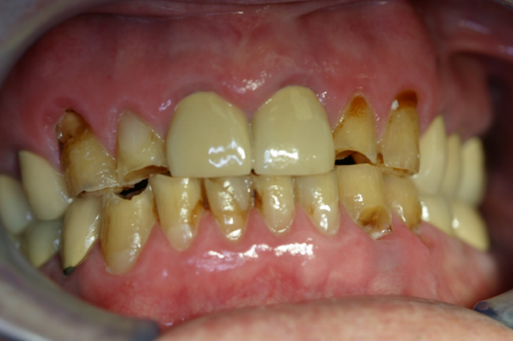
Xerostomia
Symptoms
Gumline tooth decay
Intra-oral soft tissue
changes

Slide 7
Common Causes of Dry Mouth
Medications
Aging
Tobacco and alcohol use
Nerve damage
Mouth breathing
Frequent caffeine ingestion
Cancer therapy
Other health conditions

Slide 8
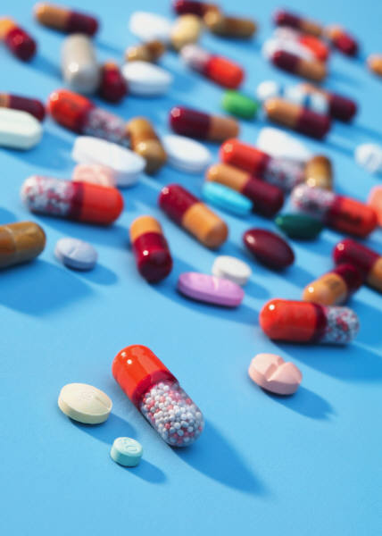
Medications
> 90% of persons 65
and older take prescription medication each week
57% take > 5 medications daily
12-20% take > 10 medications daily (polypharmacy)

Slide 9
Common Conditions
Requiring Medications
Hypertension
Stroke and blood clots
Diabetes
Chronic pain
Constipation
Arthritis
Seizures
Parkinson’s disease
Depression and psychological disorders
(e.g., dementia, OCD)

Slide 10
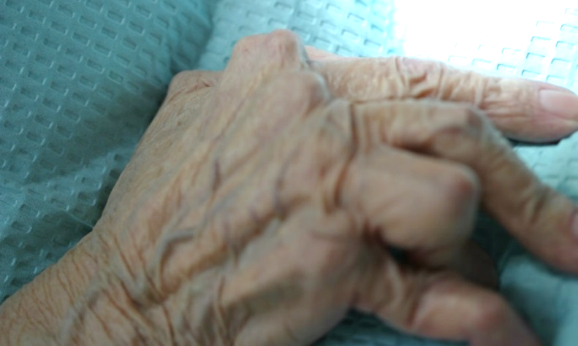
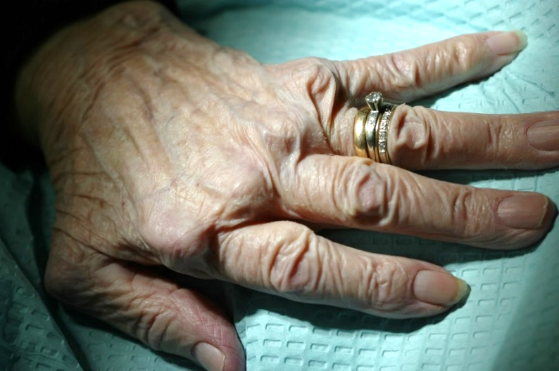
Conditions that may Require Medications
Arthritis
Reduce inflammation and combat autoimmune disease
Secondary problem
Difficulty with dexterity and manipulation of the toothbrush

Slide 11
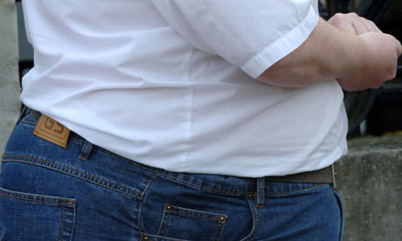
Conditions that may Require Medications
Obesity
Diabetes
Hypertension
Depression
Chronic pain

Slide 12
Why are medication side-effects more significant in the elderly?
Metabolism
  As we age the metabolism of chemicals is not as efficient.
  Drugs stay in the system for a longer period of time.

Slide 13
Why are medication side-effects more significant in the elderly?
Polypharmacological interactions
  Increase in number of medications prescribed
  Decrease in metabolism rate
  of drugs
  More reactions can cause
  issues as we age

Slide 14
Common Medications that Cause Dry Mouth
High blood pressure – Lisinopril/HCTZ, Amlodipine, Metoprolol
Diuretics – Lasix
Antibiotics – Amoxicillin, etc.
Antihistamines – Zyrtec, Benadryl, Allegra, Claritin, inhaler usage

Slide 15
Common Medications that Cause Dry Mouth
Cholesterol – “Statins”
Anti-depressants/anti-anxiety – Zoloft, Lexapro, Paxil, Cymbalta, Prozac, Celexa, Xanax, Valium
Anti-psychotics – Seroquel, Risperdal

Slide 16
Common Medications that Cause Dry Mouth
Anticholinergic – Benztropine, Albuterol
Anticonvulsants – Diazepam, Gabapentin, Lamotrigine
Narcotics – Opioids such as OxyContin, Vicodin, Codeine
Dementia/Alzheimer’s – Aricept, Exelon

Slide 17
Common Medications that Cause Dry Mouth
Parkinson’s – Levodopa, Carbidopa
Arthritics – Indocin, Celebrex, Relafen
Laxatives – Dulcolax, Senokot, Docusate

Slide 18

Other Common Oral
Side Effects from Medications
Taste alteration
Candidiasis
Gingival hyperplasia
Stomatitis
and mucositis
Lichenoid drug reaction
Dental erosion due to gastric reflux
Dental caries

Slide 19


Xerostomia Management
Avoid/Limit:
Irritants
  Alcohol
  Caffeine
  Tobacco
Sugar-containing drinks and candies

Slide 20
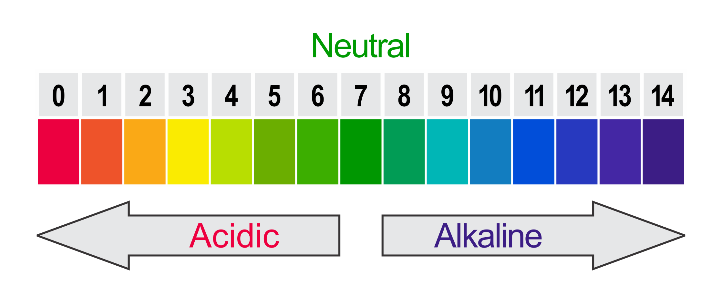
pH Balance

Slide 21
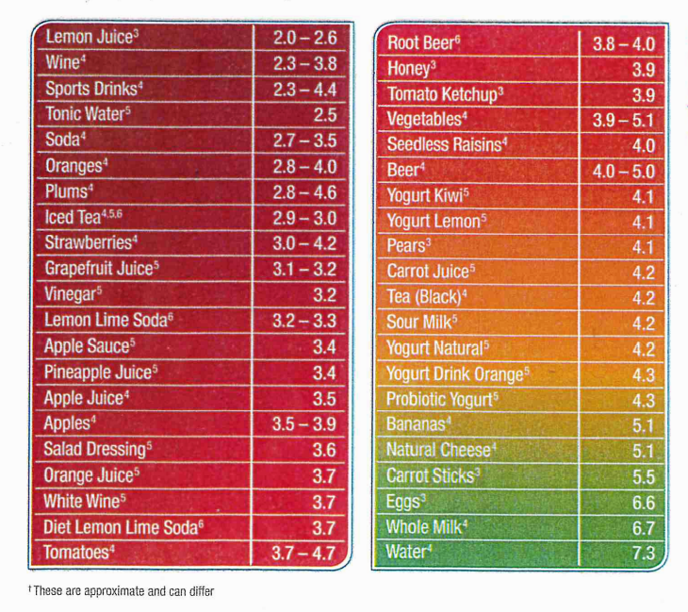
Acidity of Food and Drinks

Slide 22
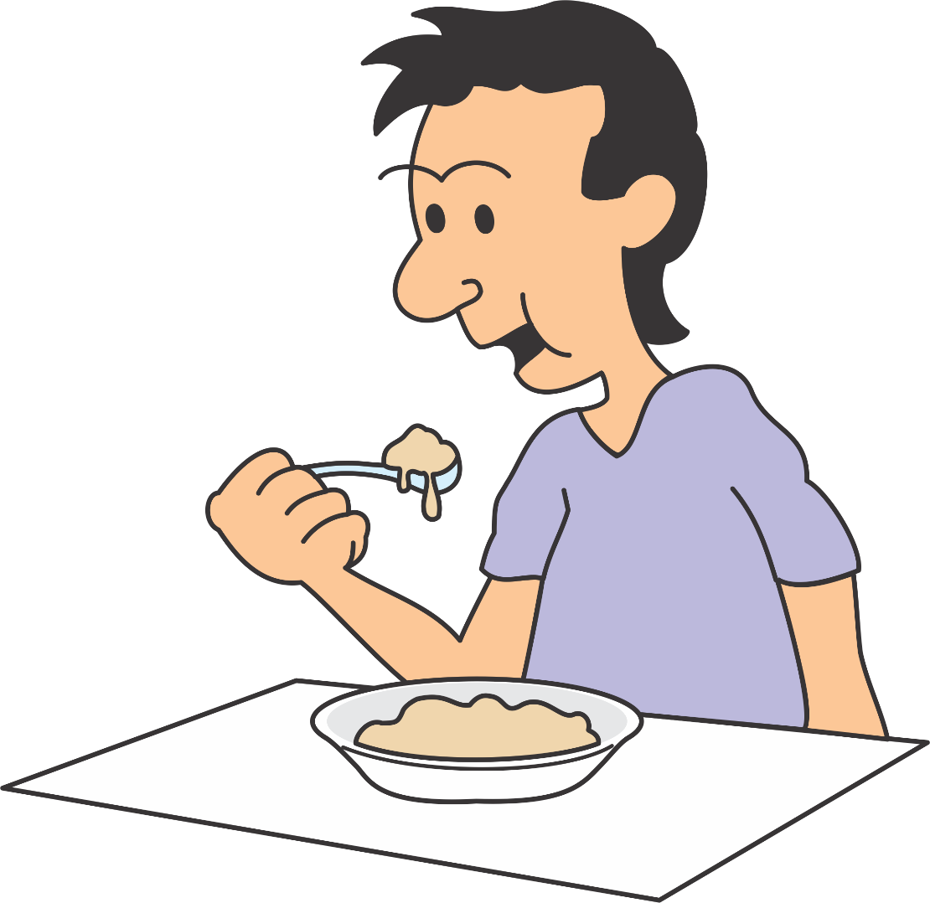
Saliva
Normal/healthy saliva
  Takes 20 minutes to neutralize food or drink
Compromised saliva
  Takes longer to neutralize food or drink

Slide 23
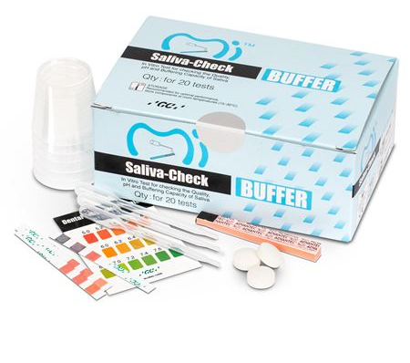
How can you test the pH of your saliva?
Ask your dentist
or hygienist
Test to measure the buffering (neutralizing) capacity of your saliva

Slide 24
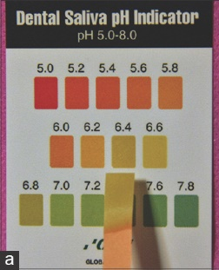
How can you test the pH of your saliva?
Neutral pH: 7.0
Acidic pH: below 7.0
Alkaline pH: above 7.0

Slide 25
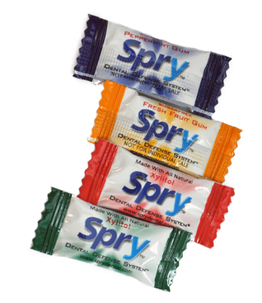
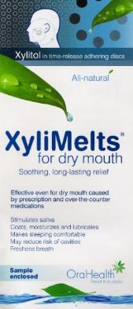
Xerostomia Management
Suggestions
  Sipping water frequently especially when eating
  Chew xylitol gums,
  mints and/or candies
  Use saliva substitutes
  Good oral hygiene

Slide 26
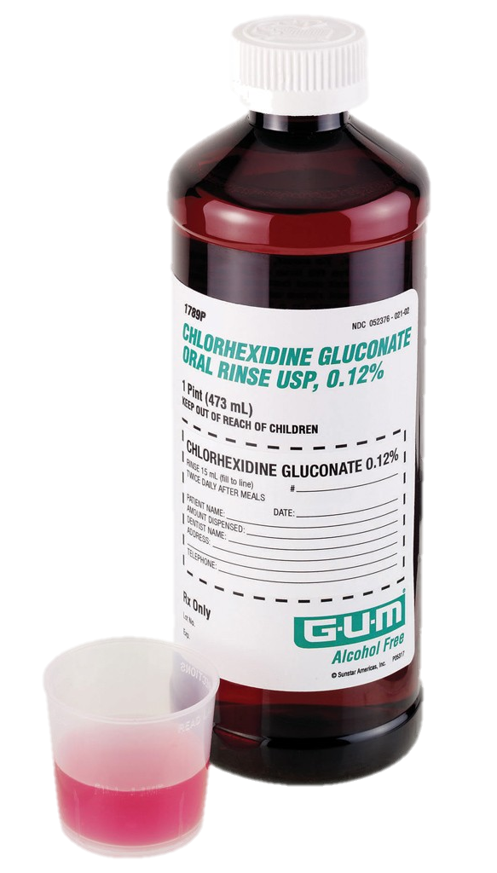
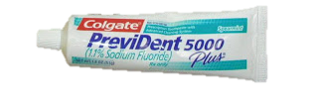
Xerostomia Management
Suggestions
  Topical fluoride, fluoride varnish or prescription fluoride toothpaste
  Alcohol-free chlorhexidine rinse
  two times daily
  Biotene products

Slide 27
Xerostomia Management
Suggestions
  Salivary stimulants (Pilocarpine)
  for severe cases
  Calcium phosphate products (MI Paste)

Slide 28
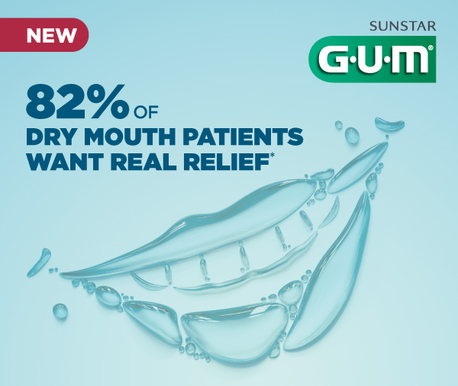
Xerostomia Management
Suggestions
  Several dry mouth products available online and OTC
  Consult with your dental professionals

Slide 29
Take-home Messages
Medications may have negative oral consequences, which should be monitored and minimized whenever possible.
Good oral preventive care is paramount to reducing the symptoms of medication side effects to maintain quality of life.

Slide 30
References
Smiles for Life: A National Oral Health Curriculum
Course Steering Committee Author: A. Stevens Wrightson, M.D.
Dental Consultants: Pamela S. Stein, D.M.D, M.P.H.; Robert G. Henry, D.M.D, M.P.H.; Joanna M. Douglass, B.D.S, D.D.S.
Smiles for Life Editor: Melinda Clark, M.D.
Reviewers: Kathy Kemle, MS, PA-C; Leslie-Faith Morritt Taub, ANP-C, GNP-BC, CDE, C. BSM, DNSc

Slide 31
Production Credits
Project Coordinator & Principal Investigator:
Darlene Carritt, RDH, BSDH
Project Contributors:
Noni Henderson, RDH, BSDH
Emily Lindquist, RDH, BSDH
Jaimee Shropshire, RDH, MHPTT
Erik White, MS, RDN, LMNT, Nebraska DHHS Program Coordinator Medicaid and Long Term Care
Dr. Charles F. Craft, Nebraska State Dental Director
Jessica O. Ball, Nebraska Oral Health Program Manager

Slide 32
Production Credits
Presentation & Design:
Kim R. Theesen
Photography:
Peggy Cain
Consultant:
Nagamani Narayana, DMD, MS

Slide 33



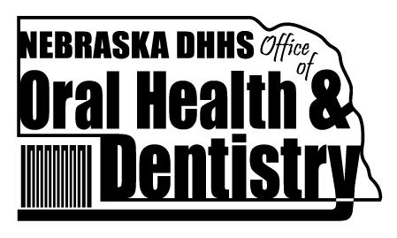

Additional Credits
This presentation produced in part with cooperation with the University of Nebraska Medical Center College of Dentistry, Nebraska Department of Health & Human Services, and the Nebraska Health Care Association.

